Slide 1

Use Case 1 Demonstrator - HITACHI
Results and Lessons Learnt
CertifAI Conference 11 June 2026 Prague
Bernhard SCHWANZER
Jean-Marie LAURANSON
HORIZON-CL3-2022-CS-01-04: INCREASED CYBERSECURITY 2022
Ref. Ares(2022)8966412 - 23/12/2022

Slide 2
Use Case 1 Demonstrator Results and Lessons Learnt
Part 1: UC1 Demonstrator Results
Evaluation methodology for the 2 scenarios UC1a and UC1b
Tools piloted and results for UC1a and UC1b
Part 2: Challenges, Findings, Knowledge Gains
Challenges and Applied Solutions
Findings and Knowledge Gains
Conclusion
Notes:
Risk assessment processes
must be learnt and understood,
must be aligned throughout solutions and solution components, PS1 uses ATT&CK ICS knowledge base for TRA and PS2 uses ISO 27005 threat catalogue for CRA and PS3 uses STRIDE for TRA
must be aligned with dynamic resources – evolving threat landscape: ATT&CK provides 2 releases per year – ENISA threat landscape refers to MITRE ATT&CK knowledge base
- Increasing known exploitable vulnerabilities –
- Increasing actively exploited vulnerabilities – MITRE ATT&CK refers to CISA KEV known exploited vulnerabilities catalogue

Slide 3
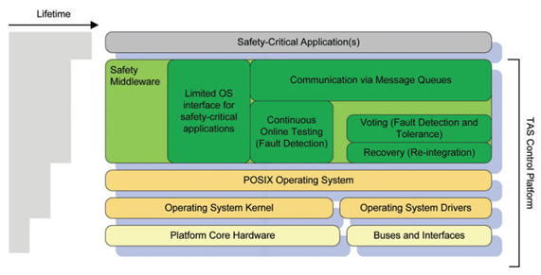
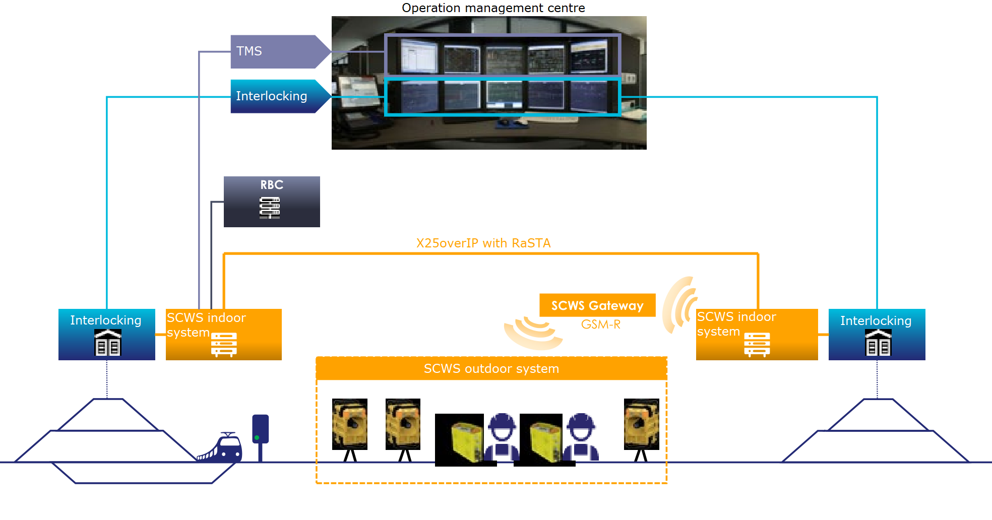
Use case 1a + 1b: Railway
UC1a TAS Platform Core:
Safety critical operating system
UC1b SCWS Indoor System:
Safety warning system which protects construction workers

Slide 4
Part 1: Tools Evaluation Method
Followed documentation and instructions from tool providers
Applying the method to Use Cases UC1a and UC1b:
  UC1a product with existing certification.
  UC1b new product applying for a certification.
Aligned with project KPIs:
  UC1.1: Reduce time and cost to re-certify TAS Platform by 50%, thereby freeing cybersecurity staff for more sophisticated (highly skilled) activities
  UC1.2: Increase threat coverage by 30% for threat identification as well as increase efficiency in vulnerability detection by 30% through continuous and automated monitoring of threats and CVEs.

Slide 5
Part 1: Tools Evaluation - UC1a scenario
UC1a Scenario and Context:
Managing threats and risks
Managing Security Assurance Case
(Managing vulnerabilities)
Notes:
  Existing structure is already in place, changing it is an extra effort
  E.g. STRIDE is used as an existing Threat Model and changing it to MITRE ATT&CK has to be justified and is not directly comparable.
  (Higher efforts in terms of number of threats to manage)
  Vulnerability management tool based on SBOMs is already in place
  Inserting and managing data in the tool is additional work.
Notes:
Important note: KPI for UC1 is the reduction of time and cost to re-certify TAS Platform by 50%
Time reduction might be possible if use case and assessor both use the tool so that the structure and methodology is clear.
Security topics with big effort (e.g. design, implementation, testing) is not covered by the framework and therefore does not affect time reduction.

Slide 6
Part 1: Tools Evaluation - UC1b scenario
UC1b Scenario and Context:
Managing threats and risks
Managing Security Assurance Case
(Managing vulnerabilities)
Notes:
  Threat Model: product switching to MITRE ATT&CK. Scenarios map to MITRE ATT&CK tactics to ease transition and facilitate understanding for the stakeholders.
  Vulnerability management tool is already in place.
  CertifAI framework: availability of evidence was a challenge due to different timelines between CertifAI and the product UC1b.
Notes:
Important note: KPI for UC1 is the reduction of time and cost to re-certify TAS Platform by 50%
Security topics with big effort (e.g. design, implementation, testing) is not covered by the framework and therefore does not affect time reduction.

Slide 7
Part 1: Tools Evaluation - UC1 scenario
Tested tools:
  CertifAI Framework (creation of SuC and SAC)
  Vimpact (upload of example SBOM)
  SAC Composer (implementation status of specific requirements based on UC1a user guide)
  Threat Spider (creation of Risk management project)
Evidence:
  CertifAI Framework SAC claims/sub-claims for selected requirements
  SAC Composer requirement conversations
  Threat Spider Risk assessment project

Slide 8
Part 2: Challenges (C) and Solutions (S)
C: Constraints related to UC1 environment for security reasons.
S: Reactive support from the tool providers and testing applied to non-corporate environment
C: Firewall whitelist makes testing cumbersome
S: Quick response for allowing IP addresses
C: Tools availability - Time constraints for testing
S: Testing time and depth adapted
C: Tools diversification was not clear
S: Testing focused on known tools
Notes:
We could not get the environment to work reliably in the corporate environment and had to revert to personal notebooks for testing.
Threat Spider, SAC Composer and the framework itself require connection to the internet.

Slide 9
Part 2: Findings and Knowledge gains
Threat Assessment Tool: Threat Spider
  Provides a detailed basis for threat consideration based on MITRE ATT&CK
  Likelihood and Risk estimation takes a lot of time
  Risk Assessment export/import to improve as appreciated to facilitate data management
  Scales and matrices are structured and clear
  Assessment of mitigations can also help trace back to threats.
CertifAI framework
  SuC created for IEC 62443-4-1 & 4-2 & CRA.
  SAC created for 4-2: Created with evidence claims and sub-claims
  SAC composer integration not working
  Well documented structured approach directly in the UI

Slide 10
Part 2: Findings and Knowledge gains
VIMPACT:
  Vulnerability Management tool is already in place so process improvement is limited
  Problem with enriching certain SBOM files.
SAC Composer:
  Information is based on configuration and security guidelines.
  After the first request it replies only the requirement text (for CRA).
  Correctly identifies the evidence for certain requirements (e.g. CR 2.11)
  In one case matched wrong requirement (CR 7.5 instead of EDR 3.12). Could be fixed by adding the requirement title to the request.
  Has to be done separately for each requirement.
  High potential for process improvement for new projects (less for existing ones)

Slide 11
Part 2: Conclusion
Tools benefits:
traceability aspects, integration and collaboration into a single interface adds value
Certification aspects:
very useful experience: expertise gained in Security Assurance domain (e.g. methodologies, improved the and evidence for standard fulfilement).
Contributes to better security assessment and therefore security efficiency
The detailed threat coverage was helpful to refine the risk assessment and improve the security posture of the product.

Slide 12
Thank You
For Your Attention

