Slide 1
SimVul & LOGA: Turning traces and logs into reviewable evidence
HORIZON-CL3-2022-CS-01-04: INCREASED CYBERSECURITY 2022
Ref. Ares(2022)8966412 - 23/12/2022
Notes:
Title slide copied from Fariz's CERTIFAI presentation template slide.
Subtitle used: Turning traces and logs into reviewable evidence.

Slide 2
Runtime data becomes reviewable evidence.
Two standalone tools. One shared idea.
SimVul
traces → behavior units
Running
system
Reviewable
evidence
LOGA
logs → message templates
Notes:
- Opening nuance: these are two standalone research tools, not a single integrated platform.
- SimVul/Prova: system traces to ExUs/OpUs. LOGA: text logs to message templates.
- Figure caption: Deck-created schematic: SimVul maps traces to behavior units; LOGA maps logs to message templates; both produce reviewable evidence.

Slide 3
SimVul uses traces for CVE review; LOGA uses log files.
third-party
trace recorder
recorded
system trace
SimVul
CVE review
Running
software
text log
files
LOGA
templates
Notes:
- SimVul does not record traces itself; third-party trace/audit software records first.
- D5.8 examples mention SPADE for audit/system-call provenance and ArangoDB for storage.
- LOGA starts from ordinary text log files; no trace recorder is involved.
- Figure caption: Deck-created schematic: SimVul uses third-party recorded system traces for CVE review; LOGA uses text log files to generate templates.

Slide 4
SimVul shows which resources a process used.
Example: a Node.js service reads status files and sends data to a database.
/proc/loadavg
reads
CPU load
reads
Node.js service
sends
/proc/uptime
database
running time
process
stored status
/proc/[pid]/stat
reads
process status
Notes:
- Example is invented, but the data model is SimVul-style: process node plus resource/artifact nodes.
- `/proc/loadavg` = CPU load; `/proc/uptime` = system uptime; `/proc/[pid]/stat` = process status.
- Edges mean observed process-resource interactions, not source-code calls.
- Figure caption: Deck-created schematic: Example SimVul process-resource graph for a Node.js service reading `/proc/loadavg`, `/proc/uptime`, `/proc/[pid]/stat` and sending status to a database.

Slide 5
SimVul turns resource use into ExUs.
One run becomes a bundle of resource lifetimes.
ExU A
status sync at 10:42
Node.js service
CPU load
running time
process status
database
Notes:
- ExU = one observed execution: a bundle of resource lifetimes.
- Resource lifetimes come from acquire/release events in the trace.
- This slide is a simplified schematic, not a tool screenshot.
- Figure caption: Deck-created schematic: One Execution Unit shown as resource lifetimes for process status sync at 10:42.

Slide 6
Similar ExUs use the same resources in the same order.
The time changes; the resource pattern stays the same.
CPU
load
running
time
process
status
database
ExU A
10:42
OpU
health-sync behavior
ExU B
10:47
same resources
same order
ExU C
10:52
Notes:
- D4.7/D5.8 definition: an OpU is a model that generalizes multiple ExUs.
- An OpU can be specialized or parameterized to produce one observed ExU.
- Similar ExUs may differ in timing, filenames, or repeated calls while preserving the pattern.
- Figure caption: Deck-created schematic: Three similar ExUs generalized into an OpU for health-sync behavior.

Slide 7
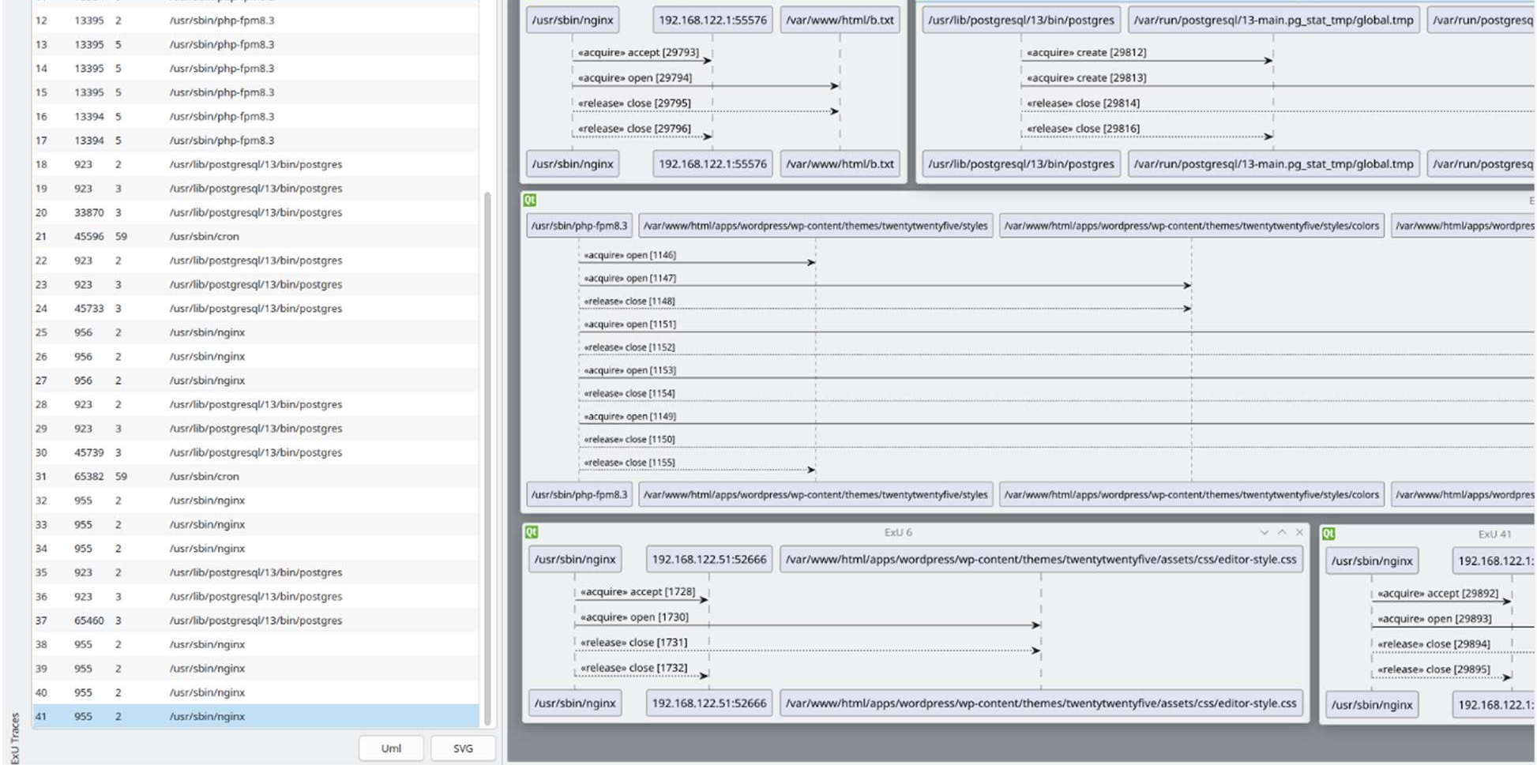
SimVul makes many ExUs inspectable.
Notes:
- Figure source: D4.7 Figure 4 / D5.8 Prova UI screenshot.
- Left sidebar lists ExUs with process and resource-lifetime counts; center shows sequence diagrams.
- Figure caption: Figure 4 User Interfaces for visualizing ExUs and facilitating the Vulnerability Detection Process.
- Same figure caption in D5.8: Figure 9 User Interfaces for visualizing ExUs and facilitating the Vulnerability Detection Process.

Slide 8
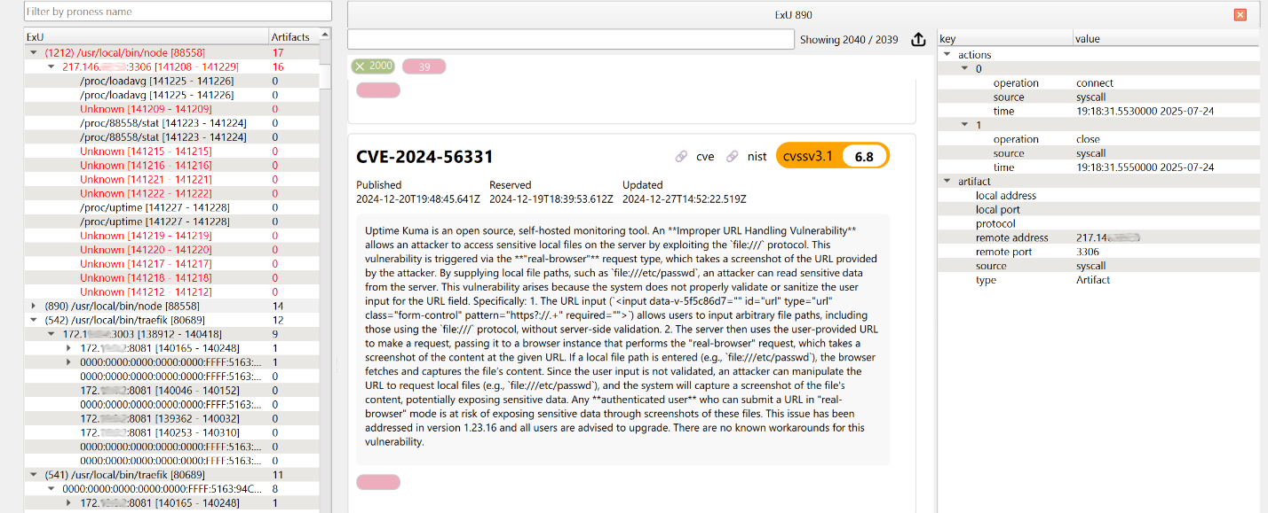
SimVul links behavior to CVE context.
Notes:
- Figure source: D6.8 use-case demonstrator material, Figure 28.
- Highlight is the CVSS v3.1 score area; example shown is CVE-2024-56331 for Uptime Kuma.
- Left panel is the process/resource tree; center is CVE/NIST context; right panel is selected action/resource attributes.
- Important wording: CVE context is evidence for review, not automatic proof of exploitability.
- Figure caption: Figure 28. NodeJS Application view in ProvaUI.

Slide 9
LOGA turns repeated log text into templates.
raw log lines
Failed password for
user
Failed password for alice
from 10.0.0.4 port 522
LOGA
from
ip
port
port
Failed password for root
from 10.0.0.7 port 981
Notes:
- LOGA assumes messages are constant text plus variable fields.
- The variables shown are examples of placeholders: user, IP, and port.
- LOGA does not need labelled templates or handcrafted parser rules.
- Figure caption: Deck-created schematic: Raw log lines are converted into a template with placeholders for user, IP and port.

Slide 10
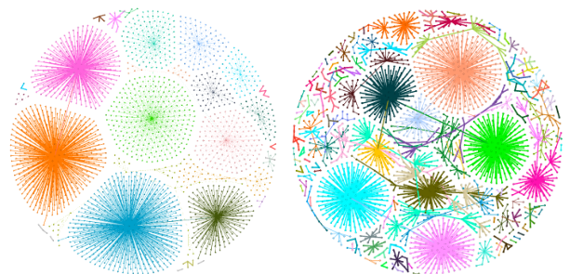
LOGA groups logs by message shape.
split lines
compare shape
cluster
align
template
Notes:
- Figure source: LOGA presentation, Structural Communities, 1NN graphs for Apache and OpenSSH.
- Method reminder: structural signatures, edit-distance comparison, then community detection such as Leiden/Louvain.
- After grouping, LOGA aligns messages inside a community to derive a template.
- Figure caption: Structural Communities. 1NN graph Apache. 1NN graph OpenSSH.

Slide 11
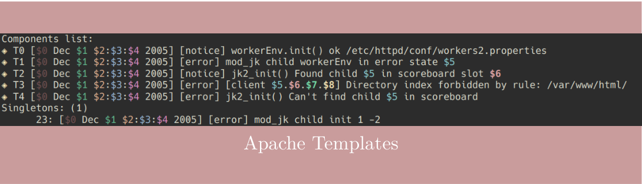
LOGA outputs templates with placeholders.
Notes:
- Figure source: LOGA presentation, Results: Apache Templates.
- The Apache example comes from repeated error-log messages with constants and variable fields.
- Placeholder segments contain no fixed tokens; they stand for the changing parts of the messages.
- Figure caption: Results. Apache Templates.

Slide 12
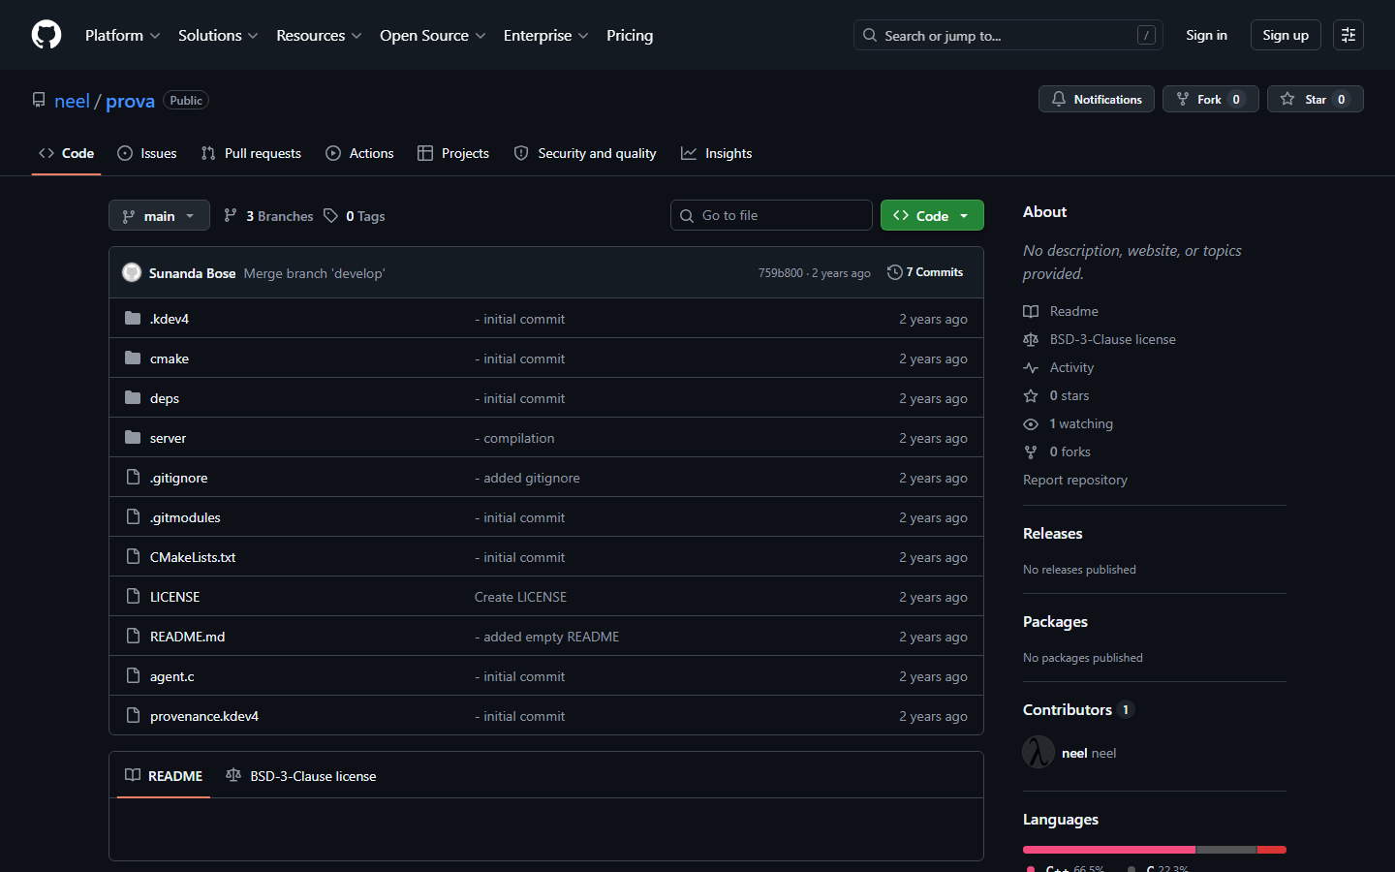
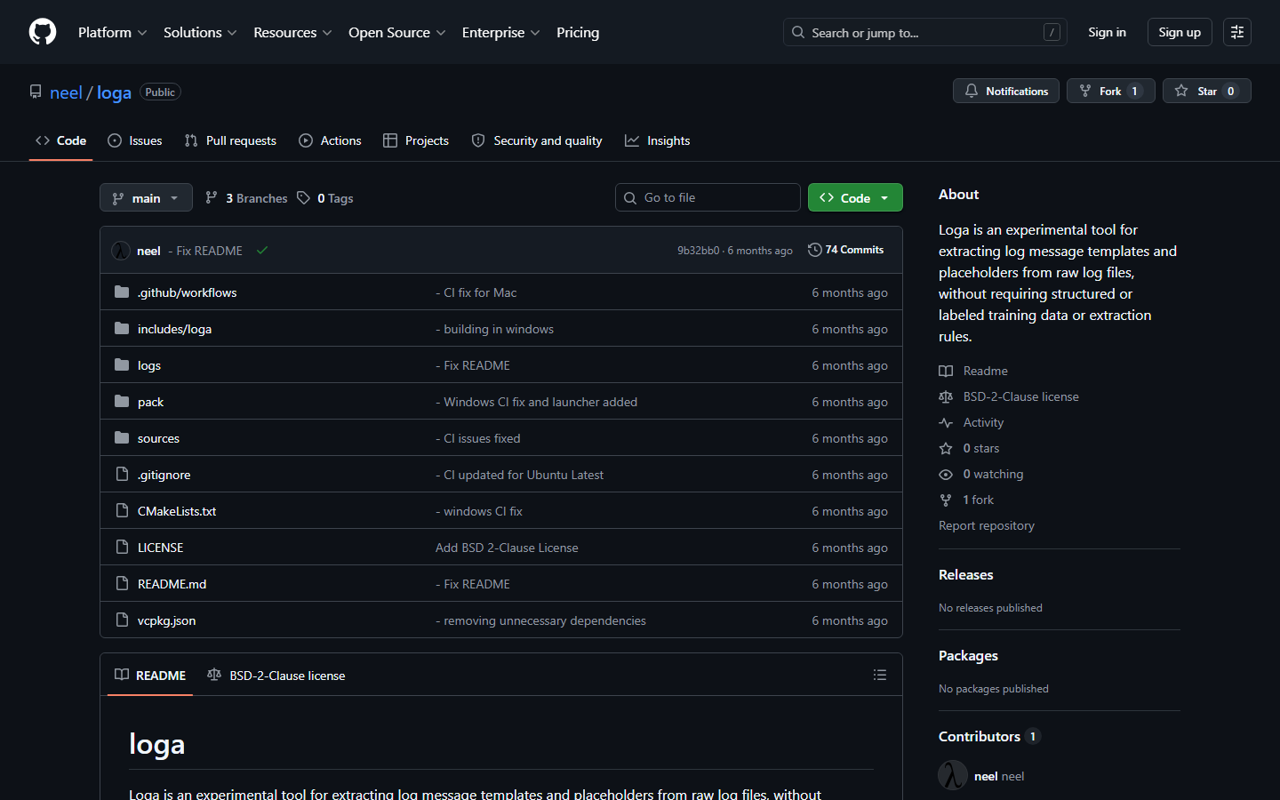


SimVul and LOGA are released open-source tools.
Prova / SimVul
LOGA
github.com/neel/prova
github.com/neel/loga
Notes:
- GitHub screenshots show separate online repositories.
- Prova/SimVul license: BSD 3-Clause, copyright 2024 Sunanda Bose.
- LOGA license: BSD 2-Clause, copyright 2025 Sunanda Bose.
- BSD is permissive: use, modify, redistribute, including commercially; keep notices. BSD-3 adds no-endorsement.
- Figure caption: Deck-created screenshots: Prova / SimVul and LOGA GitHub repositories with BSD-3-Clause and BSD-2-Clause license labels.

Slide 13
The project produced reviewable runtime evidence.
SimVul
traces → ExUs / OpUs
raw
observations
evidence
for review
LOGA
logs → templates
Notes:
- Closing boundary: do not imply that the tools are merged or deployed as one workflow.
- D5.8 describes LOGA as complementary to SimVul: application-log templates complement system-call ExUs.
- Keep the ending as project outcome, not future work.
- Figure caption: Deck-created schematic: Raw observations are processed by SimVul and LOGA into evidence for review.

