Slide 1
Copilot for Evaluation and Analysis of Security Assurance Cases
HORIZON-CL3-2022-CS-01-04: INCREASED CYBERSECURITY 2022
Ref. Ares(2022)8966412 - 23/12/2022
Notes:
"Thank you. As we just saw from the fantastic demonstrations of the SAC Composer,
we now have the capability to automatically generate complex Security Assurance Cases at scale."
"But in highly regulated industries, generation is only half the battle.
A 'black-box' AI pass/fail is useless if you get audited.
How do we trust what the AI just built? How do we verify it efficiently?"
"For my part today, representing Work Packages 2 and 3, I am going to focus entirely on the 'Check' phase of our pipeline.
I'll introduce our automated evaluation tools, acting as a 'Copilot' for human auditors,
and show how we have practically integrated them into the CertifAI framework to make AI-generated compliance auditable and trustworthy."

Slide 2
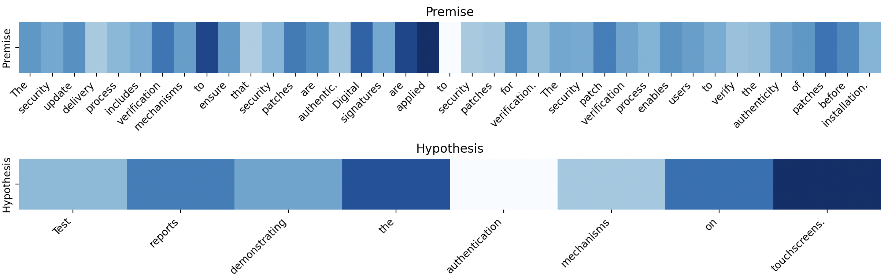
EXCLAIM: Explainable Compliance Detection
EXCLAIM: EXplainable CompLiance detection with Argumentative Inference of Multi-hop reasoning
SAC Composer
Structured Argument using Semantics Modeling of requirements to evidence trace 🔍
of logic validity
compliance e.g.: subclaim to argument
Non-compliance e.g.: evidence to argument
Notes:
Our first analytical engine focuses on the text and semantics. We call it EXCLAIM.
Instead of just asking an AI 'is this compliant?', EXCLAIM uses NLP-based text representation and multi-hop Natural Language Inference (NLI) to actually trace the logic.
It walks down the steps from a high-level system claim, to the argument, all the way to the ground-truth evidence.
It highlights exactly which tokens and logical links support the decision.
For your compliance teams, this means drastically cutting down manual verification time because the AI provides the exact, traceable proof for its conclusions.

Slide 3
EXCLAIM: Explainable Compliance Detection
Smart Data Selection – Secure, On-Premises Deployment
SAC Composer
Protecting Proprietary IP and handling negative transfer between regulation with different assumptions
compliance e.g.: subclaim to argument
Non-compliance e.g.: evidence to argument
Notes:
"But having a great evaluation tool like EXCLAIM brings up a massive industry challenge: Data Privacy."
"To do this complex semantic reasoning, you normally need massive, cloud-based frontier LLMs. But you cannot send your highly sensitive, proprietary system designs to a public cloud to check for IEC 62443 compliance."
"This is where our Smart Data Selection comes in. By carefully selecting and weighting the target data—extracting just the top 10% of highly relevant source data—we can train much smaller, specialized models. These smaller models actually outperform frontier LLMs in this specific domain, allowing you to run these complex EXCLAIM evaluations securely, 100% on-premises."

Slide 4
EXCLAIM: Explainable Compliance Detection
AssureGraph: Structural Integrity & QA
SAC Composer
Structured Argument as Graph Representation for analysing structure and argument integrity 🔍
Notes:
"While EXCLAIM looks at the text, our second method looks at the structure. This is AssureGraph."
"Assurance cases are fundamentally graphs. When you use LLMs to generate these cases, t
hey often hallucinate structural links that read well but are logically broken—like circular arguments or claims missing evidence."
"AssureGraph uses Graph Neural Networks to act as an automated QA layer.
It evaluates the structural integrity of the case and flags provenance or bias issues instantly, catching structural flaws before they ever reach a human reviewer's desk."

Slide 5
From Innovation to Deployment – The exclaim-scorer API
Key Development: Tools Integration
SAC Composer 🛡️
Assurance Case JSON Payload
exclaim-scorer 🔍 : Docker 🐳 and FastAPI
CertifAI Dashboard
Annotated Assurance Case JSON
Visualized traceability and explainability scoring
Notes:
"So, the science is state of the arts and robust. How do we actually use it in an real world such as use case partners?"
"We’ve packaged these methodologies into a self-service, containerized microservice called the exclaim-scorer, running via a REST API."
"In the CertifAI framework, the SAC Composer generates a complex Claim-Argument-Evidence JSON payload. I
t sends this to our scorer, which runs the heavy NLI and Graph inference, and sends structured scores back to the dashboard."
"From an engineering perspective, serializing and parsing massive JSON assurance graphs without causing severe latency is a major challenge,
and we are currently stress-testing this pipeline to ensure it holds up under real-world concurrent workloads."

Slide 6
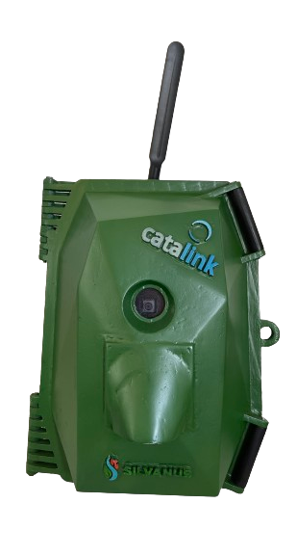
Demo – Practical Walkthrough & Use-Case Assessment
Interactive Dashboard
Use Case Validation: PATROLIoT on CRA
Turning automated explainability scores into actionable insights for human review
Notes:
In practice, the user interacts with a living dashboard. If our Copilot flags an argument as 'Uncertain' or structurally weak,
it highlights the exact node where the evidence breaks down. It doesn't just say 'fail'; it shows where and why.
(Point to the text/right image)
But as engineers, we know our ultimate metric of success isn't just an automated math score. It's utility.
We are currently rolling out an assessment framework where human industry experts manually review these automated outputs.
We are asking them the critical questions: Does the AI's hesitation align with a human auditor's hesitation? Do these multi-hop explanations actually save your teams time?
This human-in-the-loop validation is the final step to ensuring that our tools don't just work in an innovation,
but actually, meet the rigorous demands of real-world industry compliance."
Interactive Dashboard: The exclaim-scorer feeds directly into the CertifAI UI, visually highlighting exactly where evidence breaks down or structural logic fails.
Human-in-the-Loop Validation: We are partnering with industry experts to manually review these automated flags.
Real-World Calibration: We ask domain experts: Does the AI's hesitation match yours? Does this traceable proof save you time? This ensures our metrics align with actual audit standards.

Slide 7
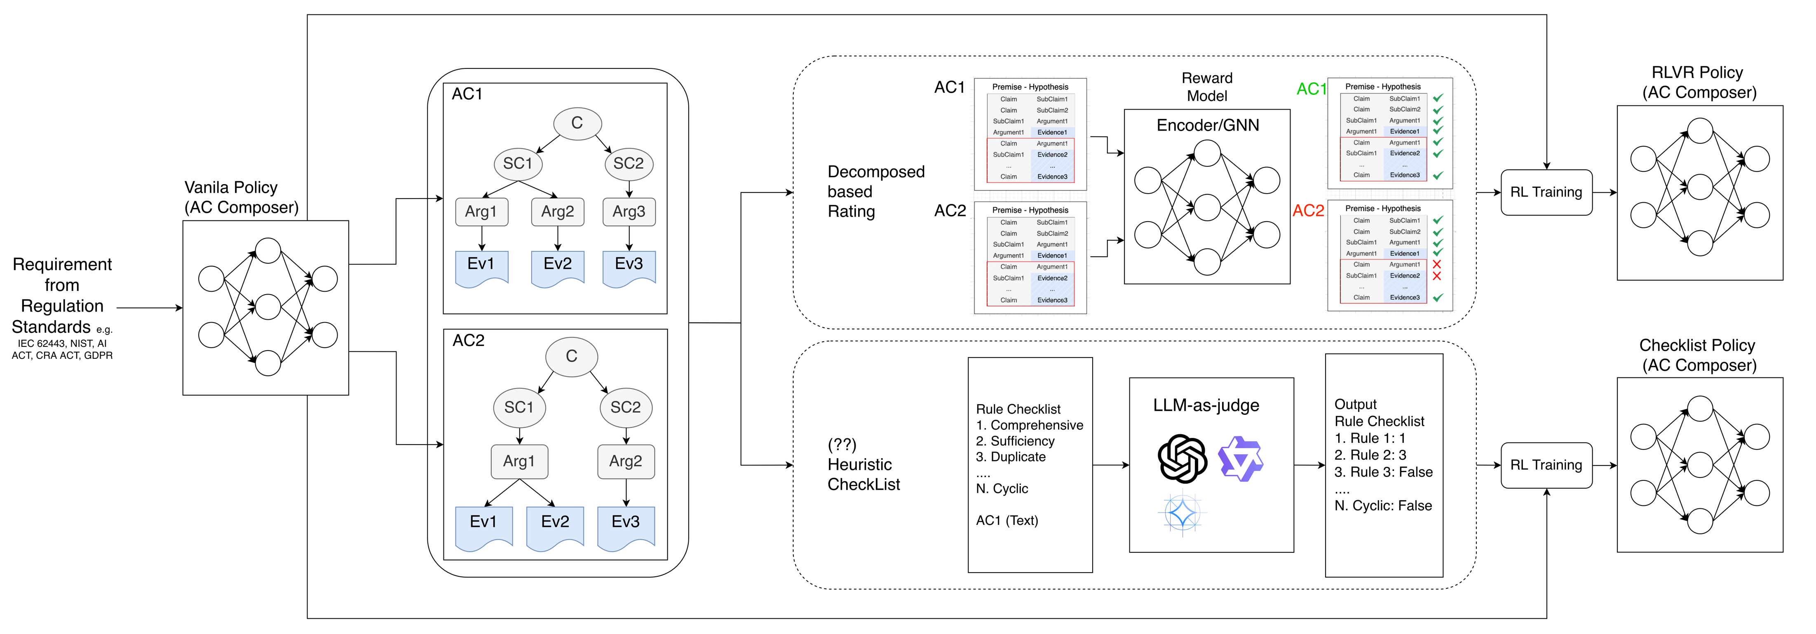
Closing the Loop – Continuous SAC Improvement via AI Feedback (EXCLAIM)
Short-term objective: On-premise Tuning Small Language Model for SAC

Slide 8
T2.2
Detection of noncompliance with requirements
Contexts
Complexity and variability of Standards & Requirements to meet
Comprehension Effort of Standards & Requirements
Scalability & Efficiency of processing large amount of document and assessment from Standards & Requirements
Integration with Existing Processes
Objective (OB1.1)
Make the process more effective and efficient to comprehend and to determine the compliance requirements derived from standards

Slide 9
Key Development: Linking and Noncompliance Detection
Natural Language Inference (NLI)
Premise (Requirement: GDPR, IEC 62443) | Hypothesis (Evidence: Data Processing Agreement, Test Results ) | Label
The processor shall assist the controller in consulting the supervisory authorities prior to processing where the processing would result in a high risk in the absence of measures taken by the controller to mitigate the risk. (Art. 28(3)(f), Art. 36) | At controller’s request and at the controller’s reasonable expense on a time and materials basis, processor shall reasonably support controller in (i) dealing with complaints, requests or orders described in Section 9.2 or (ii) fulfilling any of controller’s further obligations as Controller under Applicable Data Protection Law. | Entailment
Pairs of input text classification
  Natural text instead of first-order-logic or structured representation
  Logic: P → Q ? TRUE or FALSE
Labels: Entailment, Contradiction, Neutral
Automating process to comprehend and to determine the compliance requirements derived from standards
Notes:
Entailment label indicate compliance and contradiction or neutral indicate possible non-compliance

Slide 10
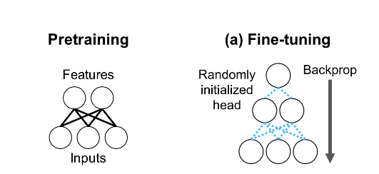
Key Development: Linking and Noncompliance Detection
Transfer Learning
Enables models trained on a general task to be fine-tuned for a specific, related task.
Adapting pre-trained NLI models from generic domain to compliance-related data
Improve their ability to recognize entailment and contradiction in technical and legal texts while addressing domain-specific challenges.

Slide 11
Key Results: Preliminary Experiments
Experiments Summary
Requirements analysis task
  The task is a linking between requirements description and the type of requirements
  Objective is to demonstrate the capability of transfer learning against simple baseline of general domain NLI models in technical domain.
Compliance detection task in privacy policy domain (data processing agreement against GDPR requirements)
  Objective is to demonstrate the benefits of performance improvement in transfer learning model in the only publicly available human annotated data in compliance detection task.
  Compared 3 different transfer learning, Fine-tuning (FT), Linear-Probing Fine-tuning (LP-FT) and Low Rank Adaptation (LoRA). We also want to compared the NLI approach to a related work [1]
[1] Azeem, M.I., Abualhaija, S. A Multi-solution Study on GDPR AI-enabled Completeness Checking of DPAs. Empir Software Eng 29, 96 (2024). https://doi.org/10.1007/s10664-024-10491-3

Slide 12
Interdependencies
Interactions with other WPs / expectations & needs​​
WP3/T3.1
Compliance Output WP2/T2.2
WP3/T3.2
WP6/T6.2

Slide 13

KPI and Planned Impacts
Before
(OB1) Reduce the time and effort of (re-)certification and (re-) assurance using AI
(OB1.1) Time and effort for understanding standards and detecting non-compliance between requirements and evidence are reduced by 25%
After

Slide 14
Summary
Key Potential Impacts
Adaptability: Transfer Learning and Natural Language Inference allows generalized formulation so it can adapt to evolving regulations and leverage knowledge from one regulatory framework (e.g., IEC) and apply it to another (NIST)
Robustness: Reduce false positive by distinguish between direct and indirect violations, identifying gaps where a regulation or standard is not fully addressed rather than just checking for keyword matches.
Scalability: large scale document analysis becomes more feasible thus reducing the manual workload.
Notes:
Compliance Detection Benchmark: Currently there are no gold standards i.e., experts verified labelled data. Evaluating the compliance detection on IEC 62443 based on SAC validated by experts is important to measure the objective of the methods.
Integration to the CertifAI Framework (T6.2): Testing the system to use case work package by delivering the implementation as on-premises installation either as library or self-deployed container.
Extend the capability of Compliance Detection Module: Extract the relevance evidence automatically.
Optimize the Model Adaptability on Evolving Standards: Explore the possibility of editing knowledge in AI model directly instead of re-training approach which more time consuming and costly.

Slide 15
Next Steps
What remains to be done?
Compliance Detection Benchmark from cybersecurity requirements (e.g. IEC 62443, NIST) with Human annotated/verified dataset
Next Deliverables
Integration to the CertifAI Framework (T6.2)
Extend the capability of Compliance Detection Module
Optimize the Model Adaptability on Evolving Standards
Notes:
Compliance Detection Benchmark: Currently there are no gold standards i.e., experts verified labelled data. Evaluating the compliance detection on IEC 62443 based on SAC validated by experts is important to measure the objective of the methods.
Integration to the CertifAI Framework (T6.2): Testing the system to use case work package by delivering the implementation as on-premises installation either as library or self-deployed container.
Extend the capability of Compliance Detection Module: Extract the relevance evidence automatically.
Optimize the Model Adaptability on Evolving Standards: Explore the possibility of editing knowledge in AI model directly instead of re-training approach which more time consuming and costly.

Slide 16
Class | RoBERTA-finetuned (Fazelnia et. al., 2024) | zero-shot baseline (DeBERTA-based-mnli) | zero-shot swap (DeBERTA-based-mnli)
Overall F1 | 83 | 79 | 77
Functional | 71 | 78 | 76
Availability | 78 | 89 | 86
Fault Tolerance | 85 | 78 | 60
Legal | 89 | 79 | 71
Look & Feel | 80 | 73 | 66
Maintainability | 85 | 75 | 78
Operability | 86 | 76 | 73
Performance | 91 | 83 | 81
Scalability | 82 | 83 | 86
Security | 86 | 83 | 82
Usability | 88 | 77 | 72
Key Results: Preliminary Experiments
Requirements analysis task
Mapping the label description as hypothesis and requirements as premise (Fazelnia, et al. 2024)

Slide 17
Dataset Statistics
GDPR Dataset Statistics
Azeem, M.I., Abualhaija, S. A Multi-solution Study on GDPR AI-enabled Completeness Checking of DPAs. Empir Software Eng 29, 96 (2024). https://doi.org/10.1007/s10664-024-10491-3
Statistics | Train | Test
Total Rows | 362317 | 154
Unique ID | 61 | 8
Unique premise | 45 | 16
Unique hypothesis | 9820 | 151
Unique class | 45 | 16
Unique target | 45 | 16

Slide 18
T3.2 Explainable AI for (re-)certification process management
Explainable non-compliance result from local interpretability of predictive ML-based tools (T2.2) and global explanation based on the SAC (T3.1).
HORIZON-CL3-2022-CS-01-04: INCREASED CYBERSECURITY 2022
Ref. Ares(2022)8966412 - 23/12/2022

Slide 19
T3.2
Explainable AI for (re-)certification process management
Contexts
Transparency of the compliance detection process: Non-compliance detection needs to explain the root causes of noncompliance
Build the understanding of which evidence have been invalidated and why
Objective (OB2.2)
Provide explainable traceability between standards requirements to all relevant certification evidences
Notes:
Standards (and potentially requirements documents) are large and complex documents that are difficult to manage so functionalities based on AI can help in reducing the comprehension effort as well as automating the detection of non-compliance.

Slide 20
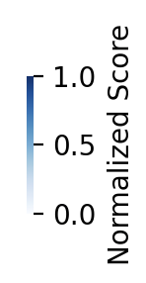
Interdependencies
Interactions with other WPs / expectations & needs​​
WP3/T3.1
Compliance Output WP2/T2.2
Global Explanation
Local Explanation
WP6/T6.2
Notes:
Security assurance case presentation

Slide 21
Key Development: Local Explanation of NLI Models Prediction
Post-Hoc Interpretation
An Importance score to each input that determine which features had the most significant impact on the model's prediction.
Why a model made a specific prediction for a given input
Understanding the model's behavior and ensures transparency in its decision-making process

Slide 22
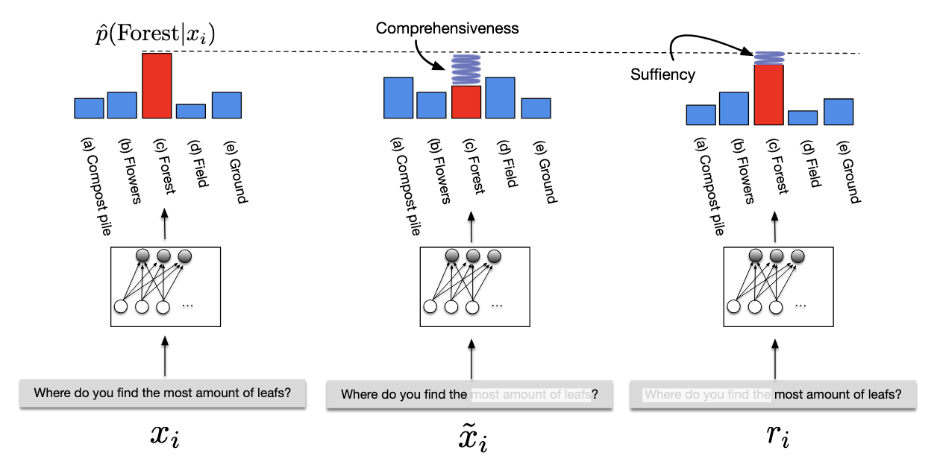
Key Results: Preliminary Experiments
Experiments Summary on Local Explanations
Evaluating Explanations
Plausibility: assessing how convincing the model’s explanations to human belief or knowledge
Faithfulness: assessing how accurately the model's explanations reflect the model actual reasoning process used to make its predictions
  Comprehensiveness
  Sufficiency
Illustration of Faithfulness metrics [2]
[1] ERASER: A Benchmark to Evaluate Rationalized NLP Models (DeYoung et al., ACL 2020)

Slide 23
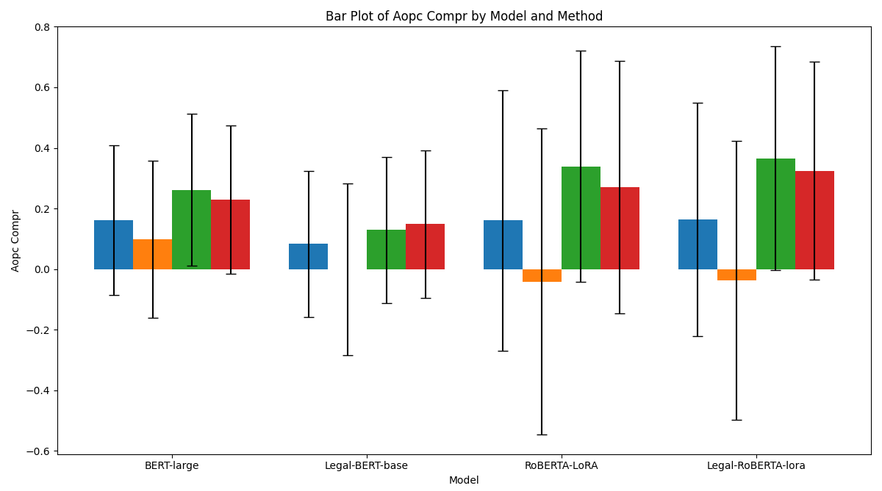

Key Results: Preliminary Experiments
Experiments Results on Local Explanations
Evaluating Explanations
  4 models (T2.2)
  4 Interpretation Methods
  Overall, LIME method extract more faithful local explanation, followed by Partition SHAP
Notes:
give the example of output of explanation on how it is compute

Slide 24
Key Development: Global Explanation of NLI Models Prediction
Deductive Reasoning of (Non)-Compliance Detection with SAC
Multi-Hop Premise Chaining
Hierarchical Context Integration
Generate Multi-Hop Pairs
compliance e.g.: subclaim to argument
Non-compliance e.g.: evidence to argument
Notes:
Multi-Hop Premise Chaining:
Instead of considering only direct parent-child relationships, multi-hop reasoning captures transitive inference chains.
If a claim is supported by multiple arguments, each argument becomes an intermediate reasoning step, linking different levels of the assurance tree.
Hierarchical Context Integration:
AI models incorporate hierarchical knowledge by aggregating multiple layers of evidence.
This structure allows for deeper logical inference rather than relying on shallow, single-step premises and hypothesis pairs.
Generating Multi-Hop NLI Pairs:
We construct extended premise-hypothesis pairs where a hypothesis is inferred from indirect connected of sub-claim to evidence or main claim to argument subclaim.
Example can be seen on Figure 5.
The model must infer the hypothesis based on both premises rather than direct entailment from a single source.

Slide 25
Key Results: Experiments with Security Assurance Case (T3.1)
Experiments Summary
From Claim-argument-evidence (CAE) trees, where each claim is supported by one or more premises forming a hierarchical argumentation structure.
Inference Variants for Comparison:
  Model with chain (Explicit Premises):
    Input Format: [Premise] + [Implicit Premises] → Hypothesis
  Model without (wo) chain (Indirect Premise)
    Input Format: [Premise] → Hypothesis
Evaluation Metrics:
  F1-score
  Hop-Specific Performance
Notes:
Baseline Approaches
Dataset Construction:
We use CAE trees, where each claim is supported by one or more premises forming a hierarchical argumentation structure.
For each target inference (hypothesis), the necessary premises (1-hop, 2-hop, or 3-hop) are extracted.
Implicit premises, which are often required for complete reasoning, are explicitly appended in one variant of the model and omitted in another.
Inference Variants for Comparison:
Model with chain (Explicit Premises):
The model is fed the full chain of reasoning, where implicit premises are appended step-by-step to the original premise to reconstruct the full reasoning path.
Input Format: [Premise] + [Implicit Premises] → Hypothesis
Model without (wo) chain (Indirect Premise):
The model is given only the direct premise and hypothesis, requiring it to infer missing steps implicitly.
Input Format: [Premise] → Hypothesis
Evaluation Metrics:
Accuracy: Standard NLI classification accuracy (Entailment, Neutral, Contradiction).
Hop-Specific Performance: Evaluating model accuracy across 1-hop, 2-hop, and 3-hop inferences separately to measure how performance degrades with increased inference complexity.

Slide 26
Key Results: Experiments with Security Assurance Case (T3.1)
Experiments Results
Deductive Reasoning: Inference Variants for Comparison
Notes:
The sample is from the security assurance case

Slide 27
KPI and Planned Impacts
Blackbox AI
(OB2) Improve assurance evidence correlation for cost-effective re-certification
(OB2.2) Transparency of (re-)certification process is increased by 25% in terms of artifacts understanding
Explainable AI
Why?

Slide 28
Next Steps
What remains to be done/can be improve?
Improve Deductive Reasoning by advanced model such as Graph Modelling.
Next Deliverables
Formalize the endpoint output representation of T3.2 and Integration into CertifAI framework (T6.2).
  Compliance Metrics.
  Summarizing Findings of Deductive Reasoning Output.

Slide 29
Summary
Key Potential Impacts
Increased Trust and Transparency:
  Post-hoc explanations allow users to understand why a model flagged a case as (non-)compliant, increasing trust.
  Multi-hop inference makes reasoning more explicit by linking intermediate steps between claims, arguments, and evidence.
Integration with Existing Methods
  Assurance cases use Claim-Argument-Evidence (CAE) structures had been used by auditor, which naturally align with multi-hop Inference.
Enhanced Automation of Assurance Case Validation: Multi-hop Inference can reduce or scale the certification task in:
  Verifying logical consistency within an assurance case,
  Checking if supporting evidence truly justifies claims and
  Detecting missing or weak justifications in regulatory compliance reports.

Slide 30
Thank You
For Your Attention

Slide 31
Work-in Progress
Graph Representation Learning for Assurance Case
Link Prediction (Pre-training task)
  Training: learning the linkage of nodes (claim → argument, argument → evidence) of available assurance case
  Inference: Predicting or Verifying the linkage of nodes of LLMs generated assurance case
Node Classification (auxiliary task)
  Predicting the label of claim vs argument vs evidence
Graph Classification:
  Compliance vs Non-compliance,
  Human vs LLM assurance case
Notes:
Multi-Hop Premise Chaining:
Instead of considering only direct parent-child relationships, multi-hop reasoning captures transitive inference chains.
If a claim is supported by multiple arguments, each argument becomes an intermediate reasoning step, linking different levels of the assurance tree.
Hierarchical Context Integration:
AI models incorporate hierarchical knowledge by aggregating multiple layers of evidence.
This structure allows for deeper logical inference rather than relying on shallow, single-step premises and hypothesis pairs.
Generating Multi-Hop NLI Pairs:
We construct extended premise-hypothesis pairs where a hypothesis is inferred from indirect connected of sub-claim to evidence or main claim to argument subclaim.
Example can be seen on Figure 5.
The model must infer the hypothesis based on both premises rather than direct entailment from a single source.

Slide 32
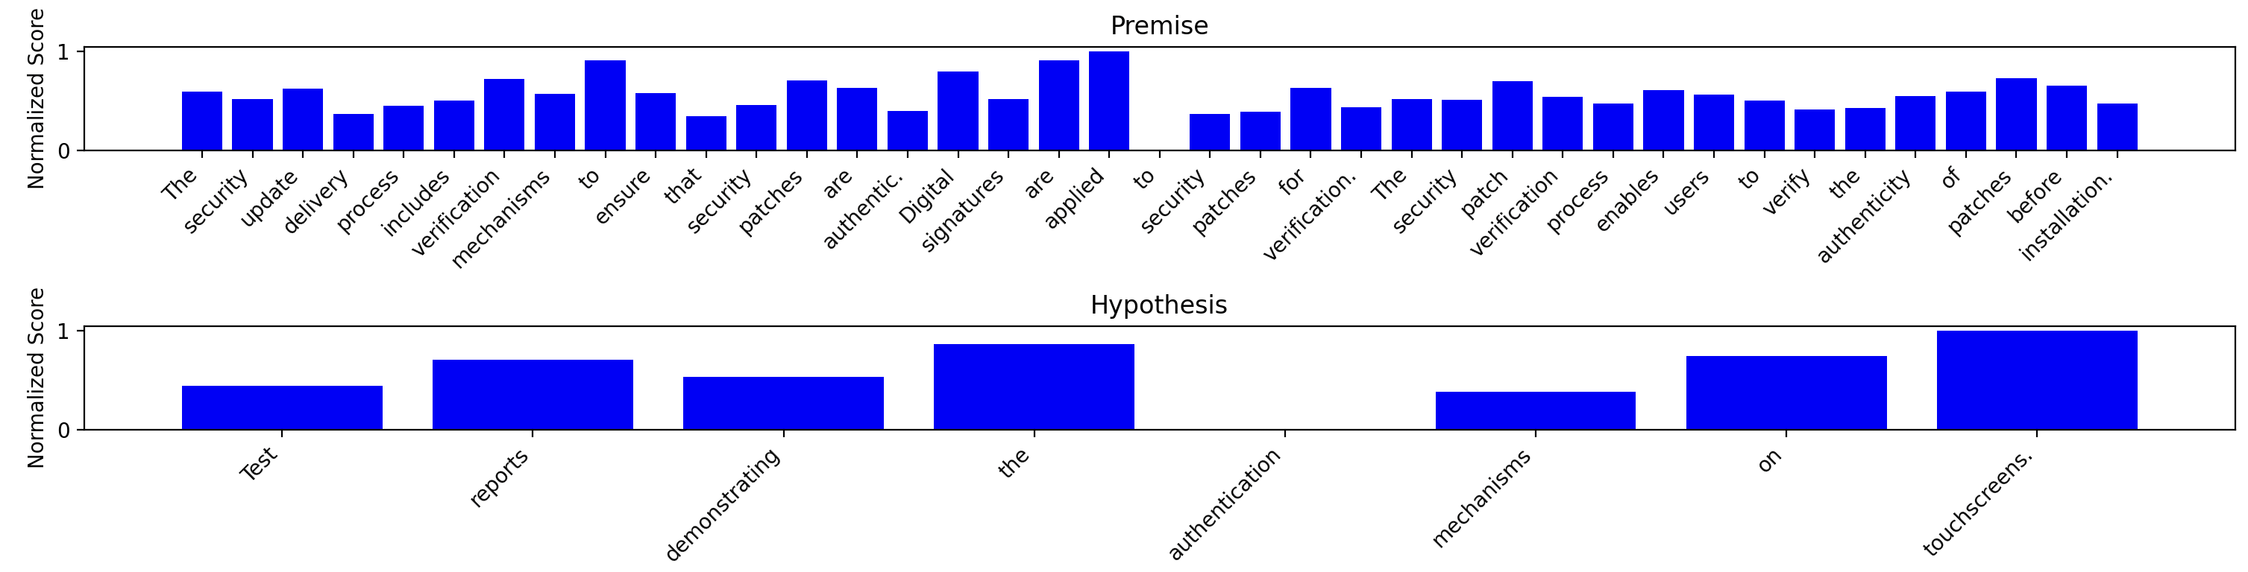
Key Development: Local Explanation of NLI Models Prediction
Post-Hoc Interpretation
Why a model made a specific prediction for a given input
Understanding the model's behavior and ensures transparency in its decision-making process
Notes:
An Importance score to each input that determine which features had the most significant impact on the model's prediction.

Slide 33
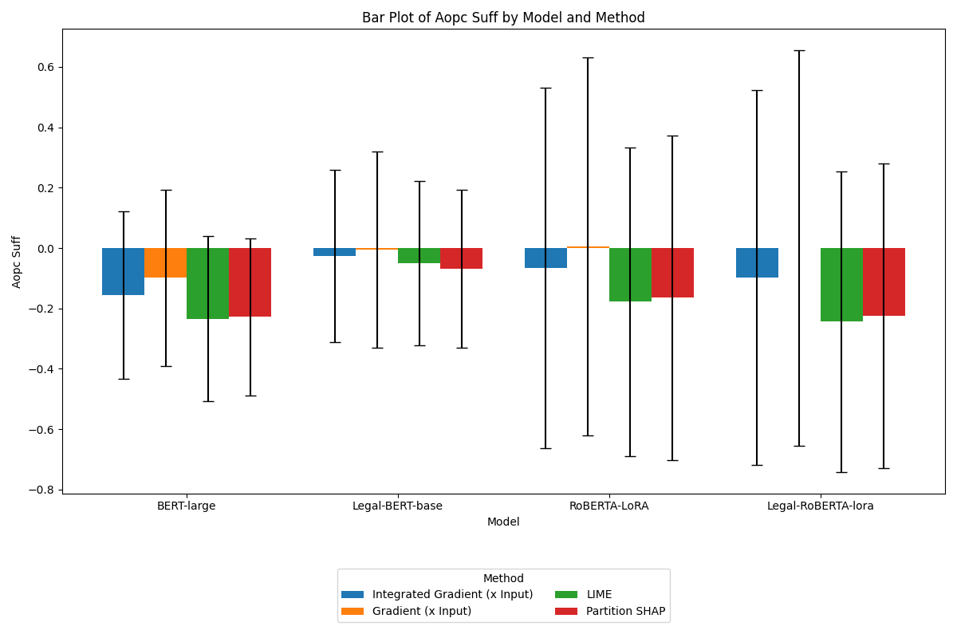
Appendix: Preliminary Experiments
Experiments Results on Local Explanations
Evaluating Explanations

Slide 34
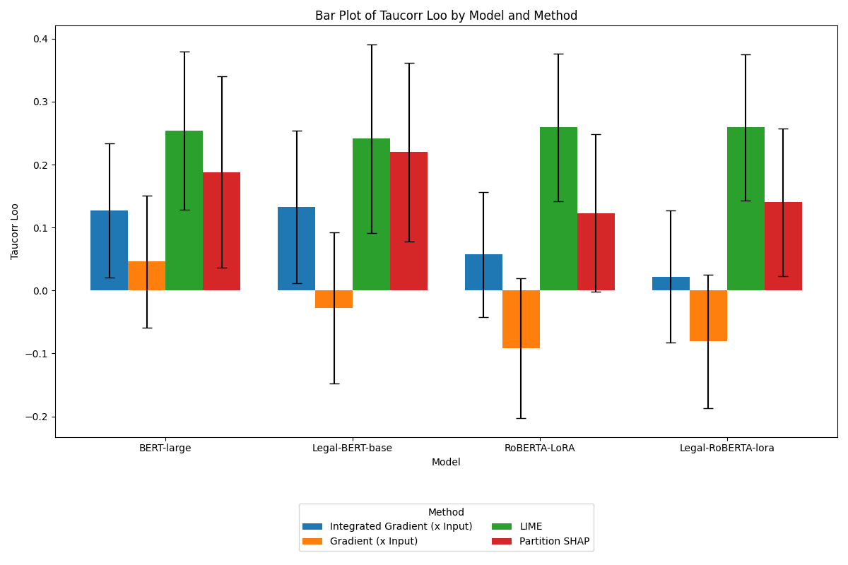
Appendix: Preliminary Experiments
Experiments Results on Local Explanations
Evaluating Explanations

Slide 35
Appendix
SAC Dataset Analysis
Traverse the Json tree structure and linearize
"ArgumentSubClaim1": {
  "description": "There is a configuration interface for authorized personnel to modify the notification message.",
  "Evidences": [
  {
    "Evidence1": {
      "description": "Screenshot of the configuration interface for the notification message.",
      "type": "screenshot",
      "source": "System User Interface",
      "date": "2023-10-01"
    }
  },
  {
    "Evidence2": {
      "description": "Access control logs showing authorized personnel accessing the configuration interface.",
      "type": "log file",
      "source": "System Logs",
      "date": "2023-10-01”
      }
},
"ArgumentSubClaim1-41": {
  "type": "ArgumentSubClaim",
  "number": 1,
  "description": "There is a configuration interface for authorized personnel to modify the notification message.",
  "evidence_type": null,
  "parent": "ArgumentClaim-38",
  "parent_description": "Authorized personnel have the ability to configure the system use notification message."
},
"Evidence1-44": {
  "type": "Evidence",
  "number": 1,
  "description": "Screenshot of the configuration interface for the notification message.",
  "evidence_type": "screenshot",
  "parent": "ArgumentSubClaim1-41",
  "parent_description": "There is a configuration interface for authorized personnel to modify the notification message."
},
"Evidence2-49": {
  "type": "Evidence",
  "number": 2,
  "description": "Access control logs showing authorized personnel accessing the configuration interface.",
  "evidence_type": "log file",
  "parent": "ArgumentSubClaim1-41",
  "parent_description": "There is a configuration interface for authorized personnel to modify the notification message."
},

Slide 36
Appendix
SAC Dataset Analysis
Dataset statistics summary:
  #Requirements: 6
  #Models : 3
  #Repeat per requirements: 5
  #Instances: 1597
  Types:
    #MainClaim: 90
    #Sub-claim: 180
    #Argument-claim: 181
    #Argument sub-claim: 333
    #Evidence: 795

Slide 37
Appendix
Evaluating Structured Data
Measure synthetic dataset quality:
Metrics
  Flat metric: Absolute different count per type
  Structure metric: Graph/Tree Edit Distance
Comparison between
  Intra-model: the same model between different generation
  Inter-model: pairs of different model

Slide 38
Appendix
Evaluating Structured Data
Flat metric: Absolute different count per type
Diff Type | Avg. Intra-model ↓ | Avg. Inter-model ↓
Main-claim | 0.000 | 0.000
Sub-claim | 0.000 | 0.000
Argument-claim | 0.022 | 0.022
Argument-subclaim | 0.300 | 0.600
Evidence | 0.899 | 2.199

Slide 39
Appendix
Evaluating Structured Data
Flat metric: Absolute different count per type
Intra-model Flat-Metric
Model | MainClaim | SubClaim | ArgumentClaim | ArgumentSubClaim | Evidence
chatGPT4o | 0 | 0 | 0 | 0 | 0
Llama3.1-70B | 0 | 0 | 0.4 | 1.4 | 3.4
Qwen2.5 | 0 | 0 | 0 | 0 | 0
Inter-model Flat-Metric
Model Pair | MainClaim | SubClaim | ArgumentClaim | ArgumentSubClaim | Evidence
chatGPT4o and Llama3.1-70B | 0 | 0 | 0.2 | 0 | 2.8
chatGPT4o and Qwen2.5 | 0 | 0 | 0 | 0 | 0.6
Llama3.1-70B and Qwen2.5 | 0 | 0 | 0.2 | 0 | 2.2

Slide 40
Appendix
Evaluating Structured Data
Structure metric: Graph/Tree Edit Distance
Avg. graph edit distance intra-model per model
Intra/Req | 1 | 2 | 3 | 4 | 5 | 6 | 7
Qwen2.5 | 0.0 | 0.0 | 0.0 | 2.4 | 0.8 | 3.0 | 0.0
chatGPT4o | 0.0 | 0.0 | 0.0 | 0.0 | 0.0 | 0.0 | 0.0
Llama3.1-70B | 9.3 | 9.3 | 2.4 | 9.6 | 6.0 | 15.1 | 8.8

Slide 41
Appendix
Evaluating Structured Data
Structure metric: Graph/Tree Edit Distance
Avg. graph edit distance: 7.827
Avg. graph edit distance intra-model per model
Model1 | Model2 | GED
Qwen2.5 | chatGPT4o | 0.343
Qwen2.5 | Llama3.1-70B | 13.977
chatGPT4o | Qwen2.5 | 0.571
chatGPT4o | Llama3.1-70B | 14.057
Llama3.1-70B | Qwen2.5 | 9.703
Llama3.1-70B | chatGPT4o | 9.714

Slide 42
Appendix
Utility Evaluation of Synthetic Data
Cross-LLM evaluation setup
  Train a model on a set of seen requirement-based (SACs) generated by LLM A
  Test the model on an unseen requirement set generated by LLM B.
 | ChatGPT4o | Qwen2.5 | Llama3.1-70B
chatGPT4o | - | .84 | .87
Qwen2.5 | .93 | - | .88
Llama3.1-70B | .96 | .91 | -

Slide 43
Appendix
Evaluating Structured Data
Qwen2.5 and ChatGPT4o seems the most consistent and in-agreement with each others
Llama3.1-70b generate inconsistent SAC structures between different generation, but it can be useful for sampling
The graph/tree can be used to create an implicit pairs by traversing possible path from root (Main-claim to Evidences)

Slide 44
Thank You
For Your Attention

Slide 45
Break Slide
Lets Take Break For 5 Minutes

Slide 48
Interdependencies
Interactions with other WPs / expectations & needs​​
WP3/T3.1
Compliance Output WP2/T2.2
Data Explanation
Local Explanation
WP6/T6.2
Notes:
Security assurance case presentation

