Slide 1
Technical Meeting - Final Conference
T3.1 Evidence correlation and assurance case composition
- SAC Composer tool -
11 June 2026
Grandium Hotel, Prague
HORIZON-CL3-2022-CS-01-04: INCREASED CYBERSECURITY 2022
Ref. Ares(2022)8966412 - 23/12/2022

Slide 2
Technical Meeting - Final Conference
T3.1 Evidence correlation and assurance case composition
- SAC Composer tool -
11 June 2026
Grandium Hotel, Prague
HORIZON-CL3-2022-CS-01-04: INCREASED CYBERSECURITY 2022
Ref. Ares(2022)8966412 - 23/12/2022

Slide 3

Need to accelerate (re)certification
Need to curb costs
Limited/distributed knowledge
Automation through Digital solutions
Natural Language Processing
+
New/enforced company processes
Security Assurance Case Composer
Security Assurance Case
meets
Large Language Models

Slide 4
Security Assurance Case
Composer

Slide 5
  OB2: Improve assurance evidence correlation for cost-effective re-certification
  KPI:
-15%
  Time of { _______ } is reduced by 15%
  recommendations, selection, configuration, and composition of assurance case patterns to the specifics of each certification product, process or service

Slide 6

… interpret requirements
… organize the evidence
… justify their fullfilment
According to product/service context and characteristics
How to?

Slide 7
Standard
Requirements
Product / Service
Evidence

Slide 8

Standard
Requirements
Product / Service
Evidence

Slide 9

Security Assurance Case
Evidence
SubClaim
Claim
Argument

Slide 10
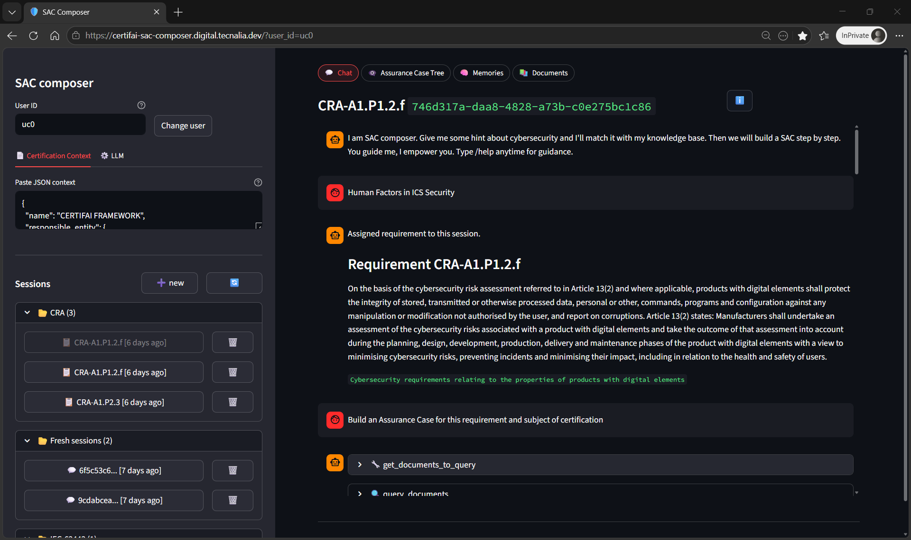

Slide 11

Workflow
Upload documents related to SoC.
Define Subject for Certification (SoC) in a JSON
By session requirement selection
Create an Assurance Case – core automation
Review SAC (JSON) & extra information
Refinement

Slide 12
Tool capabilities
Document (evidence) ingestion
Advanced manual search in documents
Agentic AC building // all-at-once
  Requirement decomposition
  Evidence discovery
  Argumentation and arragement

Slide 13




Microservice architecture
Requirement ingestion
Document ingestion
gen AI service
  LLM server
  business logic workflow
User Interface service – web app

Slide 15

Challenges
Systematic output format - Claim-Argument-Evidence Schema
Hallucinations in evidence and its location within document
Refinement process
Conversational feature of tool

Slide 16


Lesson’s learnt

Slide 17
Lesson’s learnt
Lack of data -> No ML upfront
Gen AI apps for `open problems`
Complexity increases fast
Strong soft. engineering (full stack)
Local LLM management is a pain
Ideas ahead of implementation

Slide 18
Summary
Motivation, objectives and KPI
Tool capabilities – Demo
Lessons learned

