Slide 1
ThreatSpider: a Tool for Continuous Cyber Risk Management
HORIZON-CL3-2022-CS-01-04: INCREASED CYBERSECURITY 2022
Ref. Ares(2022)8966412 - 23/12/2022

Slide 2
Outline
Background
Objectives
ThreatSpider Overviwew
Architecture
Components
Training Curriculum
Modules
Games
Expectations
Impact and Future Directions

Slide 3
Objectives and Expectations

Slide 4
CertifAI Objectives (WP5)
T5.1 - Comprehensive threat modelling framework
  To deliver → a schema for the description of threats in the evaluated system which includes the targeted technology domains and contains relationships to security requirements for further risk management processes
T5.2 - Automated threat identification-
  To deliver → a method for automating the identification of threats in the system model throughout the development lifecycle
T5.4 - Continuous Risk Management Methodology
  To deliver a → a risk management methodology according to relevant certification and compliance scheme

Slide 5
Partners Expectations
Process Efficiency & Compliance
  Reduce certification time & effort (P)
  Support standards compliance (IEC 62443, CRA) (P)
  Adapt across lifecycle phases (P)
  Ensure consistent, repeatable results
Security Coverage & Modelling
  Strengthen overall cybersecurity posture
  Cover broader threats (incl. non-adversarial)
  Support safety-critical system modelling (P)
  Expand mitigation coverage
  Include known vulnerabilities
  Integrate CTI sources (e.g., ATT&CK)
Usability & Human Factors
  Capture analyst knowledge & experience
  Enable collaboration & participation
  Provide clear documentation & guidance
Technical & Operational Features
  Support flexible workflows (threat / vulnerability-driven)
  Enable offline use + external updates
  Integrate AI (with optional use)
  Allow customization for different use cases

Slide 6
ThreatSpider Overview

Slide 7
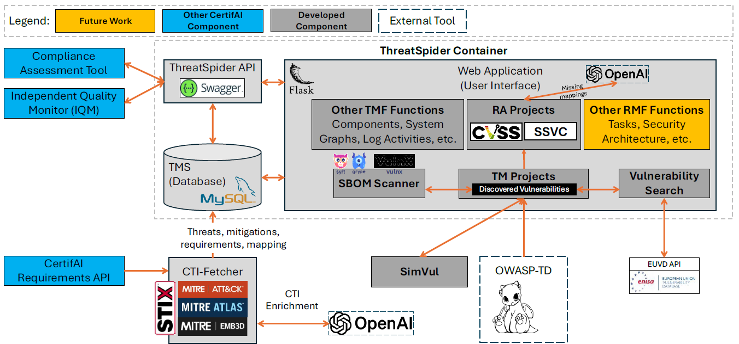
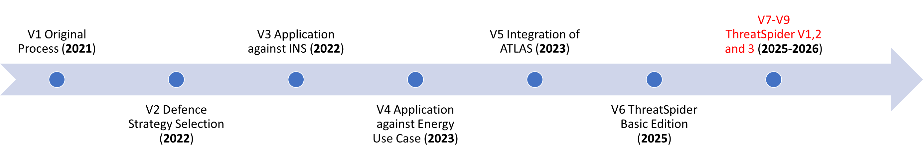
ThreatSpider as a component of CertifAI Risk Management Framework (RMF)

Slide 8
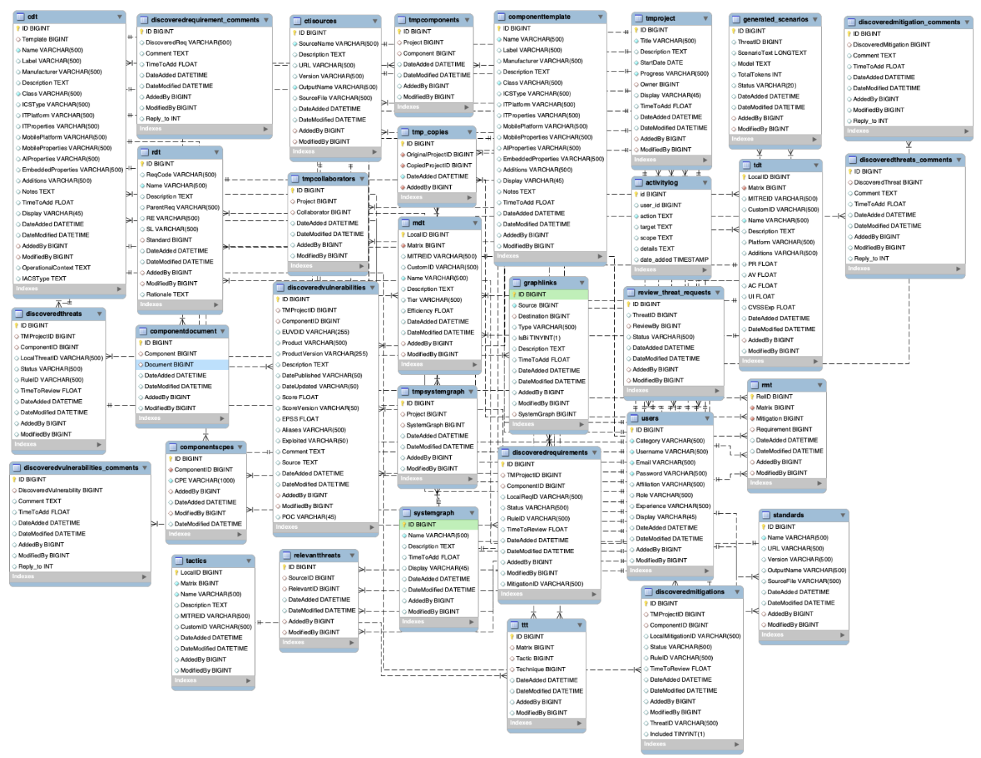
ThreatSpider Database
Abstracts the description of components, systems, threats, vulnerabilities, mitigations, requirements, the relationship between them in addition to supporting threat modelling and risk assessment processes
Consists of +67 interconnected tables
Defined in D5.5 and expanded in D5.10
Implemented in MySQL

Slide 9
CTI-FETCHER
a CLI tool that continuously ingests cyber-threat intelligence and updates the ThreatSpider database tables. It currently pulls from ATT&CK (Enterprise, ICS, Mobile), ATLAS (ML/AI components), EMB3D (embedded systems), and CAPEC (software), ensuring broad coverage across technology domains.

Slide 10
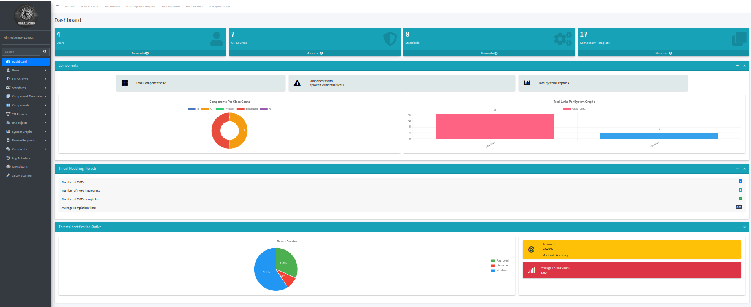
ThreatSpider User Interface: Supporting functions
User management
CTI Sources Management
Standards and requirements
Systems definition functions
SBOM Scanning
Activity Logs
Comments and Reviews
AI assistant

Slide 11
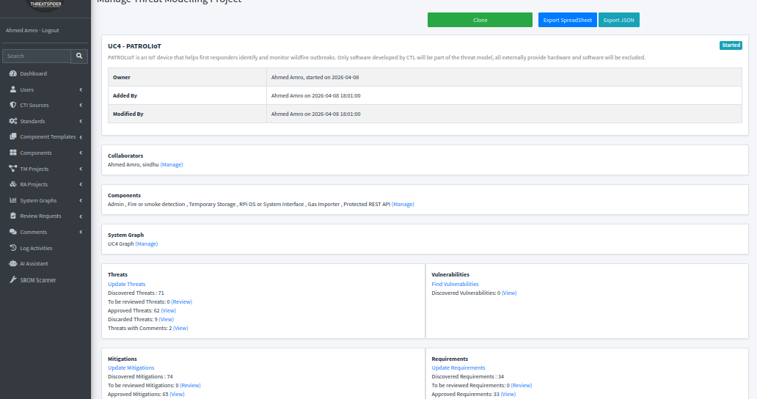
ThreatSpider User Interface: Threat Modelling Projects
System definition
Auto-manual Threat identification
Auto-manual Mitigation and requirement mapping
Vulnerability identification
Reporting
Importing OWASP Threat Dragon threat models
Version control through cloning

Slide 12
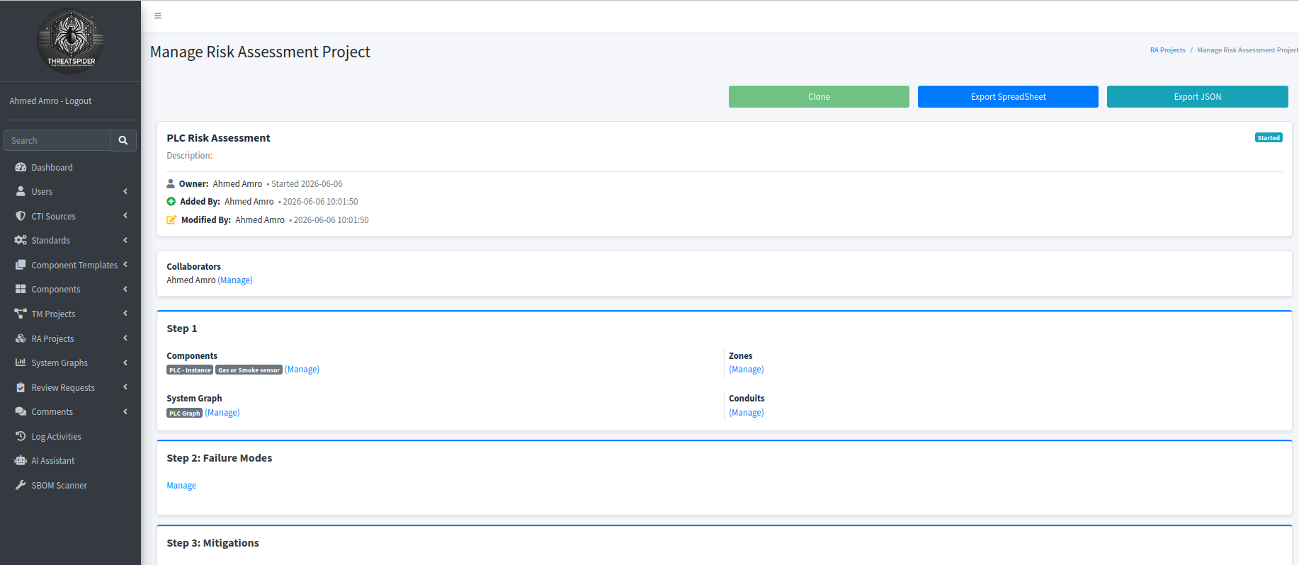
ThreatSpider User Interface: Risk Assessment Projects
Implements a FMECA-based risk assessment process
Adaptations to support IEC62443-3-2 risk assessment
Integrates AI functions for the generation of missing data

Slide 13
ThreatSpider User Interface: Risk Assessment Projects

Slide 14
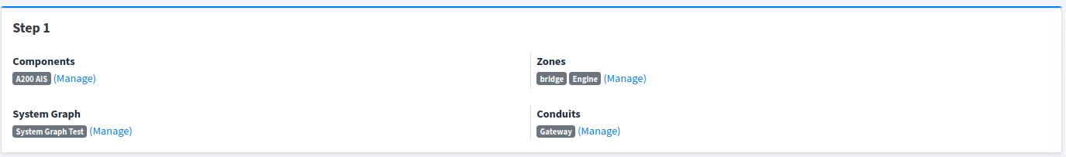
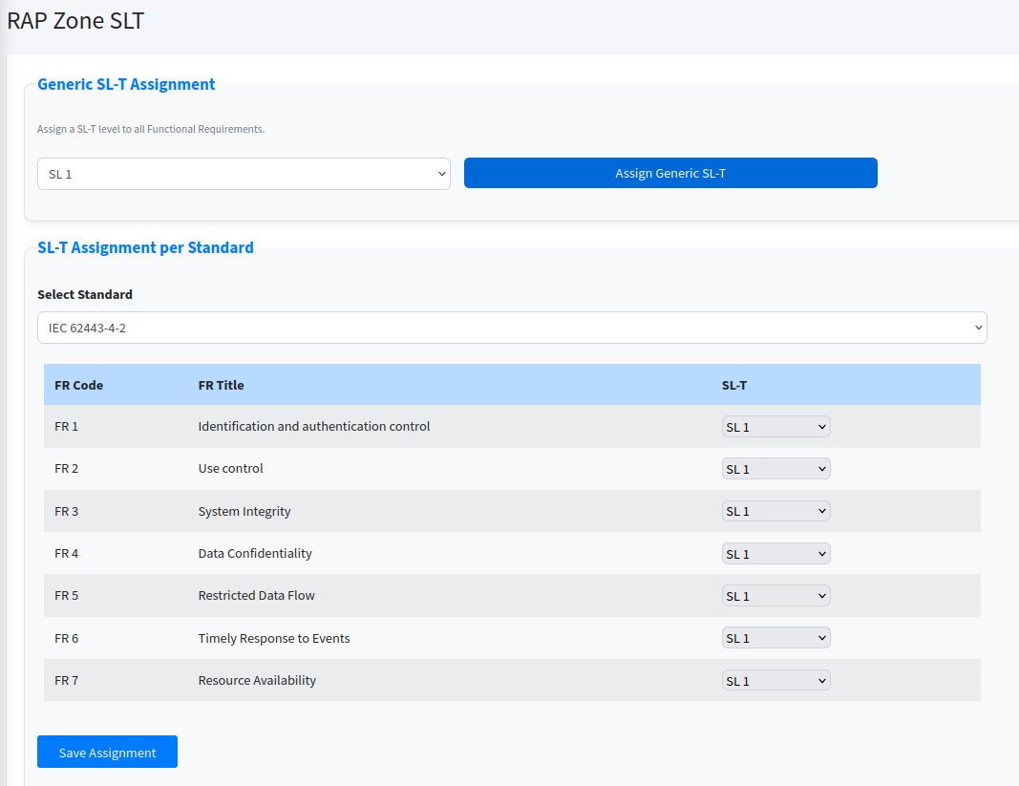
Risk Assessment Projects: Step 1

Slide 15
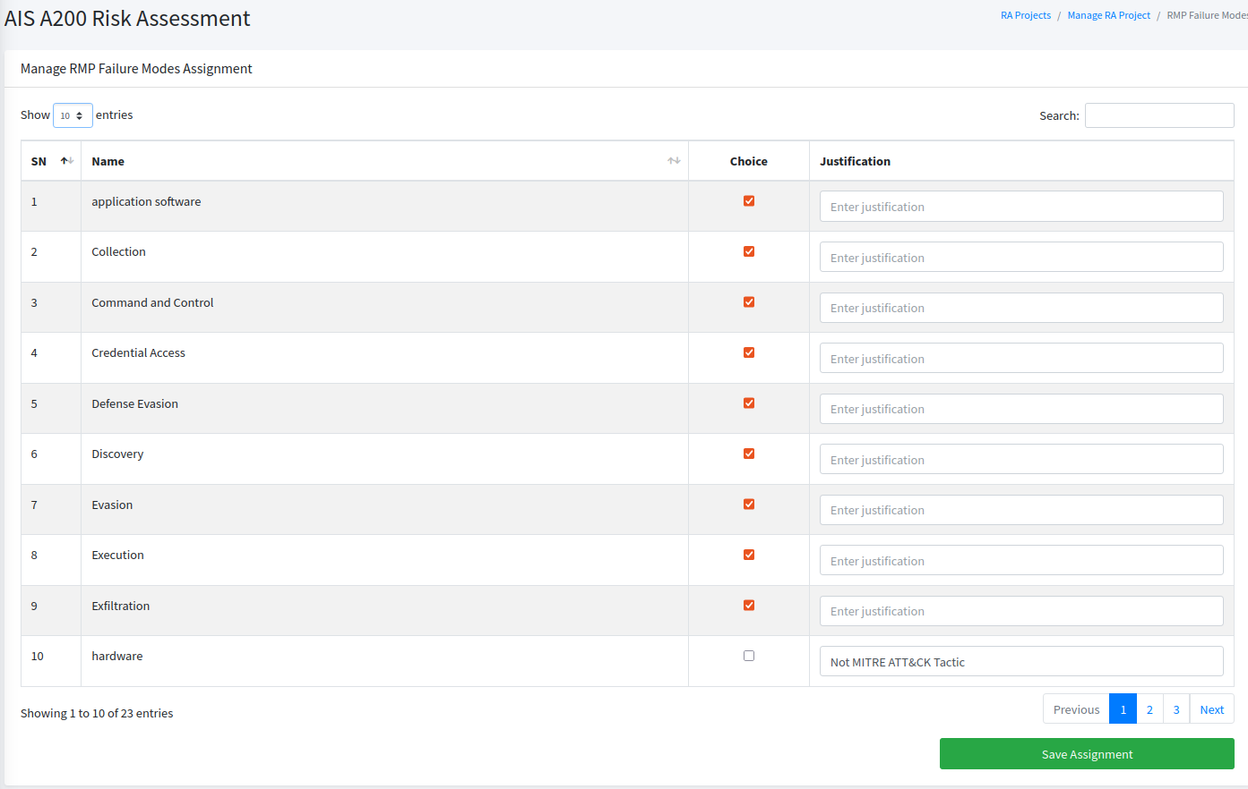
Risk Assessment Projects: Step 2

Slide 16
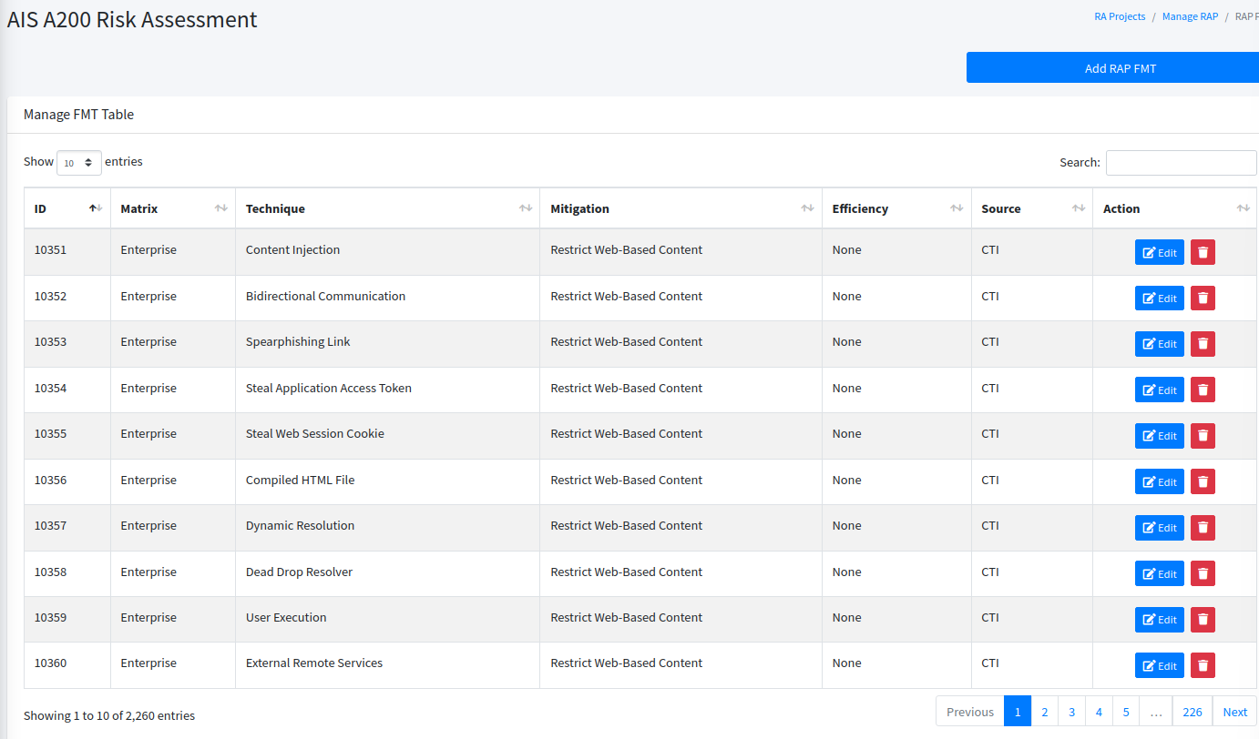
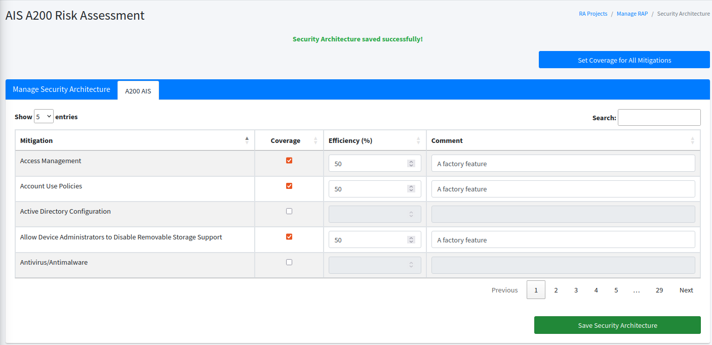
Risk Assessment Projects: Step 3

Slide 17
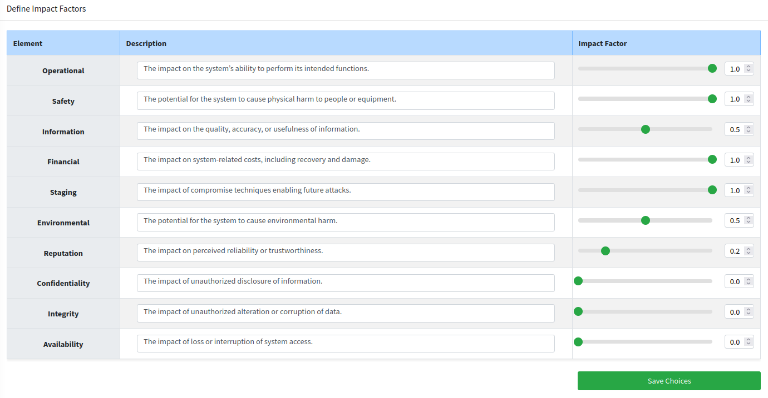
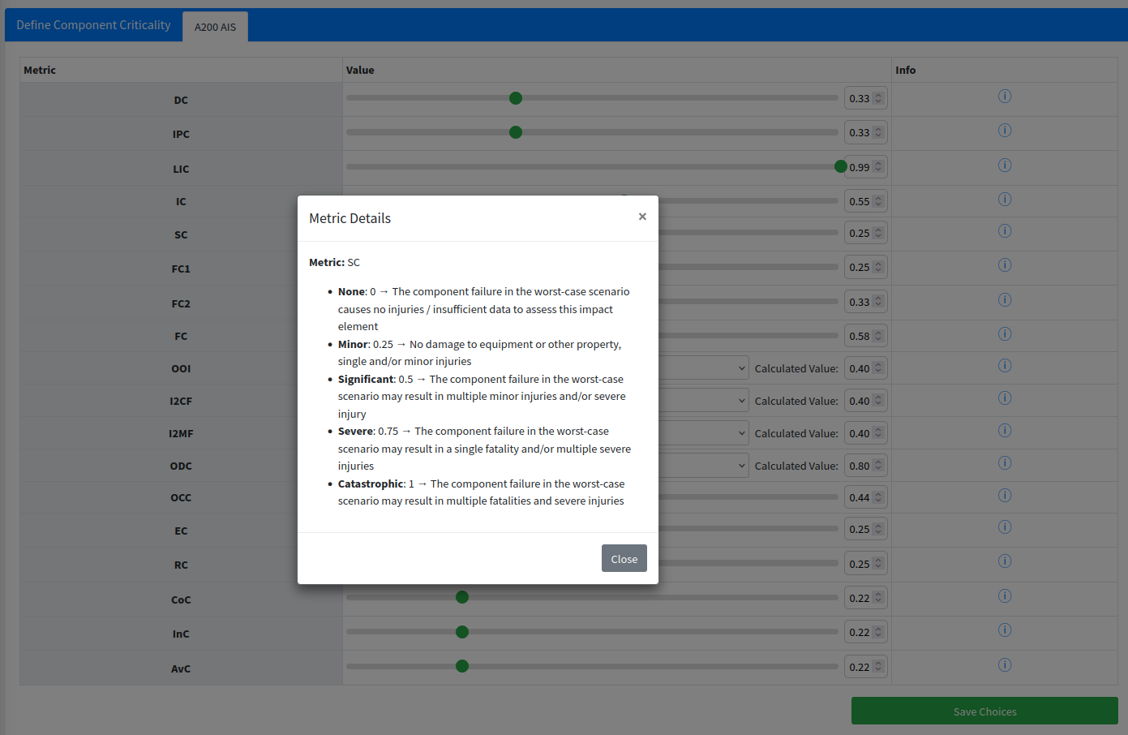
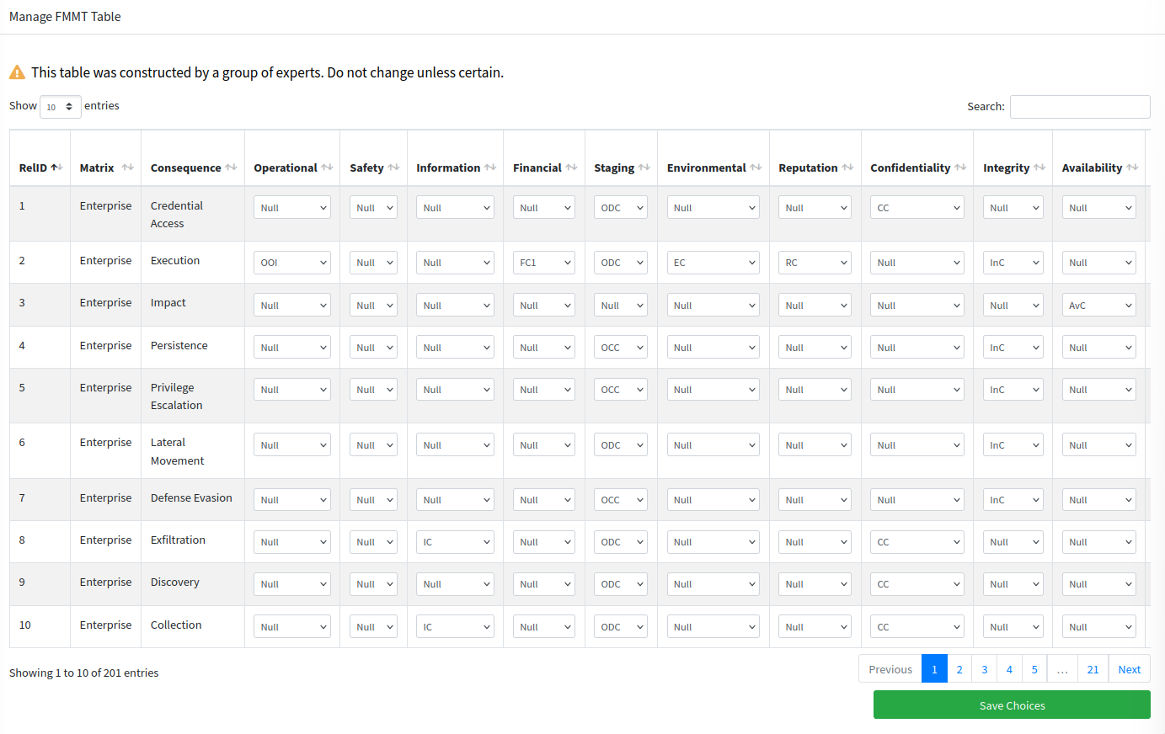
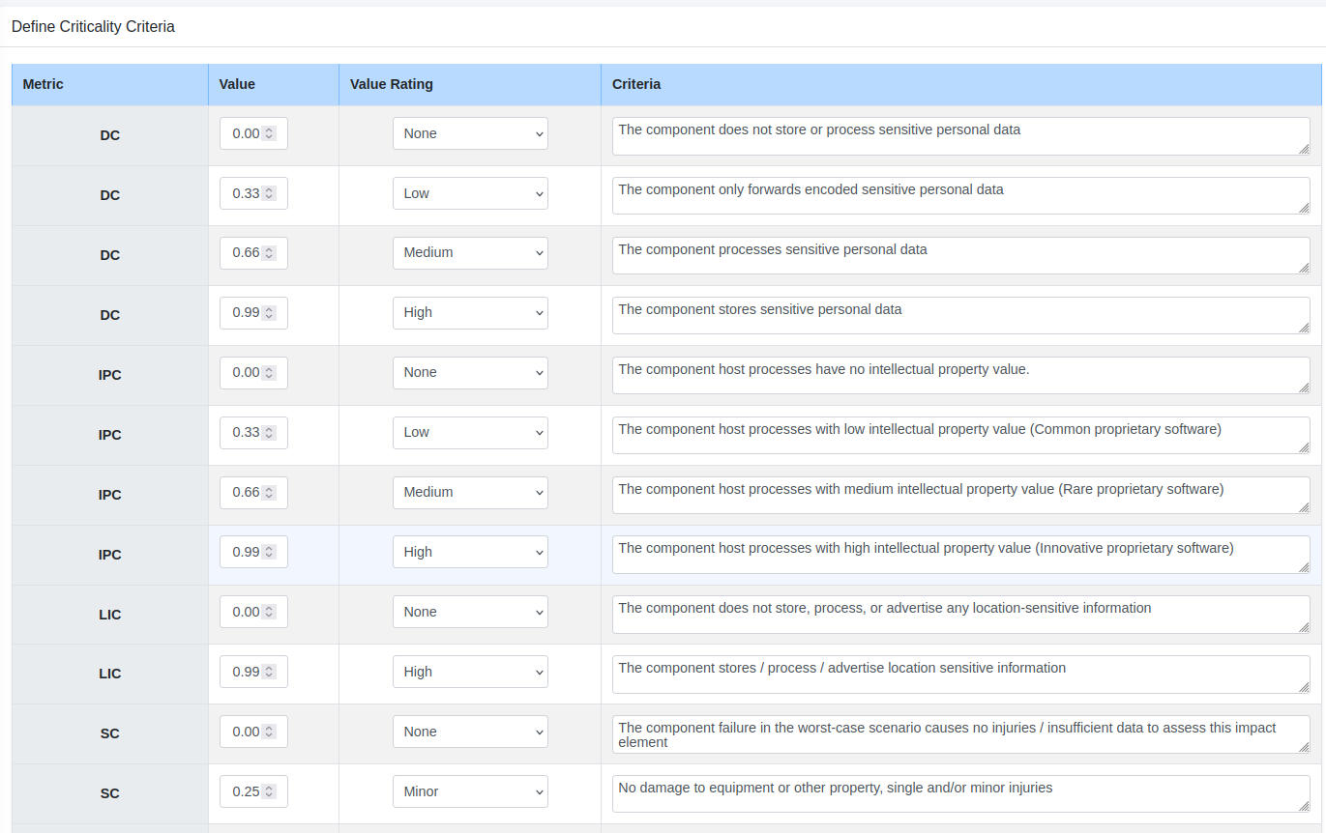
Risk Assessment Projects: Step 4

Slide 18
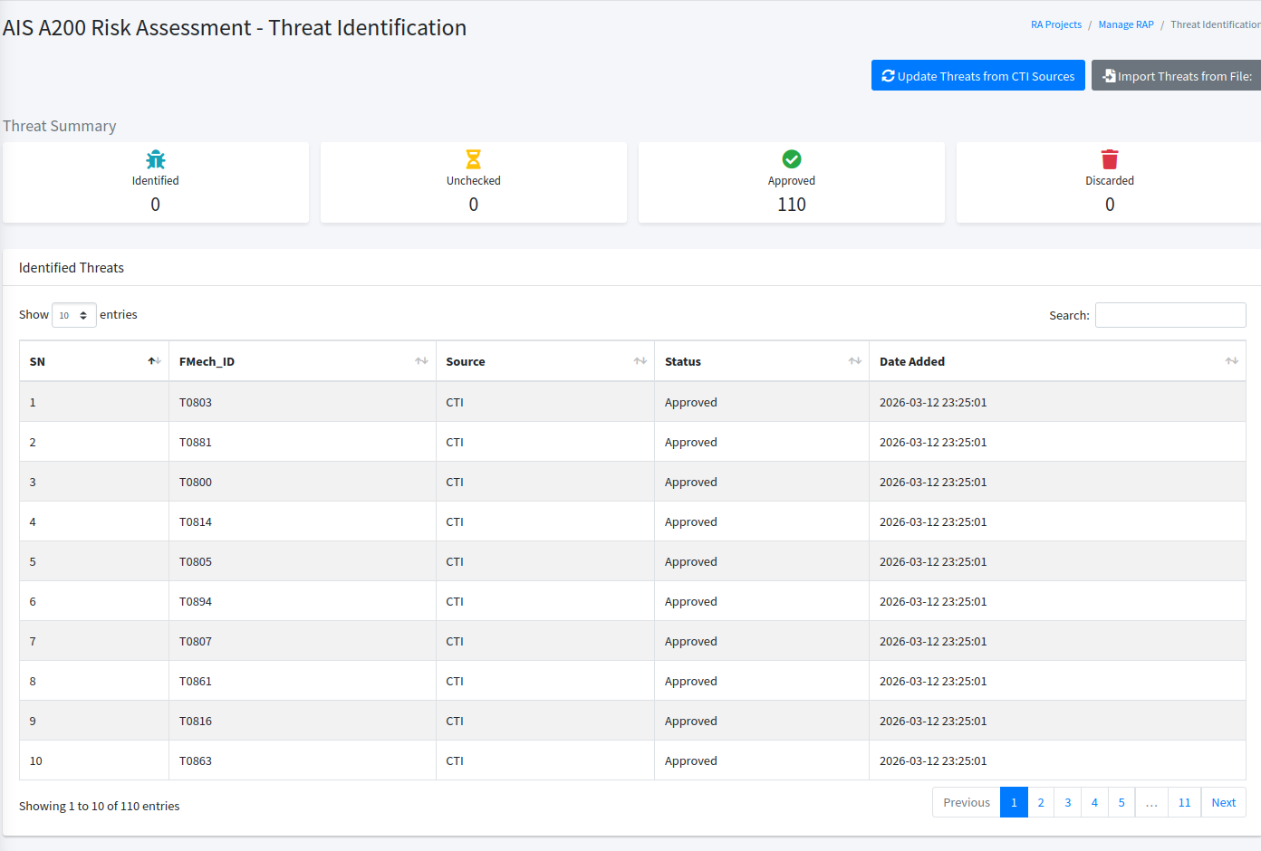
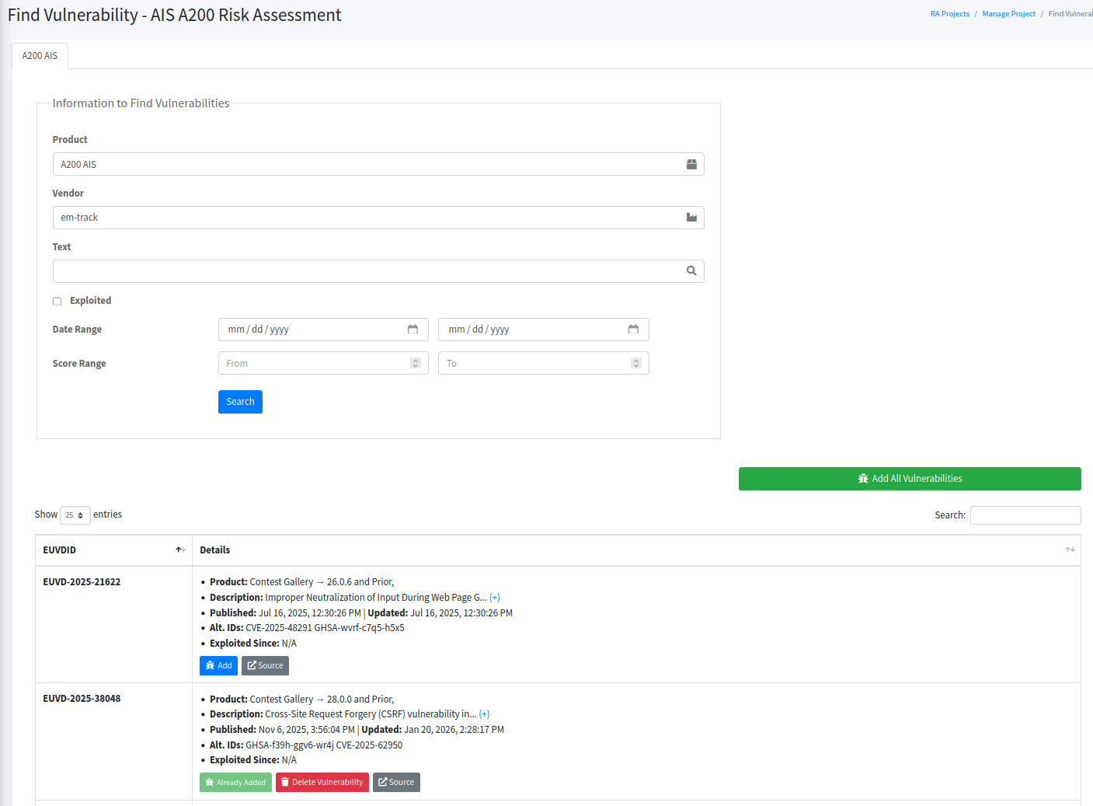
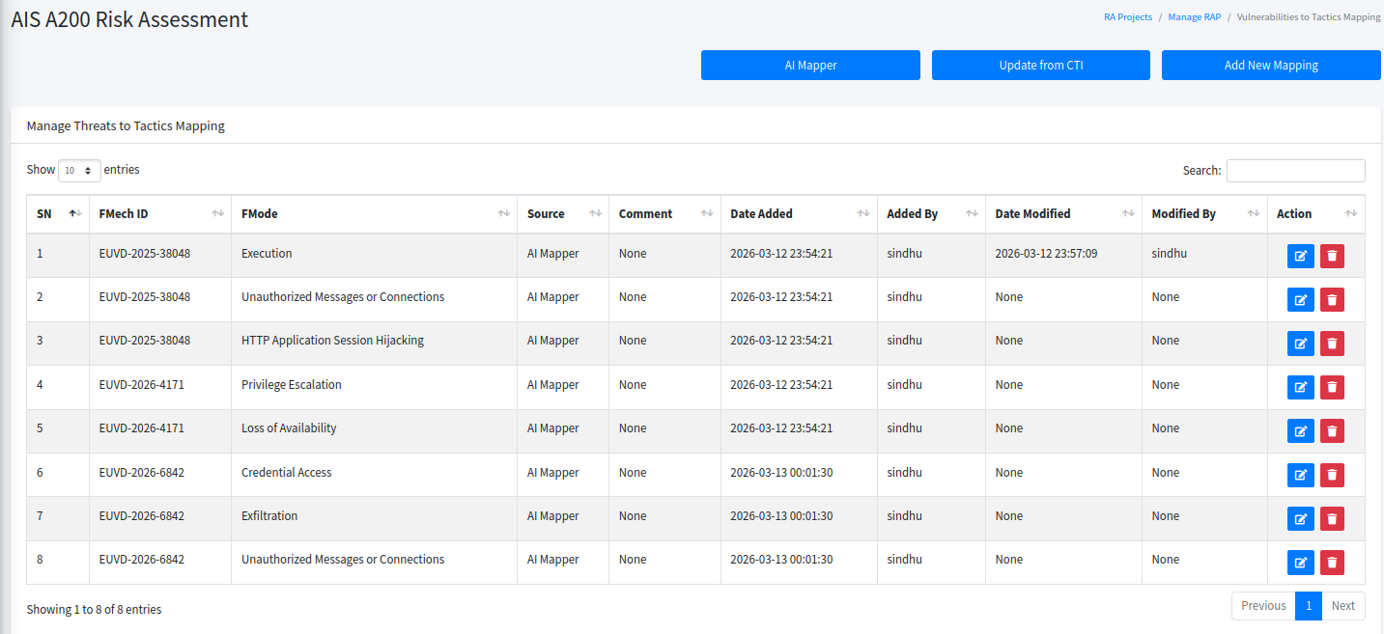
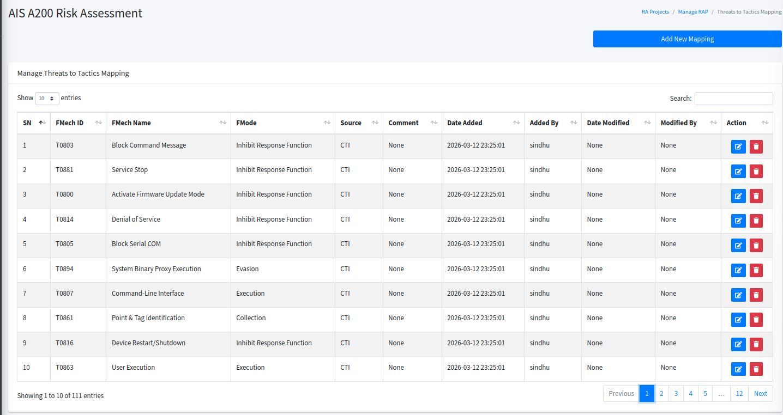
Risk Assessment Projects: Step 5

Slide 19
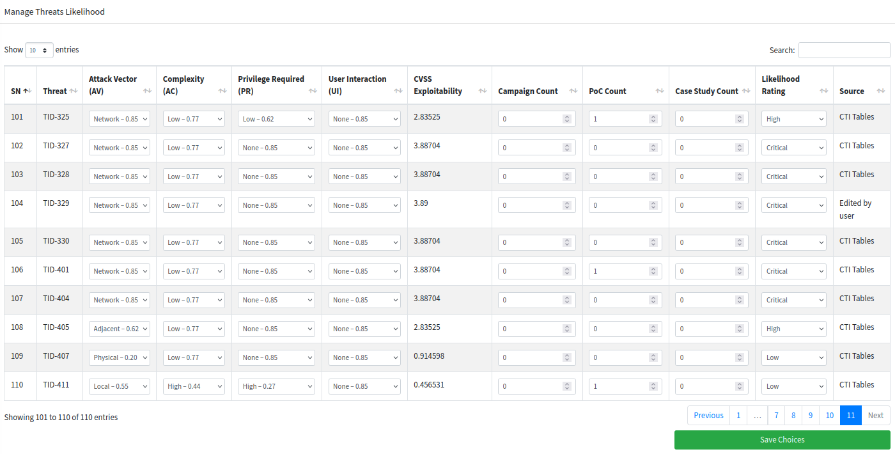
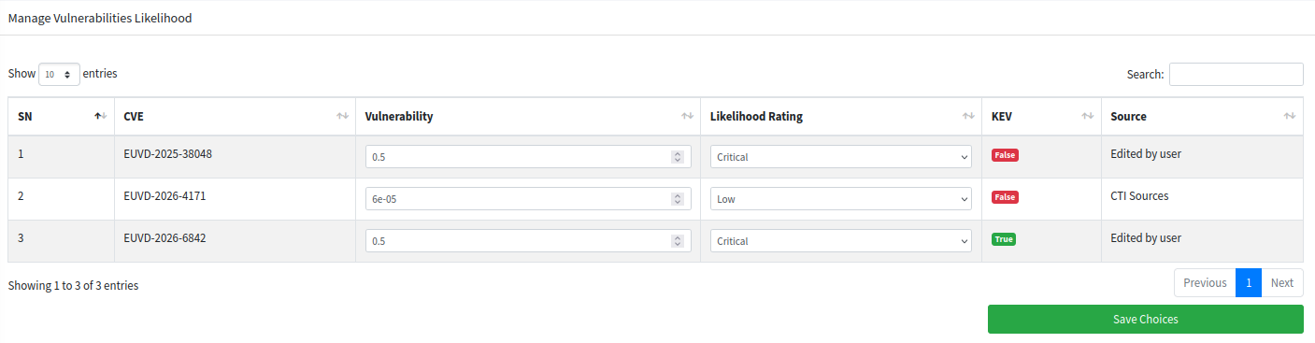
Risk Assessment Projects: Step 6

Slide 20
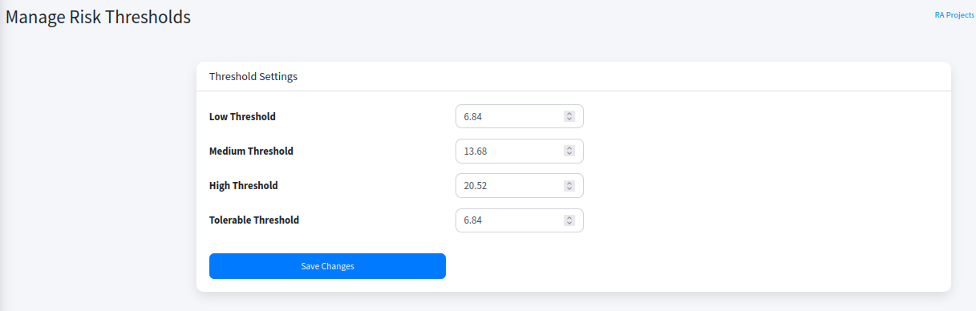
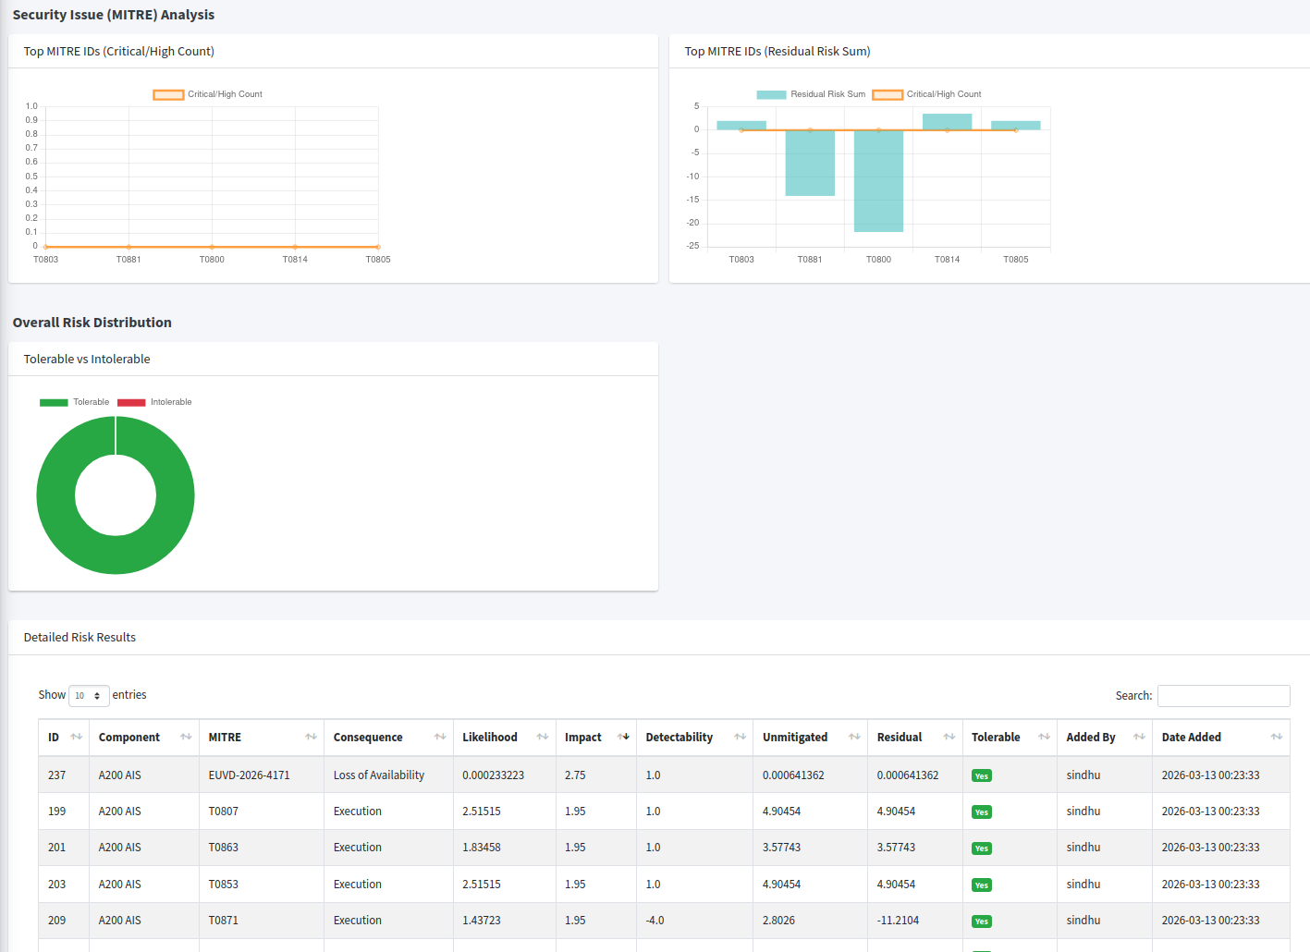
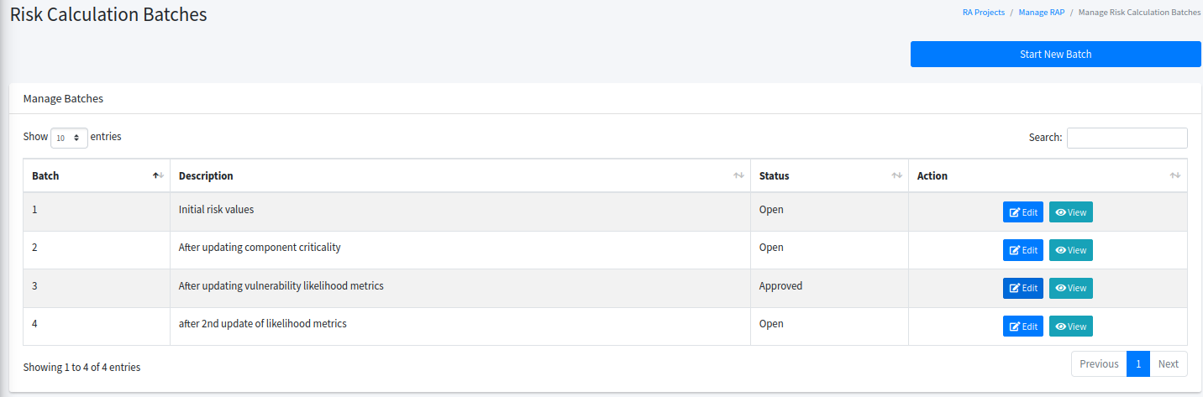
Risk Assessment Projects: Step 7

Slide 21
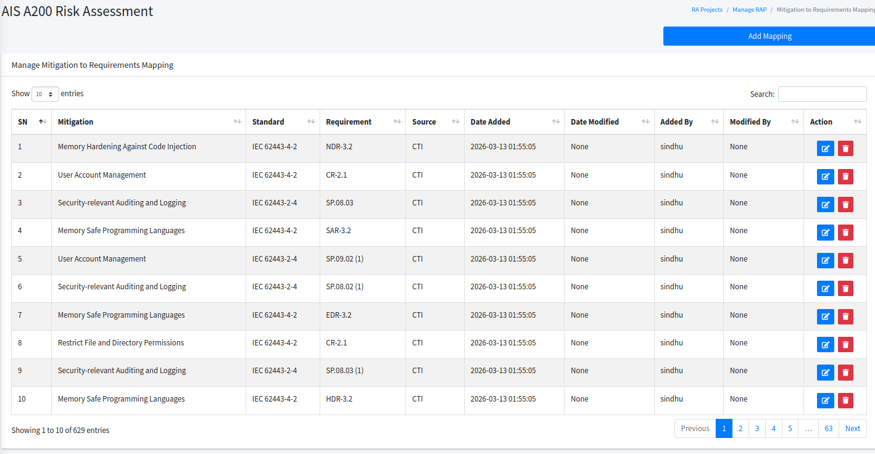
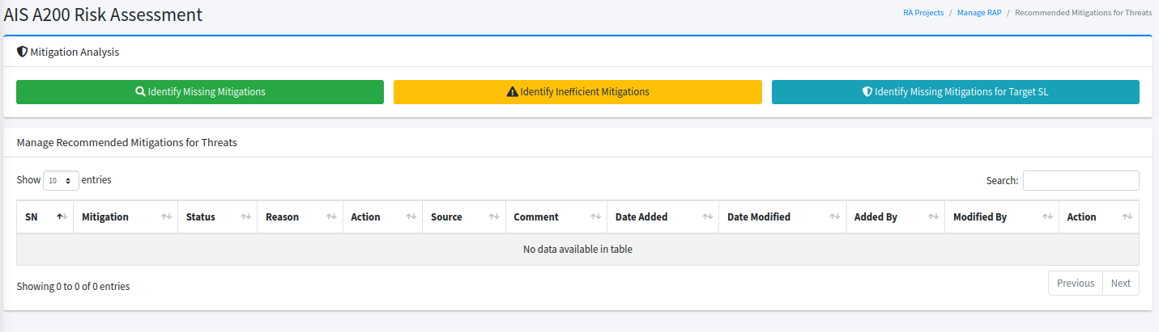
Risk Assessment Projects: Step 8

Slide 22
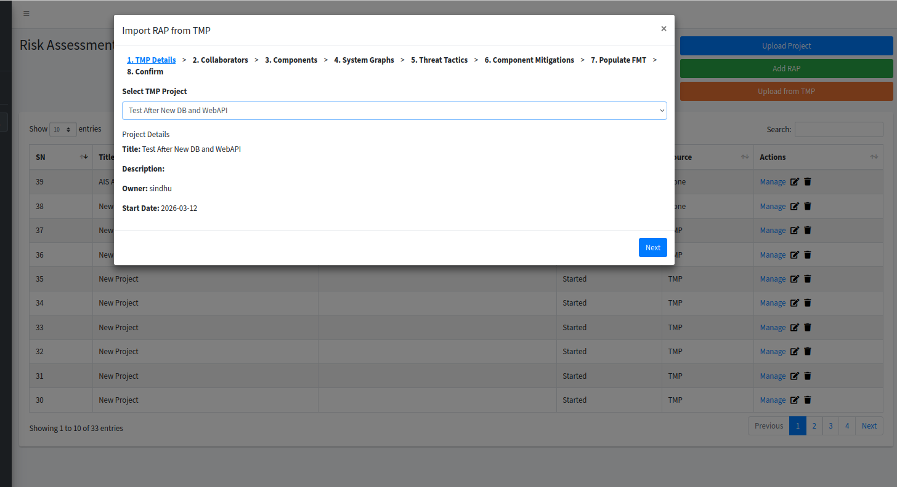
Risk Assessment Projects: Convert TMP to RAP

Slide 23
ThreatSpider Development and Testing
Development
Containarized Web Application
3 releases to partners with 11 development iterations for testing
Testing
NTNU rigorous testing for each version
3 pilot testing rounds against 4 use cases each time
Demonstrations and discussion

Slide 24
Utilization Scenarios
  Threat modelling and risk assessment projects for ICS, embedded, IT, mobile, Software components (inc. SBOM)
    From scratch
    Importing from OWASP threat model
    Converting threat modelling projects to risk assessment projects
  Outputs
    Relevant threats and vulnerabilities
    Relevant needed mitigations and actions
      Missing, inefficient, to achieve a target security level
    Relevant requirements
    Reports

Slide 25
Training Curriculum

Slide 26
Training Curriculum
Educational modules
  Modules
    Module 1: Attack Strategies and Malware
    Module 2: Cyber Risk Managemeent
    Module 3: Bridging the gap from threat modelling to penetration testing plans
  Delivery
    Moodle as the LMS
    https://moodle.62.238.27.4.nip.io/ [! Still under construction]
Gamified training
  ATLAS Introduction game
  https://atlas.62.238.27.4.nip.io/
Notes:
The modules were developed in collaboration with other projects at NTNU. The core content was derived from CertifAI methods and tools while the scope was adapted to the other projects objectives.

Slide 27
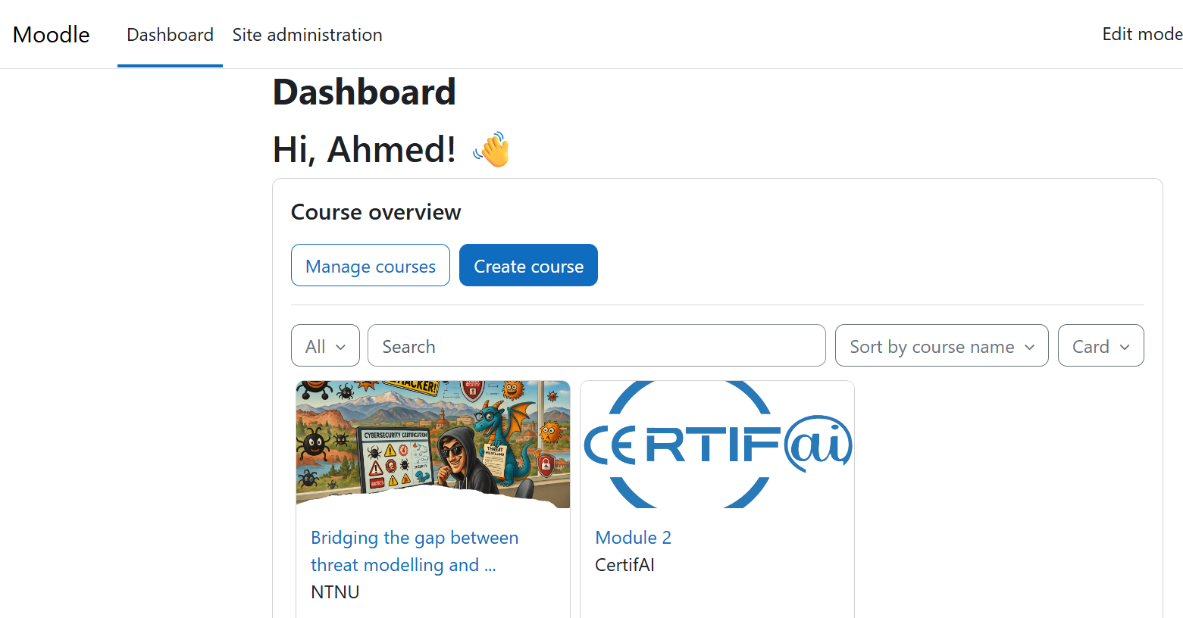
Moodle-based Training Program
A training program hosted on Moodle
Additional courses, users can be added
  invitation for contribution
Hosted online
Notes:
The modules were developed in collaboration with other projects at NTNU. The core content was derived from CertifAI methods and tools while the scope was adapted to the other projects objectives.

Slide 28
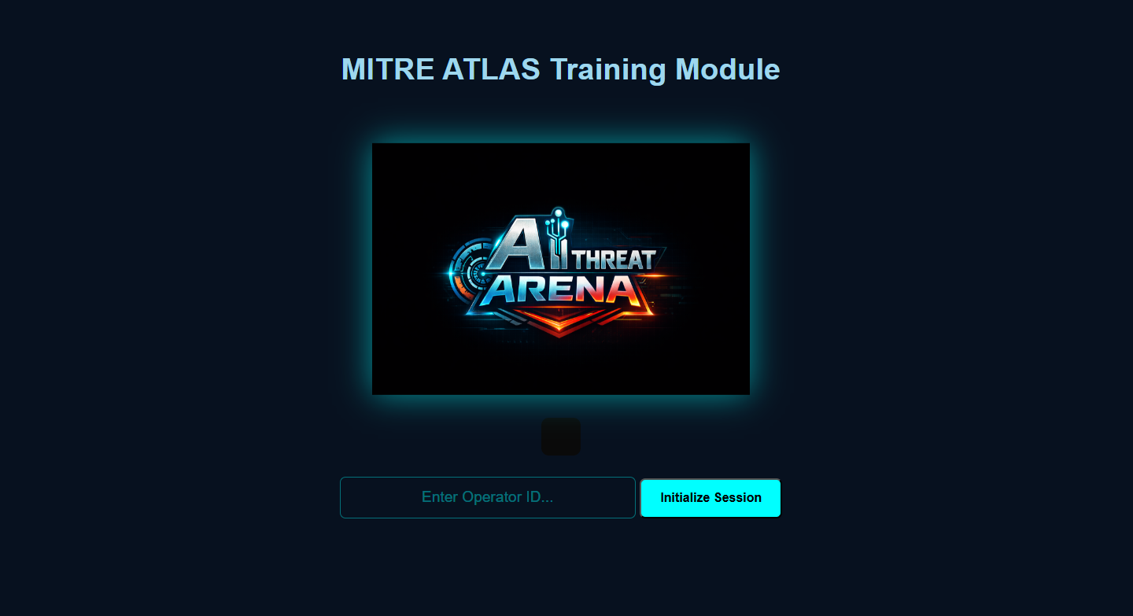

ATLAS Training Game
A gamified module introducing MITRE ATLAS
Blue and Red Team Scenarios
MITRE ATLAS Case Studies → Game Scenario
1st release hosted online (Ready for testing)
Notes:
The modules were developed in collaboration with other projects at NTNU. The core content was derived from CertifAI methods and tools while the scope was adapted to the other projects objectives.

Slide 29
Impact and Future Directions

Slide 30
Impact
Development of a curriculum
  3 traditional modules (1-2 hours each)
  1 gamified module
  All already utilized in other projects
Training master, PhD students, and postdocs
  1 MSc, 4 PhDs, 1 postdoc
Publications
  3 conference papers, 2 of them directly related to ThreatSpider
  a journal in the making
Collaboration
  Across projects in NTNU
    3 projects already (or will) utilize CertifAI outputs
  Collaboration with other universities
    Ongoing application of ThreatSpider against an autonomous ship as a use case.
Ongoing efforts to assess the generated IP assets

Slide 31
Research Directions and Improvements
System Model
Improve modelling properties
Automate modelling from different sources (e.g. network)
Threat Identification
Improve definition of inference rules
CTI and Data
Integration of additional data sources
Harmonization of different sources
Threat Modelling and Risk Assessment
Support additional approaches

Slide 32
Research Directions and Improvements
User friendliness
Process improvements
Data quality aspects
Transparency
Assumptions
AI Integration
Human and AI interaction
Confidentiality and privacy preserving methods

Slide 33
Thank You
For Your Attention

