Slide 1
CertifAI Integrated Framework,
Giannis Ledakis (UBITECH)
HORIZON-CL3-2022-CS-01-04: INCREASED CYBERSECURITY 2022
Ref. Ares(2022)8966412 - 23/12/2022

Slide 2
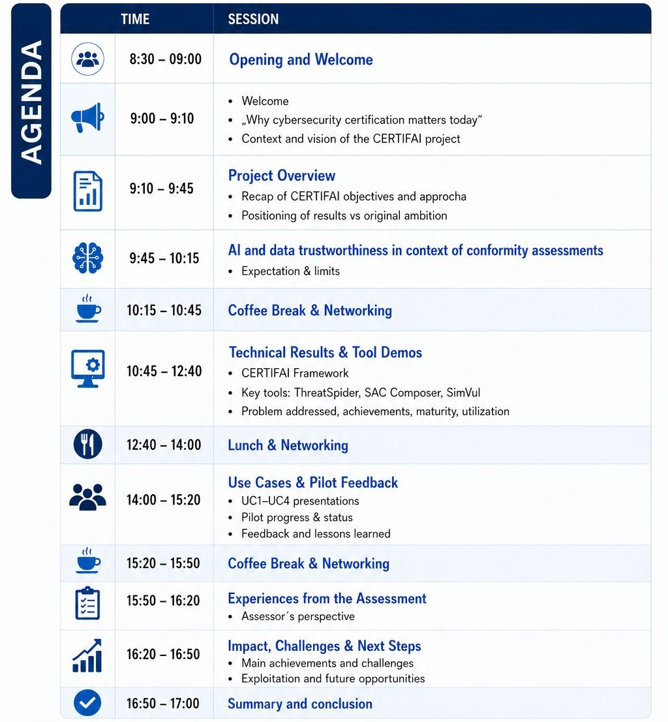
Agenda

Slide 3

Problem Statement & Challenges
Conformity assessment to security standards is needed reduce the impact of cyberattacks and increase the resilience of ICT products, services, and processes throughout their life cycle.
Traditional conformity assessment process is predominantly a static and expensive one-time assurance activity that does not cater to the needs of agile product delivery, which promotes continuous product updates and upgrades, and often changes in requirements.
Each update opens doors to product vulnerabilities, and consequently poses cyber risks for product users and companies’ reputation.
To avoid these issues, it is essential to enable a partial and continuous lean re-certification of ICT products, services, and processes, to empower manufacturers to prevent, detect, counter and quickly respond to cyber threats
CertifAI integrate framework is the central point of reference for the CertifAI tools and enable the dynamic certification process

Slide 4

Our Approach
CERTIFAI Integrated Framework implements the methodology for agile cybersecurity conformance assessment by integrating the research results of WP2-WP5.
Enables compliance assessment based on the artifacts defined and the evidence generated across various phases of the development process of ICT products and services.
Provides user interface for defining and managing the conformance process
Taking as inputs the requirements, the threat model and the evidences, analyzes the compliance of the overall product or a service.

Slide 5
Relevant
Objectives
OB1: Reduce the time and effort of (re-) certification and (re-) assurance using AI
OB2: Improve assurance evidence correlation for cost-effective re-certification
OB3: Reduce the effort of testing by implementing AI-based test case selection and formal methods
OB4: Enable continuous and proactive cybersecurity evaluation and certification

Slide 6
Name | Offered Functionalities
Unified Controls Catalogue | Provides practitioners with comprehensive information to accurately interpret and implement each requirement
Security Assurance Case (SAC) Compomser | Constructs and maintains assurance cases
ML-based vulnerability detection - SimVul | Collate and analyze logs from multiple applications and systems
Vulnerability Insights and Metrics Performance and Control Tool - VIMPACT | Provides insights into the vulnerability landscape of software dependencies
Formal Verification Framework | Toolkit and methodology to support formal verification
Risk Management Framework – Threat Spider | Contextual framework for continuous risk management processes
CertifAI Conformance Assessment | Aggregating the results from all tools to provide a final scoring and report regarding the conformance assessment based on the needs and the assets of any organization
CertifAI Integrated Framework Dashboard | Dashboard provides a central point of interaction for the users of CertifAI
CertifAI
Tools Overview

Slide 7
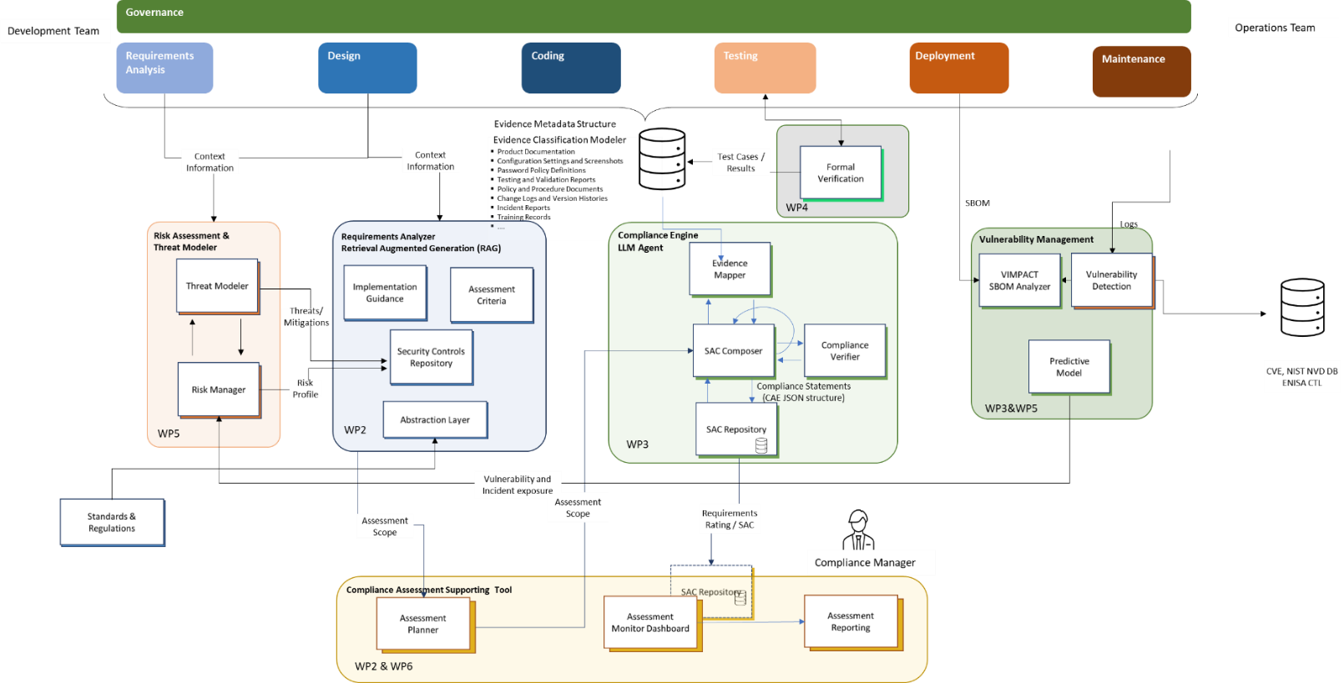

Slide 8

Certification Process
Goal: To evaluate whether a product meets the specified standard's requirements.
A certification process involves reviewing and analyzing a set of evidence to determine compliance with the specified requirements
Context analysis
Understand the characteristics and scope of the product and organization subject to the certification
Gather Evidence
Compilation and organization of the body of evidence that supports proof of compliance and map them to the requirements
Review Evidence
Analyze how each piece of evidence, along with its supporting arguments, substantiates the associated requirement
Determine Compliance
Assess the adequacy and sufficiency of the provided evidence and determine how well the requirement is being met to determine satisfaction or if there are findings that prevent compliance

Slide 9
CertifAI Assessment Methodology
Plan and Prepare
Determine standards scope
Define target objectives (SL, ML, …)
Determine organizational scope
Develop the assessment plan
Collect and organize evidence
Map evidence as a proof of compliance with requirements of the standards
Build and control body of evidence supported in a SAC
Data Gathering
Create a detailed report with findings
Include quantitative scores and qualitative insights
Suggest a roadmap for achieving full compliance
Share the assessment report with relevant stakeholders
Analyze Evidence
Report Results
Evaluate evidence in accordance with acceptance criteria
When product in operation monitor for non-compliance issues
Rate the level of compliance
Document findings

Slide 10
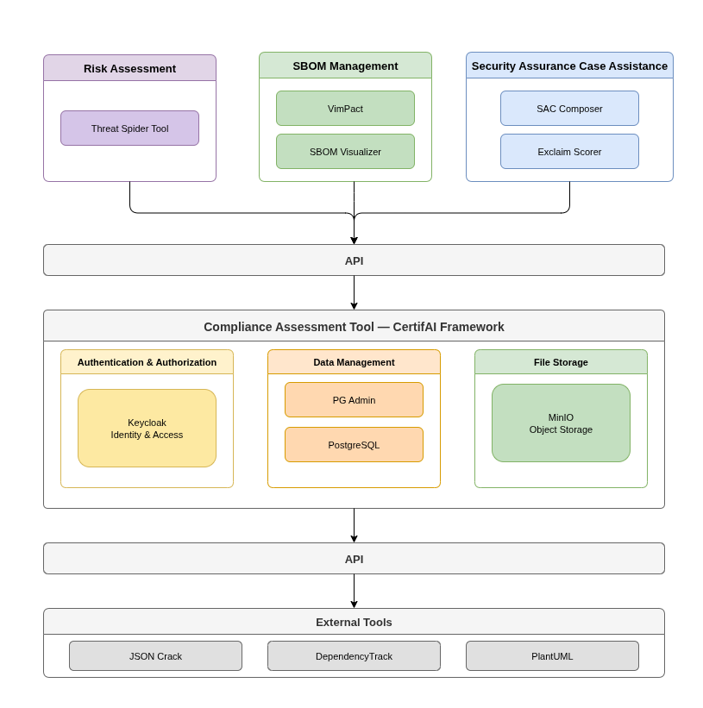
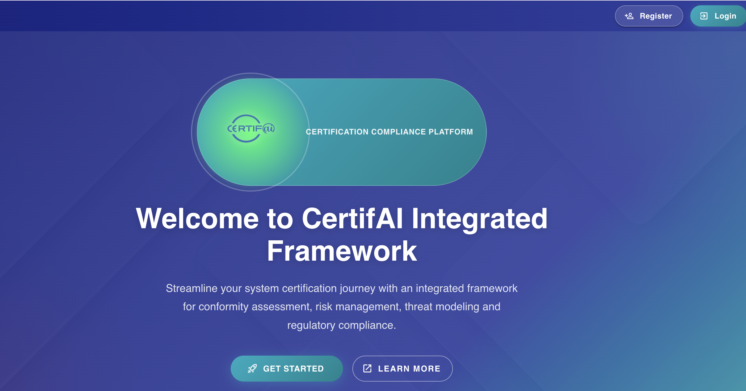
CertifAI Assessment Methodology

Slide 11
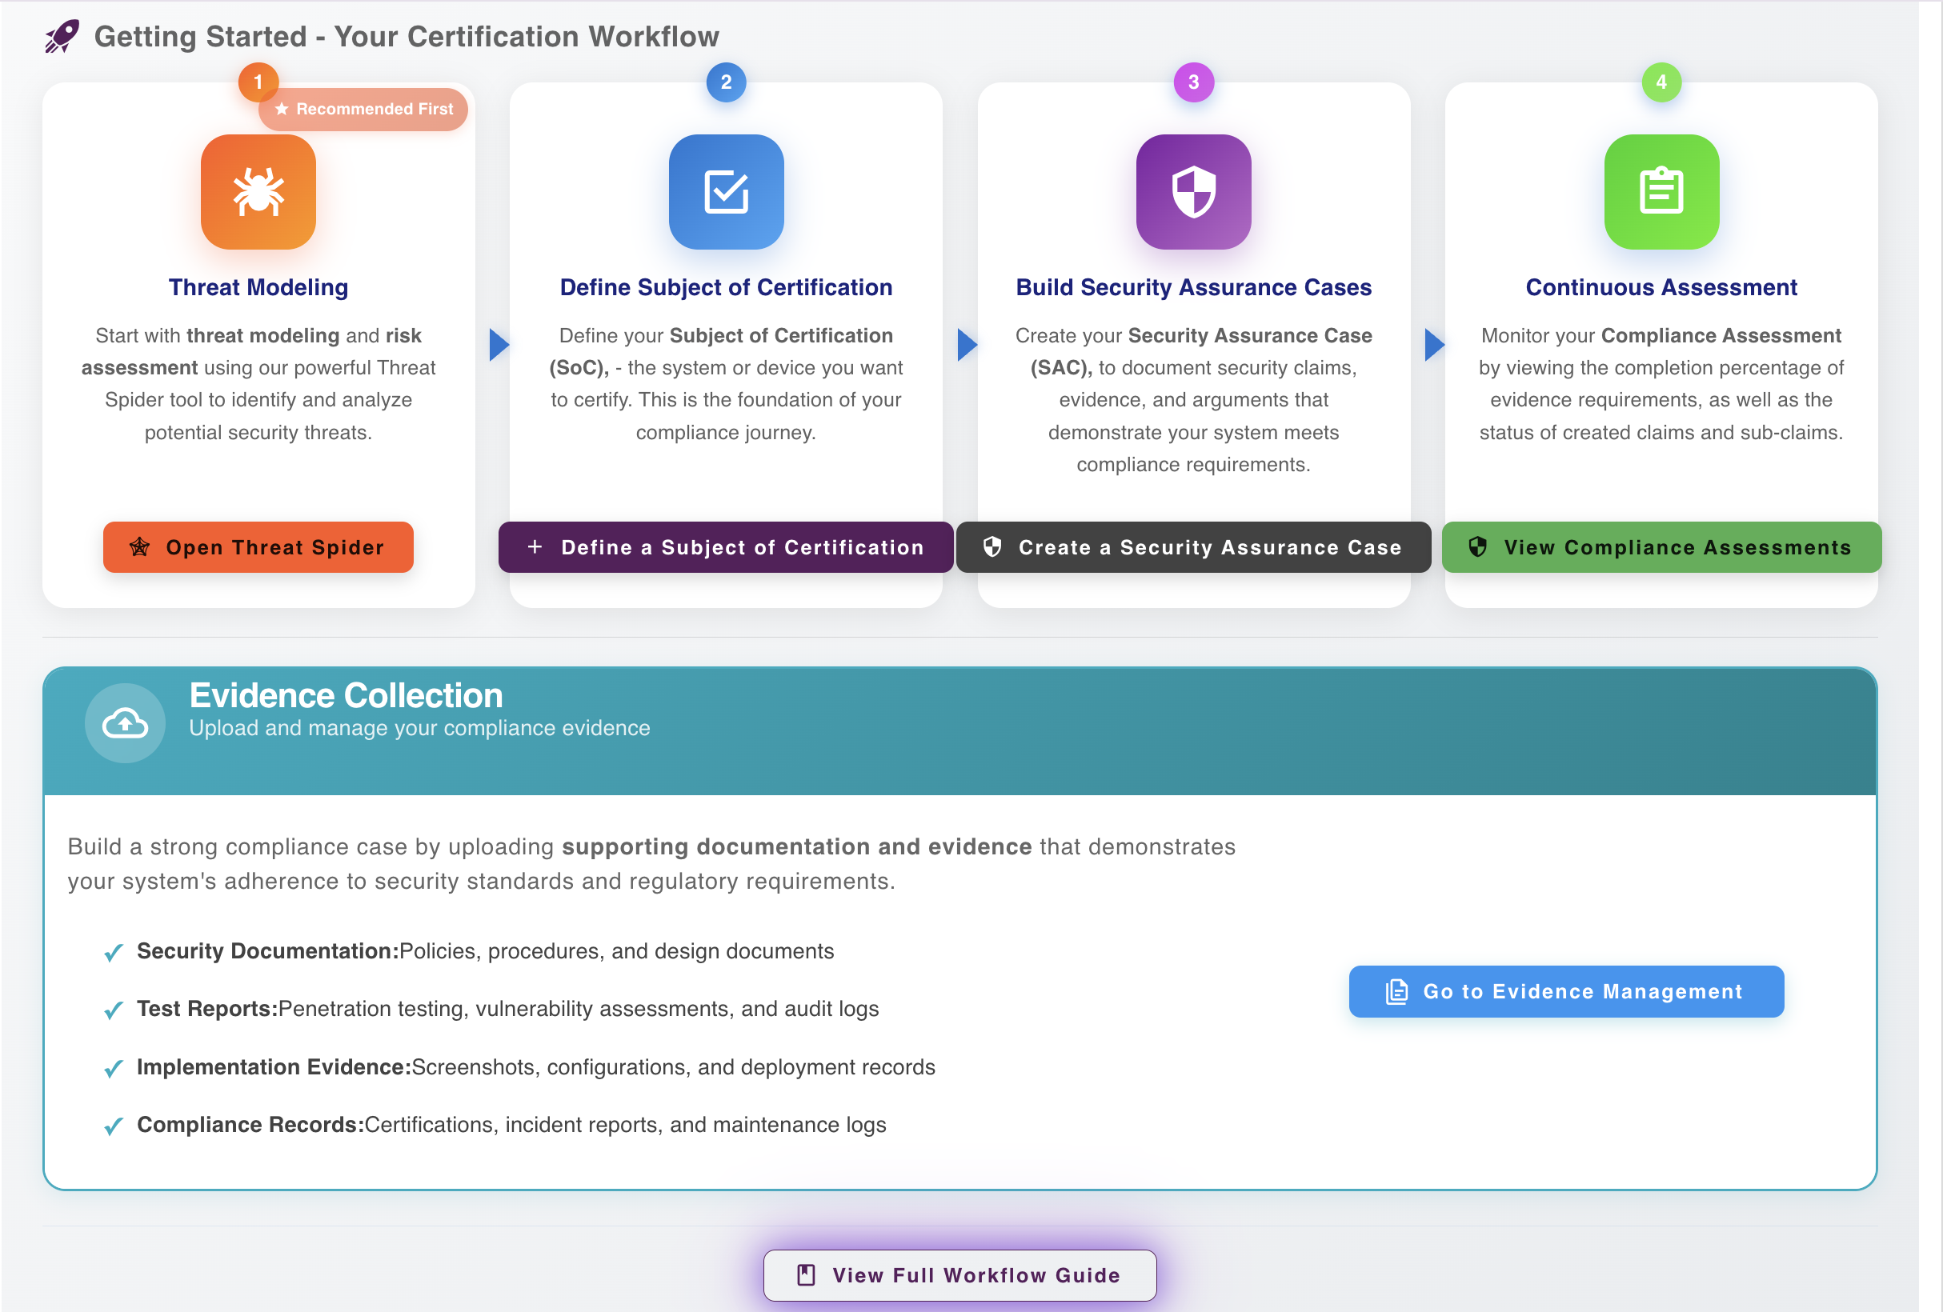
CertifAI Integrated Framework Workflow

Slide 12
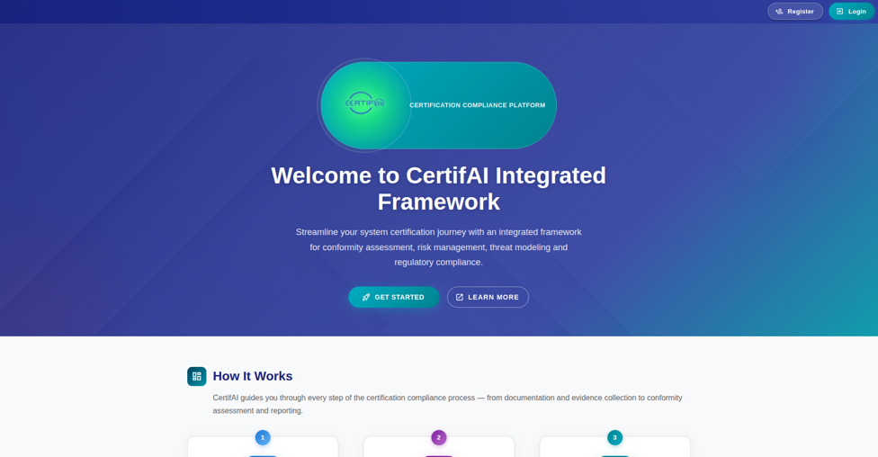
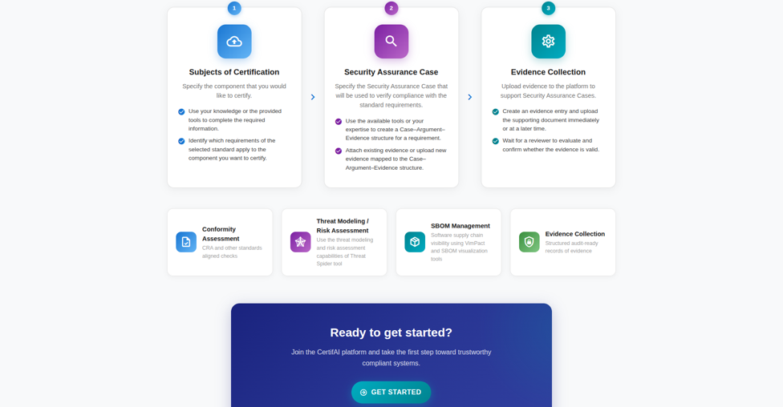

Slide 13
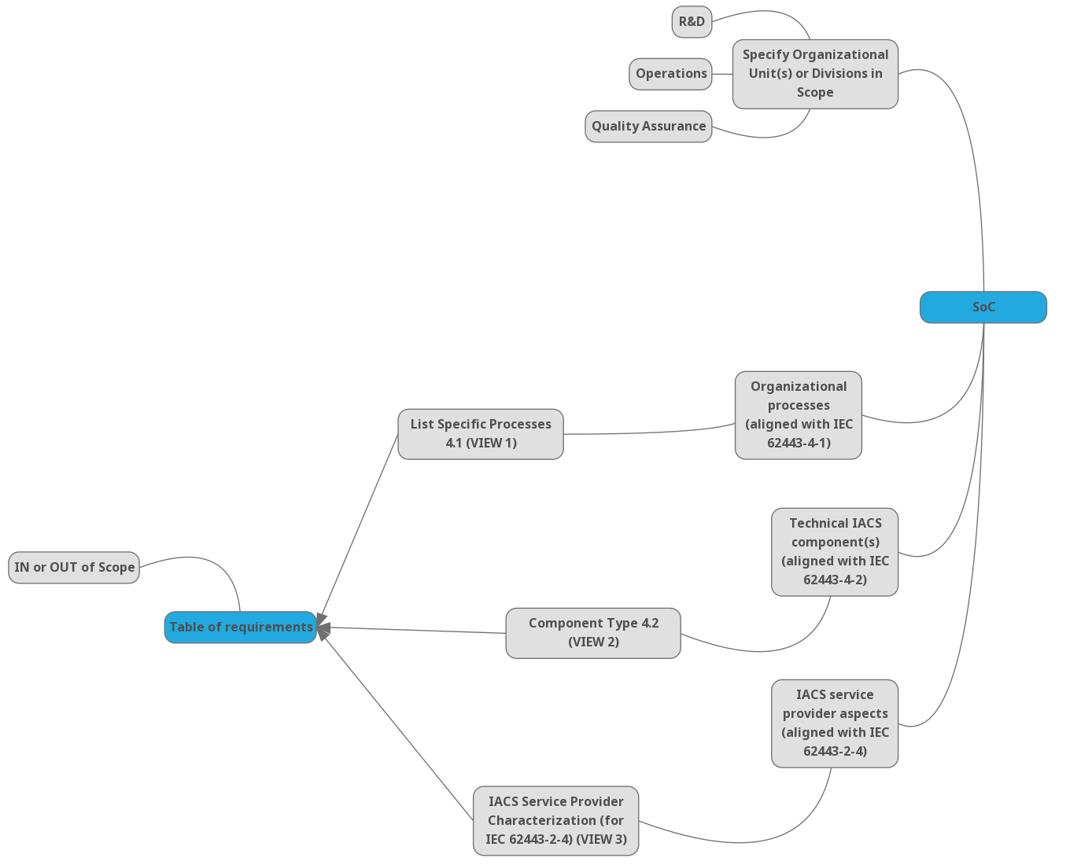
Step 1:
Define Subject of Certification

Slide 14
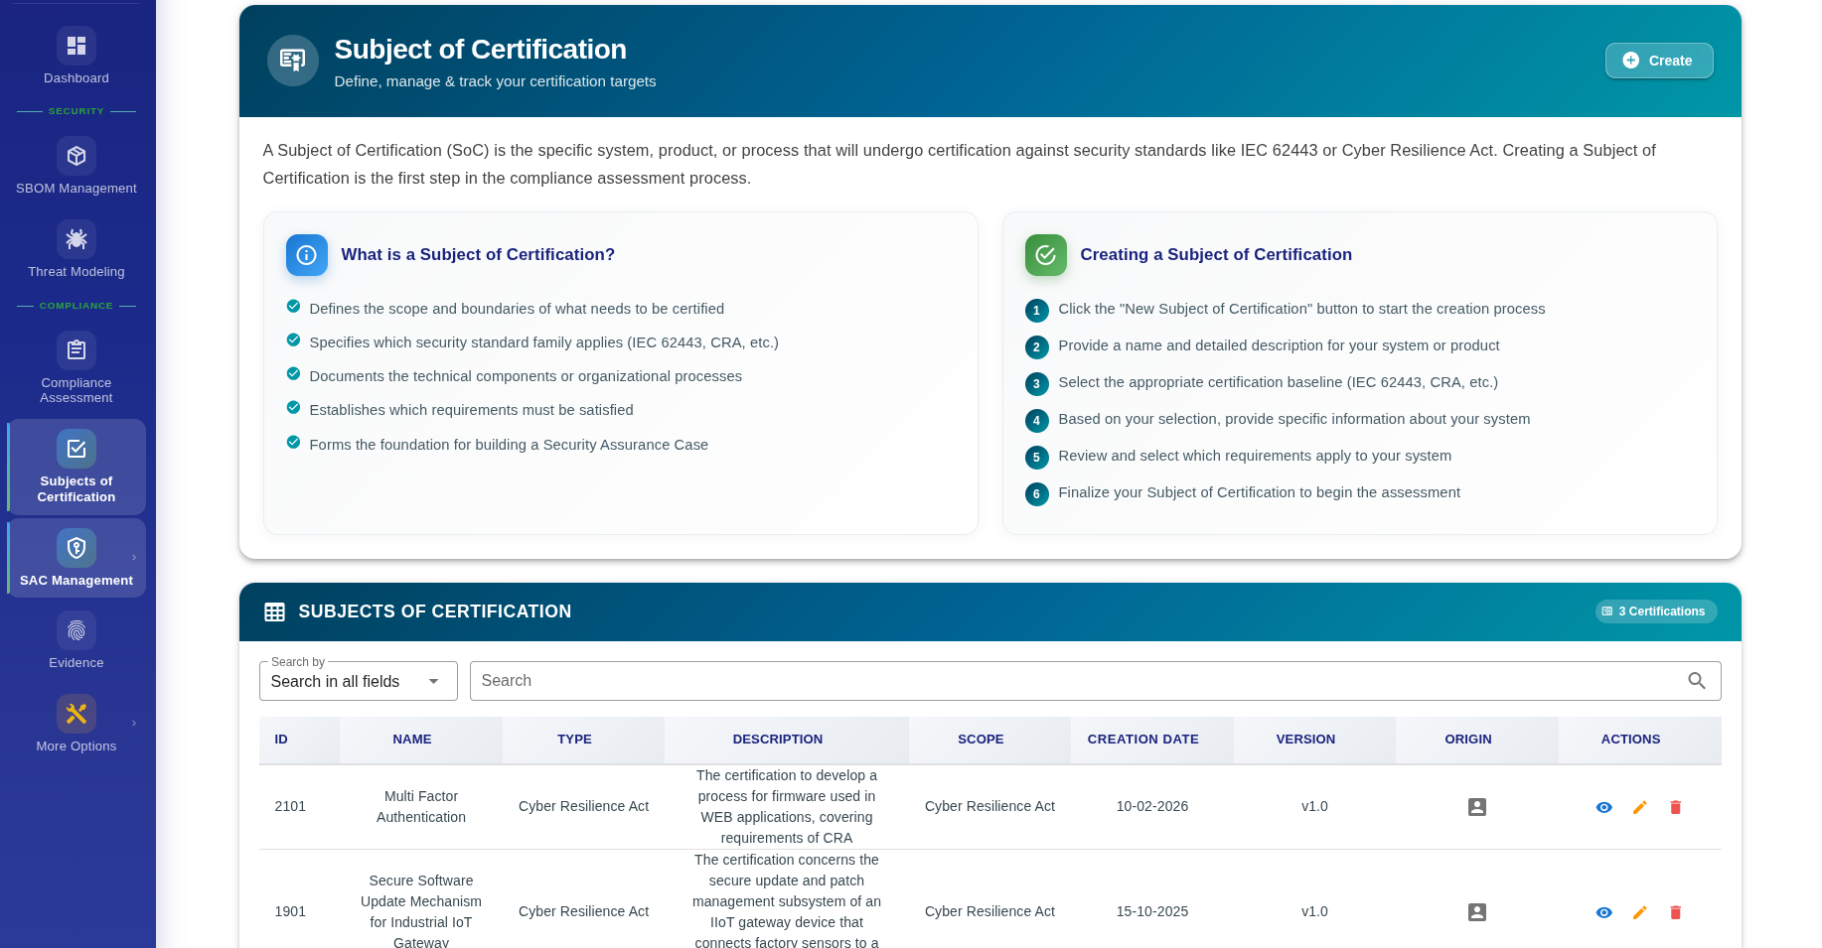
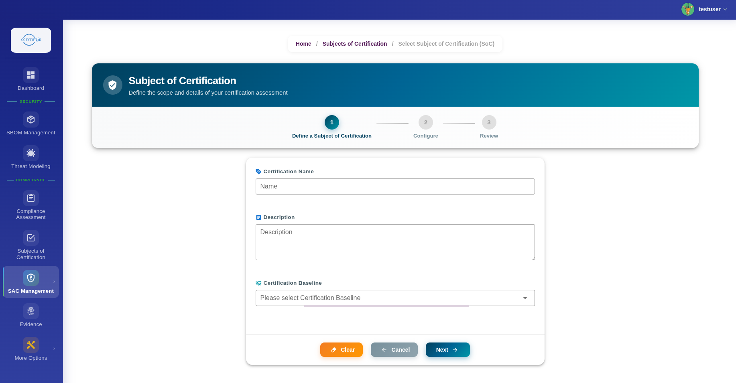
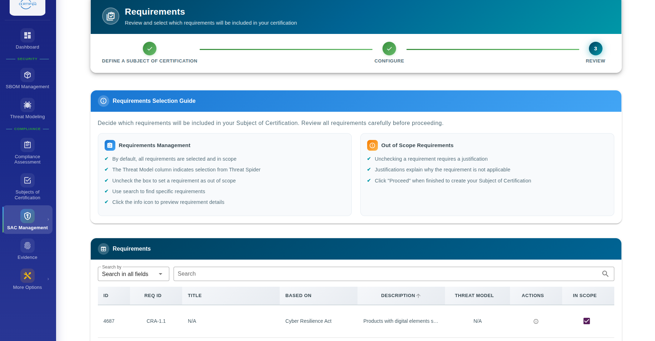
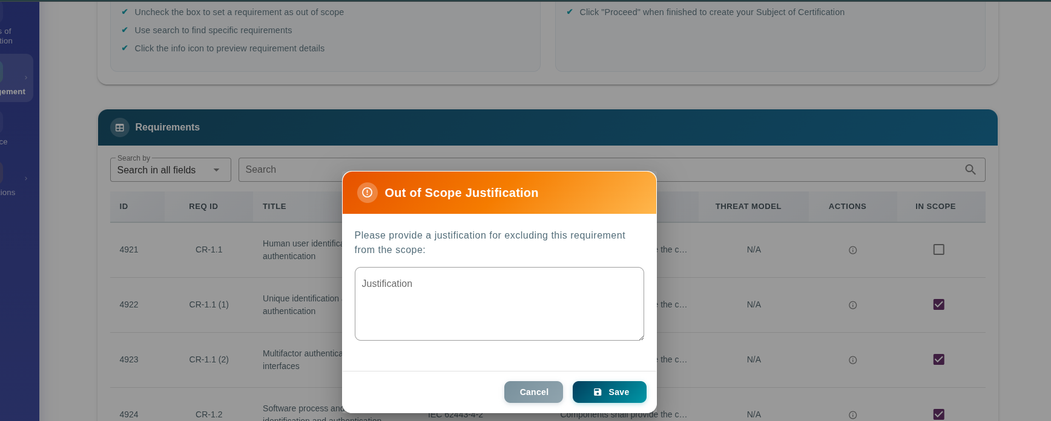
Certification Process : Subject of Verification

Slide 15
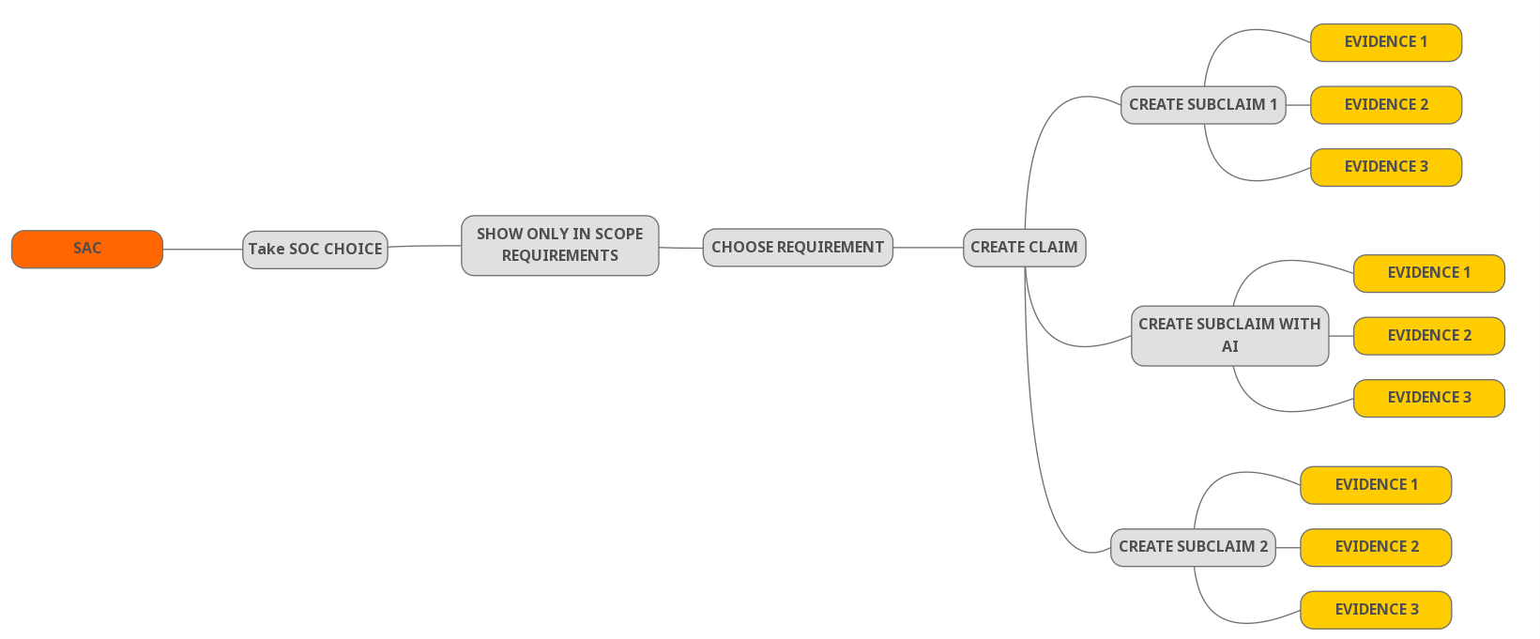
Step 2:
Define Security Assurance Case

Slide 16
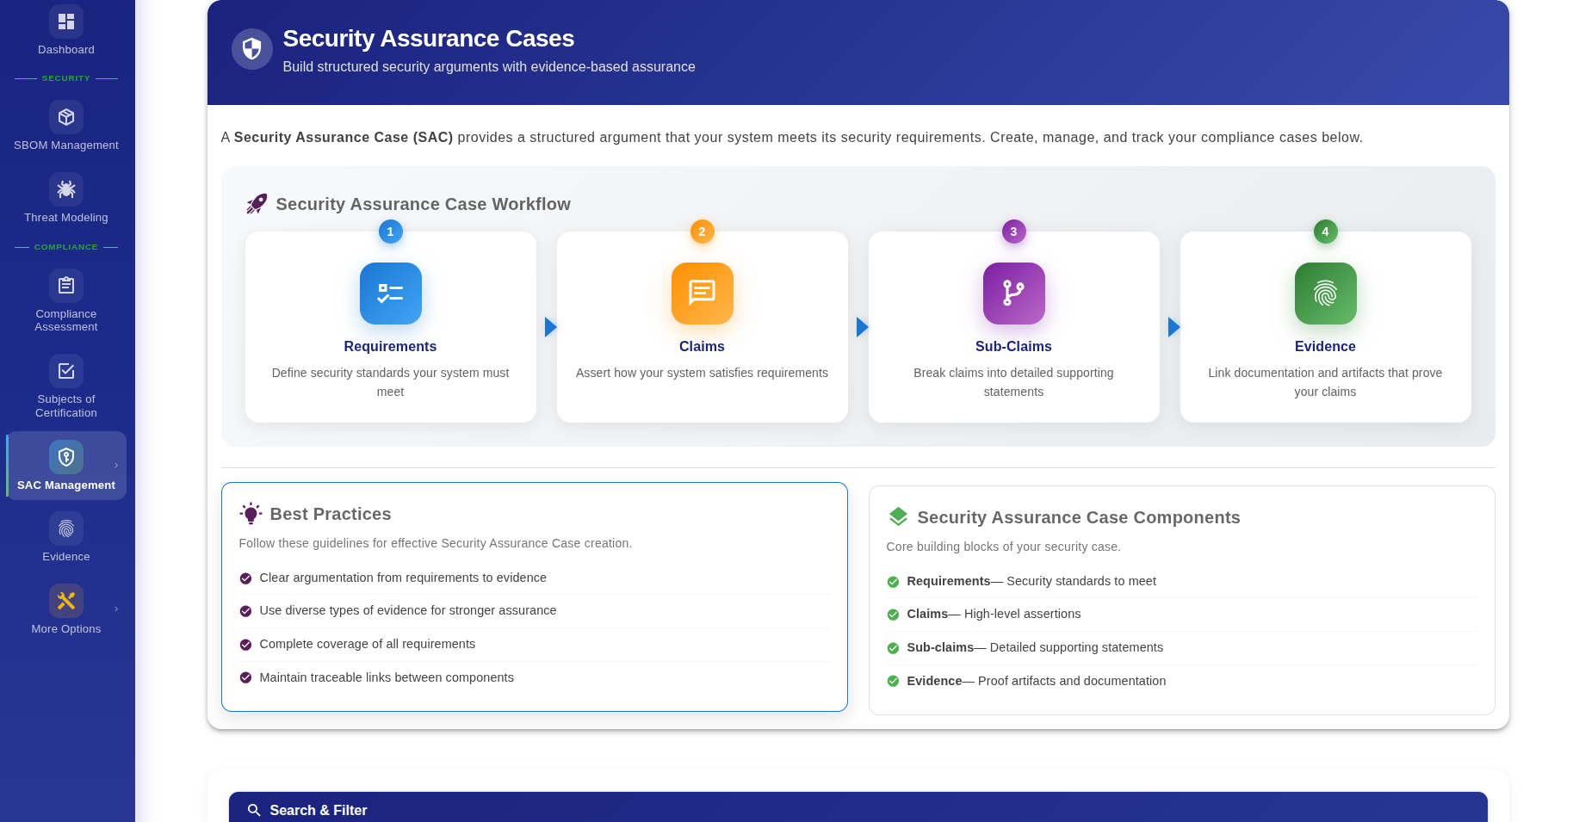
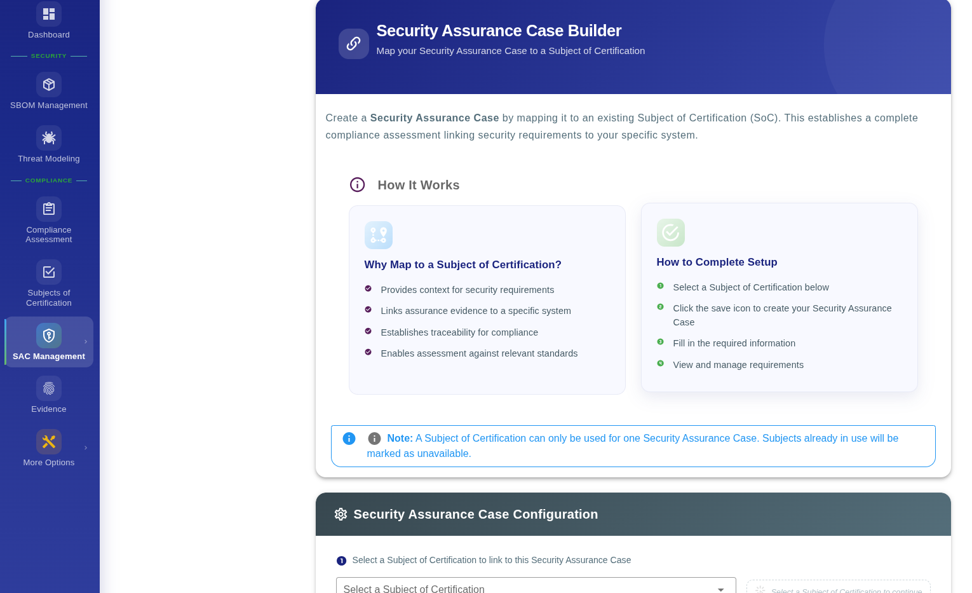
Security Assurance Case

Slide 17
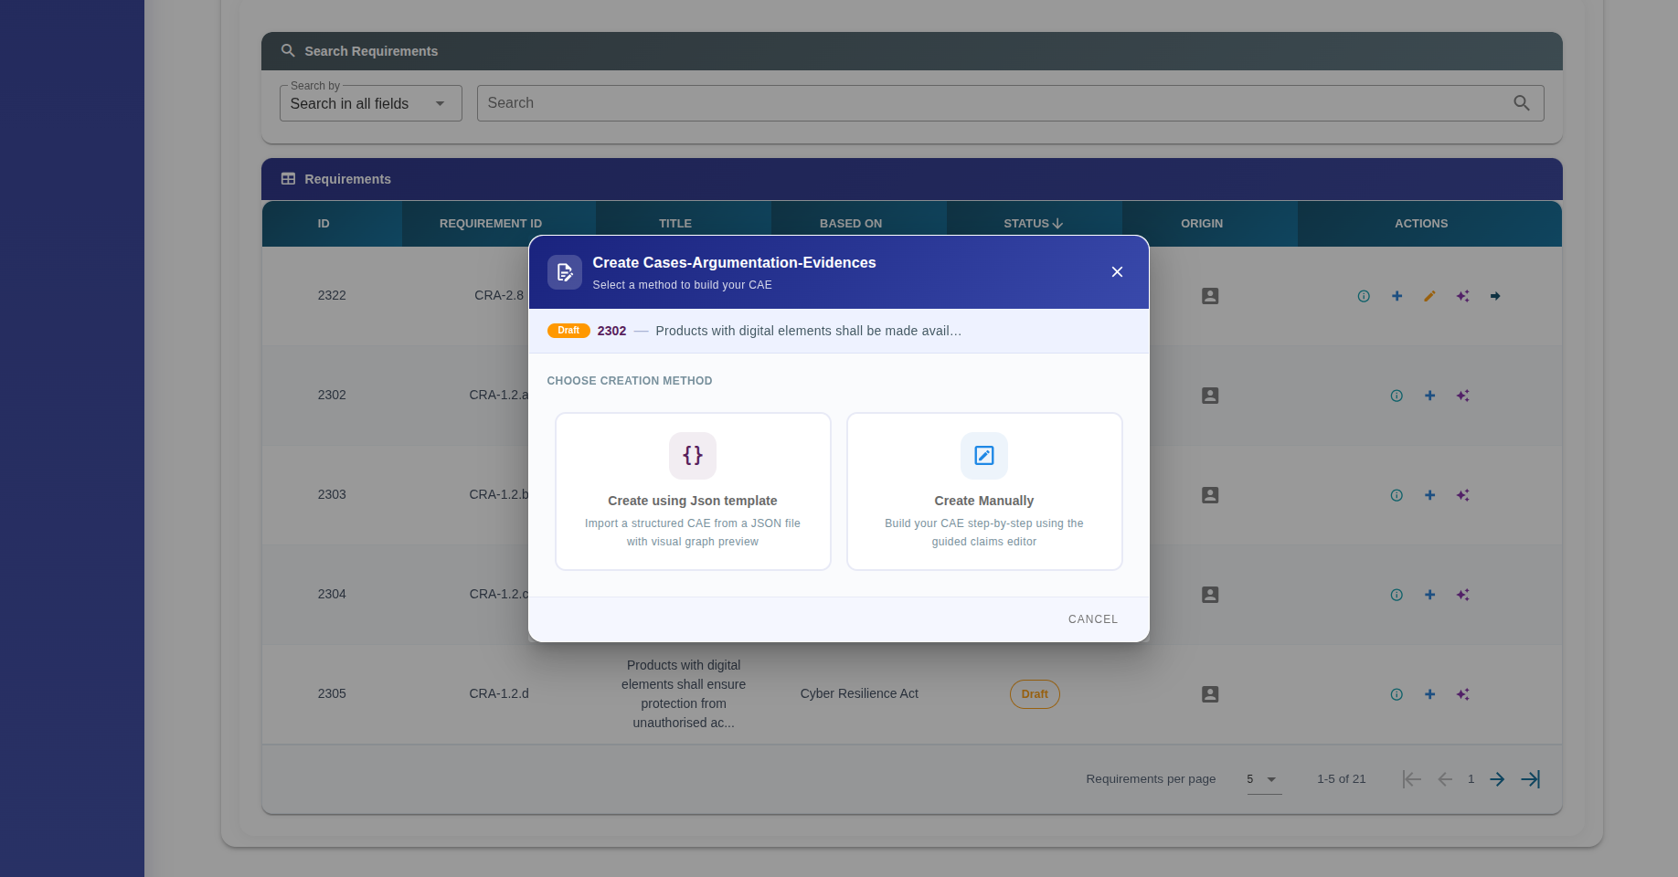
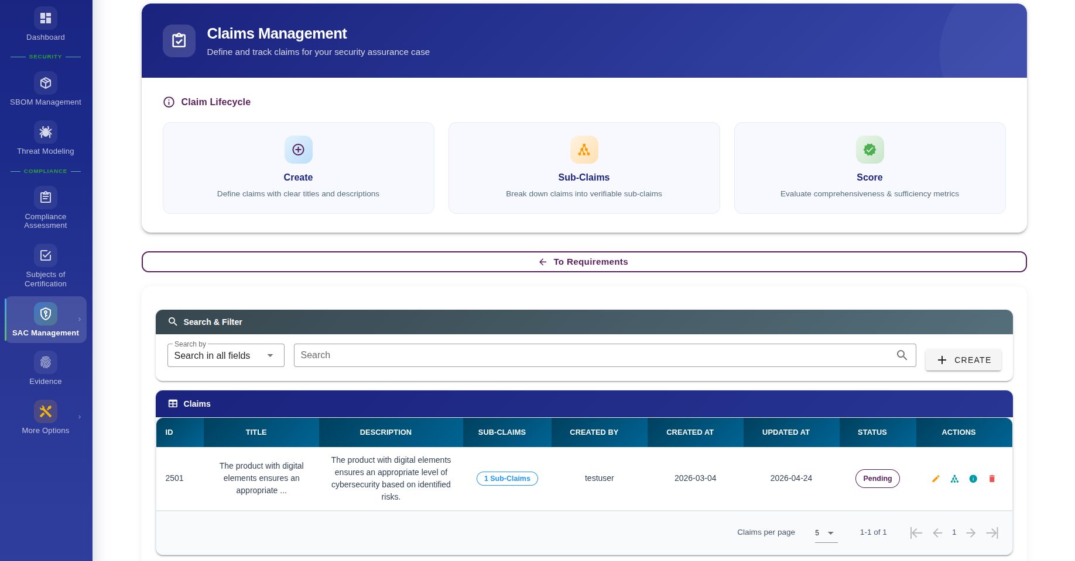
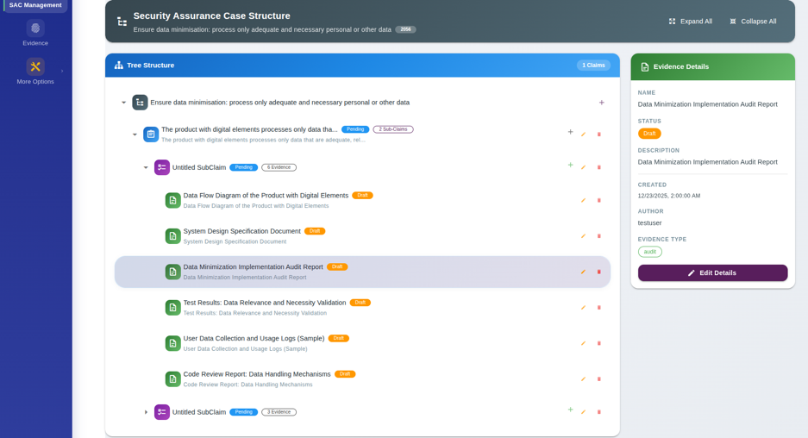
Security Assurance Case

Slide 18
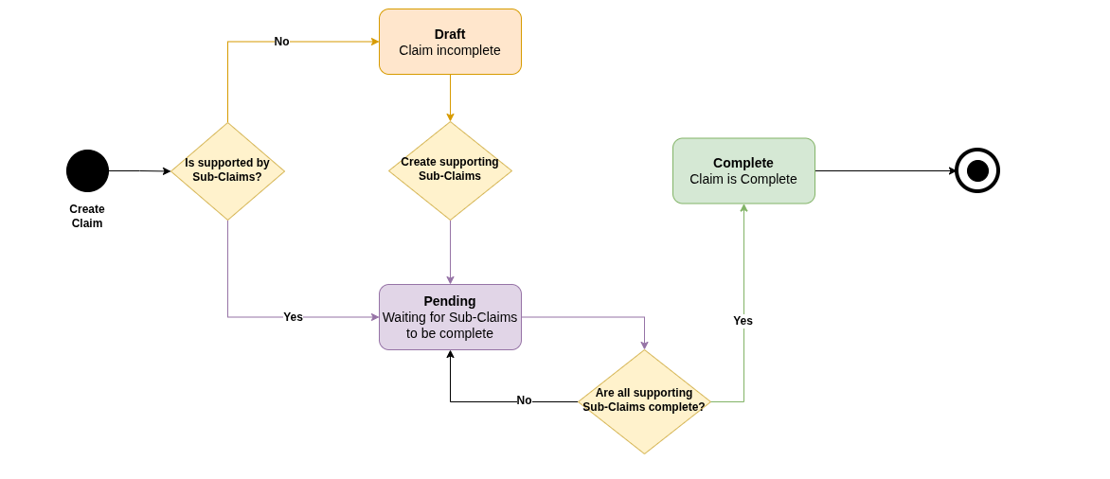
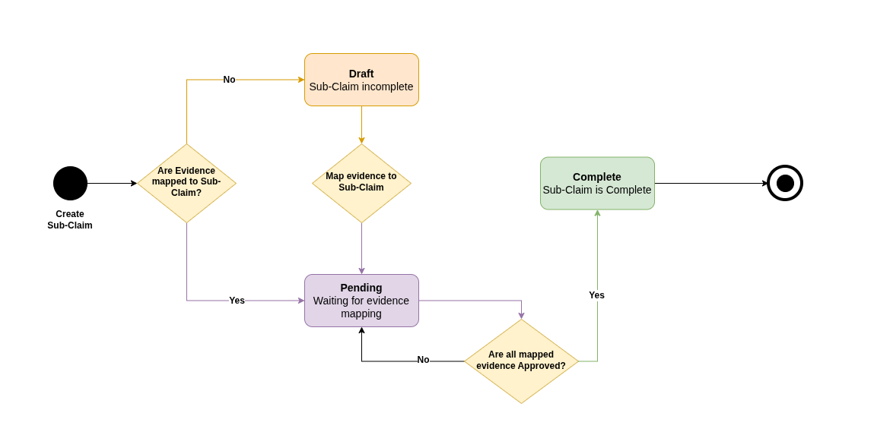

Slide 19
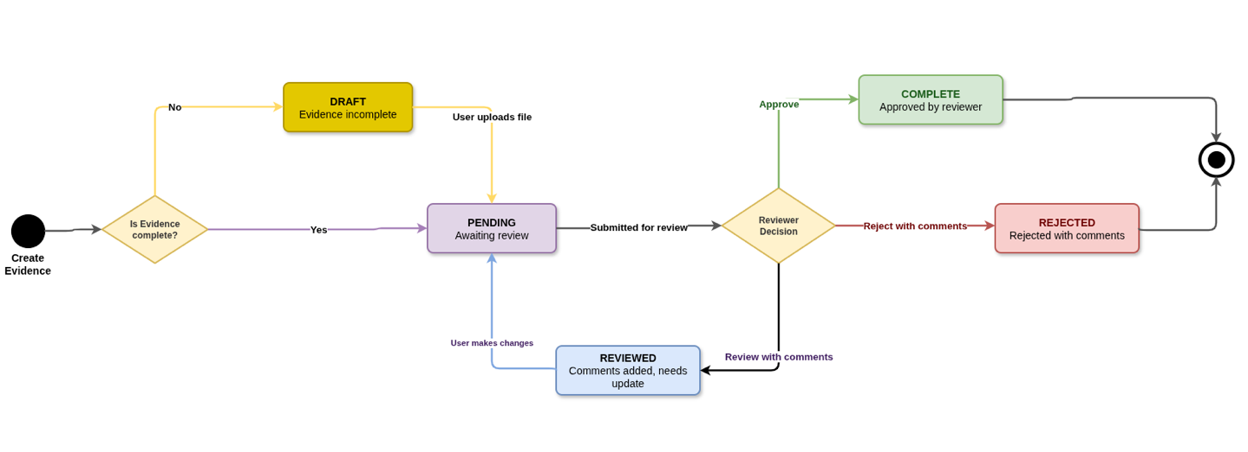
Step 3:
Analyze Data and Collect Evidences

Slide 20
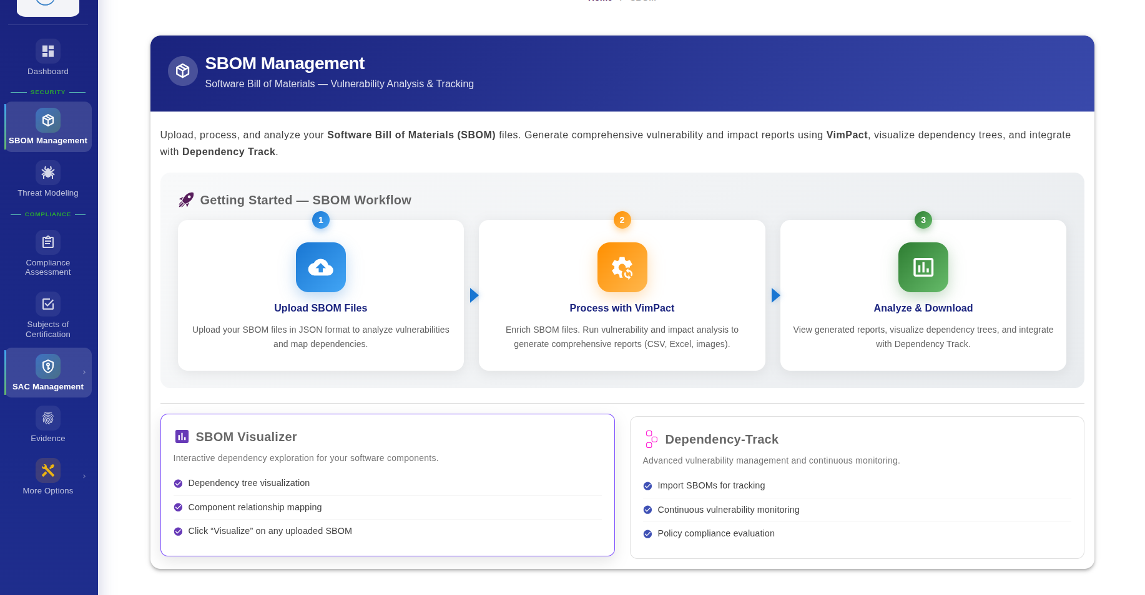
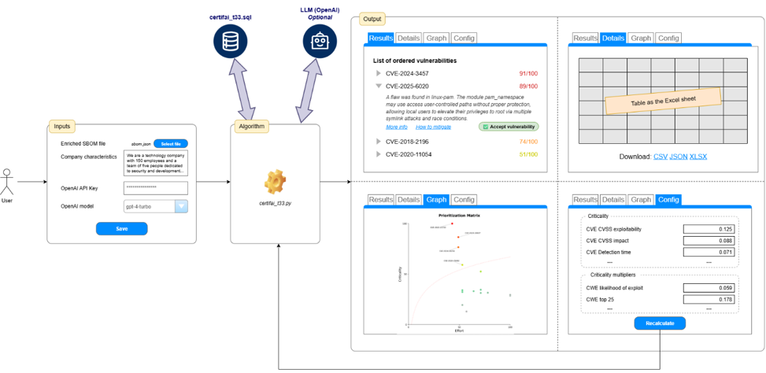
SBOM Management and Vulnerabilities

Slide 21
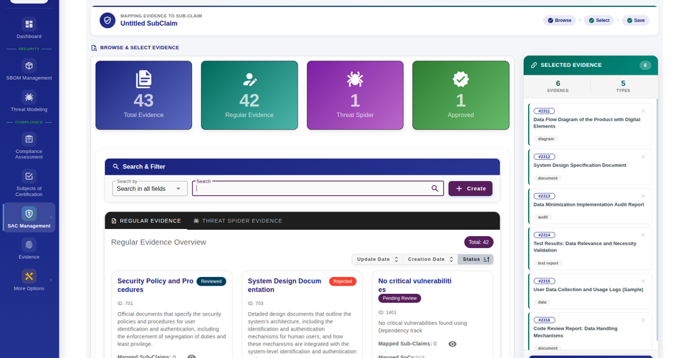
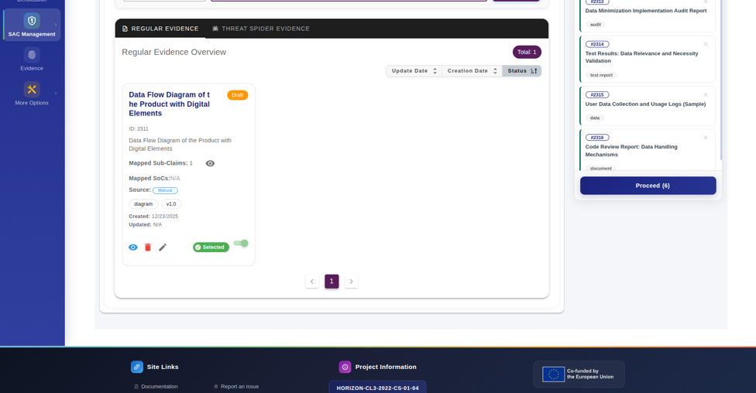
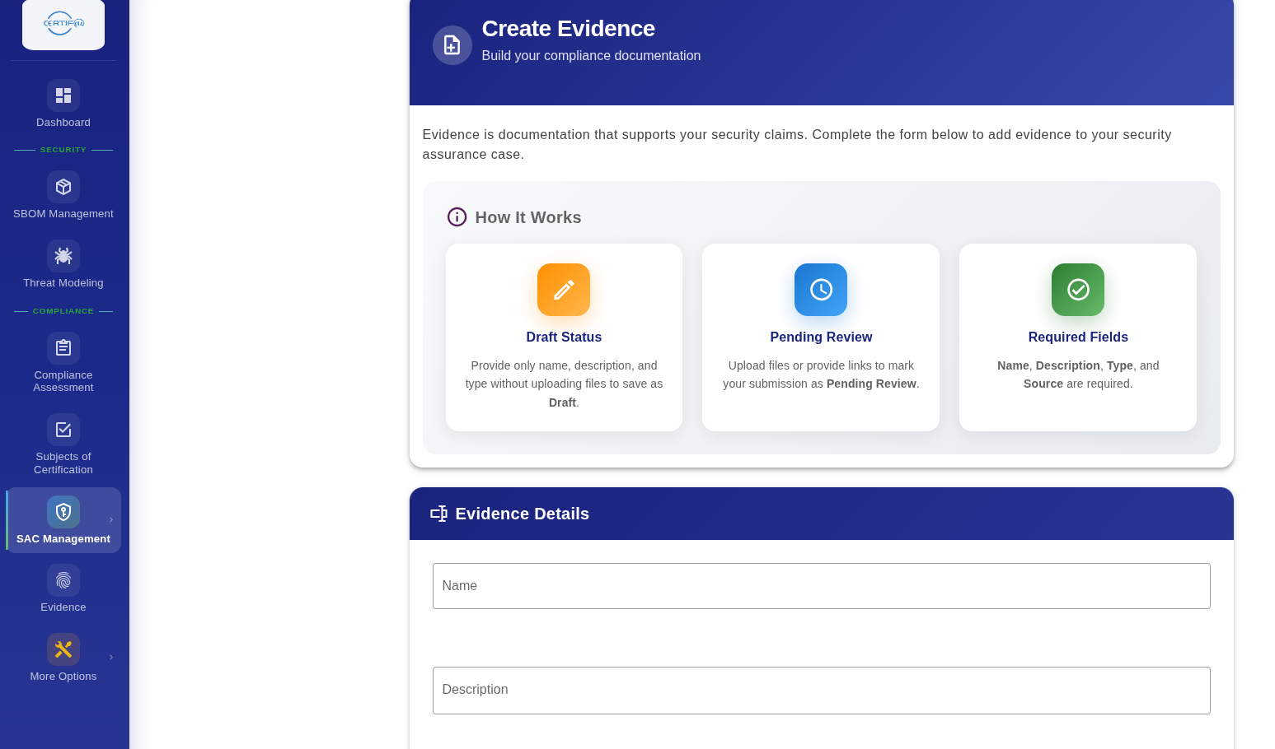
Evidences

Slide 22
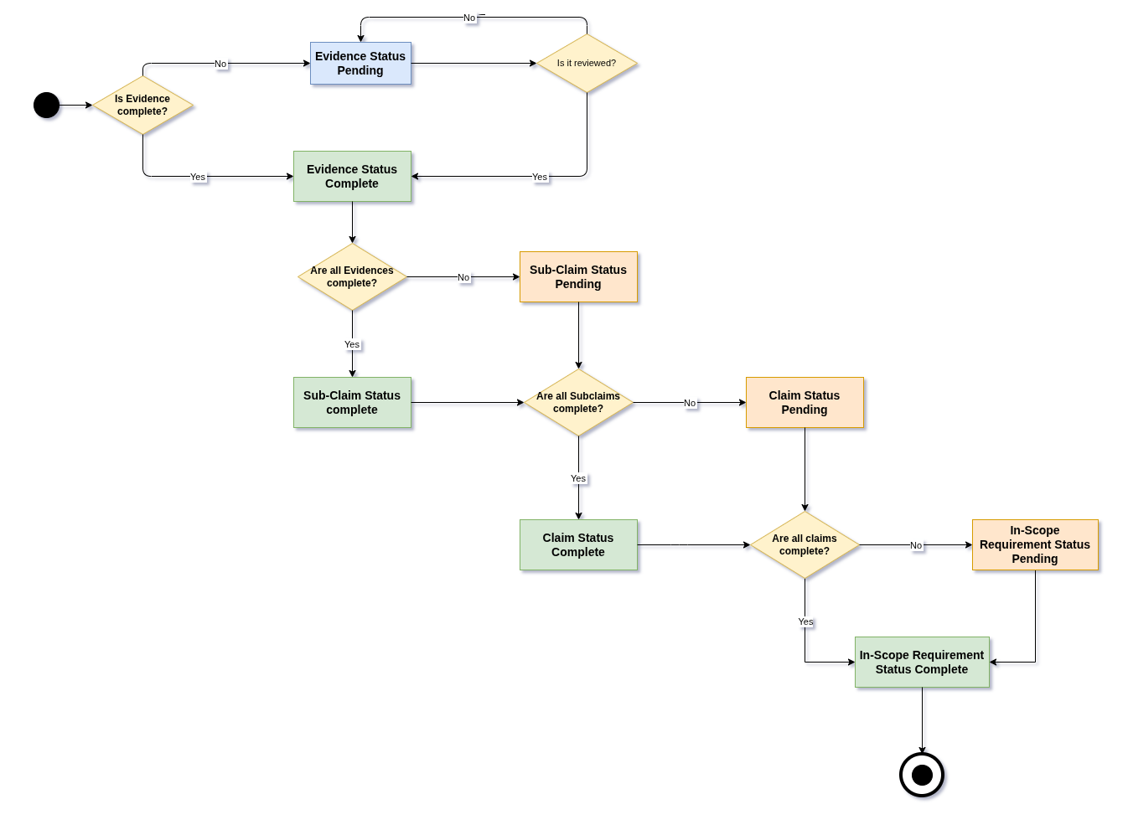
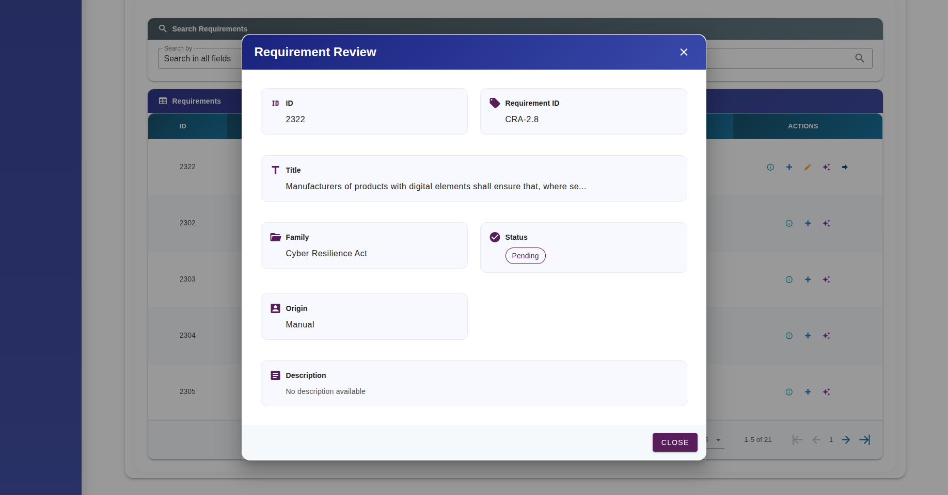
Compliance Assessment

Slide 23
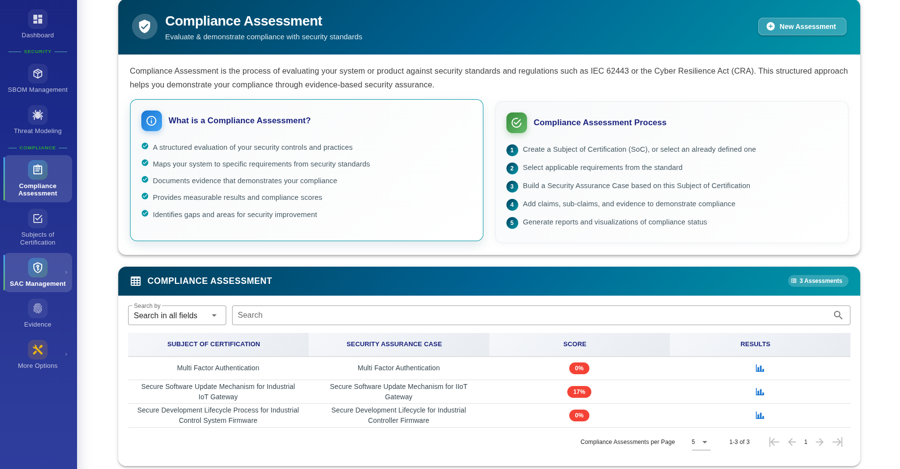
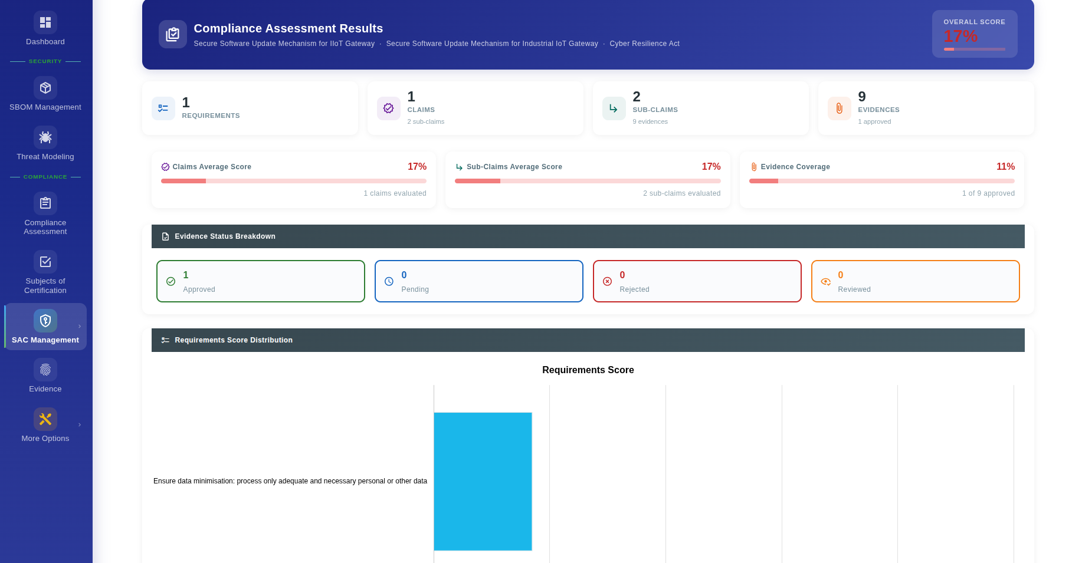
Compliance Assessment

Slide 24

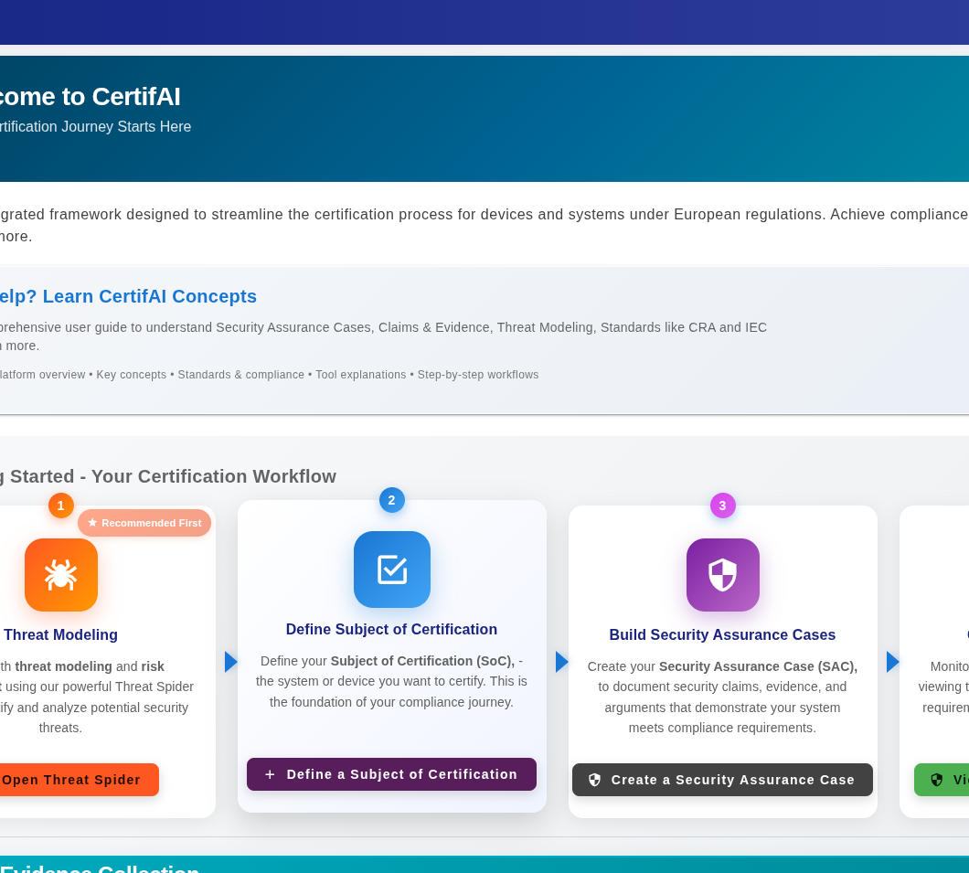
Demo Time

Slide 25
Project tools have been integrated into the framework
Easy to install process
Online sandbox version for testing
  https://certifai-ca.euprojects.net/
    Request for an invitation code or ask for a full demo session
Documentation available online
  https://certifai.readthedocs.io/
Currently under evaluation from 4 discrete use cases
Conclusion

