Slide 1
Technical Meeting - Final Conference
AI and data trustworthiness in context of conformity assessments
11 June 2026
Grandium Hotel, Prague
Per Myrseth, DNV
HORIZON-CL3-2022-CS-01-04: INCREASED CYBERSECURITY 2022
Ref. Ares(2022)8966412 - 23/12/2022

Slide 2
Key ambitions
Continuous threat & risk assessment & management
Continuous product certification and re-certification

Slide 3


Context / on the road towards
  AI drives automation
  AI makes AI and IT systems
    AI is used in lifecycle of products and systems
  AI generate data and information
    AI is used in lifecycle of data and information.
  AI perform risk, governance and compliance activities
  AI audits AI
Notes:
AI drives automation
AI makes AI and IT systems
AI is used in lifecycle of products and systems
AI generate data and information
AI is used in lifecycle of data and information. Synthetic data, generate, merge, transform and analyse data, information, visuals, logs, predictions… and adds metadata and semantics
AI perform risk, governance and compliance activities
on AI generated assets + legacy IT and OT,
and on trad operations and assets.
AI audits AI (e.g. third party audits)
based on AI generated documentation, testing, validations and compliance evaluations. AI draft the certification report.

Slide 4

Cybersecurity - game changers
Anthropic: Claude Mythos Preview.
  “it is strikingly capable at computer security tasks”
OpenAI GPT-5.4-Cyber
Google: Pentagon to use Gemini in classified government operations.
The coming decade is known as the Decade of Action for sustainability. With our customers and partners, we will make a positive impact on our priority SDGs and work towards the 1.5°C target of the Paris Climate Agreement.
These models:
  help to secure data, systems and infrastructures
  outperform defenses designed for human-scale attacks
  may represent a systemic risk
Notes:
Key sources:
Claude Mythos Preview \ red.anthropic.com April 7, 2026
Trusted access for the next era of cyber defence | OpenAI April 14, 2026
multiple sources, including Google seals Pentagon AI deal despite employee backlash MSN April 29, 2026

Slide 5
System and data life cycle, building capacity to automate and digitalize
DevSecOps
Cybersecurity management
Risk management
Compliance and Certification
Third-party audits / conformity assessment

Slide 6
Risk processes – Information – AI support
Digitalisation and automation
of risk management
IT & AI system
Trials
Risk process
steps
Cybersecurity information
AI
Certification
Data and information
Standards & requirements
Data

Slide 7
Certification processes – Information – AI support
Digitalisation and automation of
certification preparation or self-declaration
Trials
IT & AI systems
Certification process
steps
Cybersecurity information
AI
Risk
Data and information
Standards & requirements
Data

Slide 8
What to trust as evidence in a product audit?
Risk management
Certification preparation or self-declaration
AI
AI
Provider or user
Risk
Certification
Data
Data
Risk management file
Documentation
AI
Auditor
AI and data driven audit and continuous assessment
Audit process
Data

Slide 9
Automating product life cycle & GRC processes
Driver less
Provider
DevSecOps AI
AI
Mind off
Process
Eyes off
Data
GRC Digitalisation & automation
Hands off, eyes-on
Hands on, AI support
Auditor AI
AI
Digitalisation &
automation
Process
Data
Levels of automation inspired by J3016_202104 - Taxonomy… Driving Automation Systems…. Road Motor Vehicles
Notes:
Inspired by :
J3016_202104 - Taxonomy and Definitions for Terms Related to Driving Automation Systems for On-Road Motor Vehicles

Slide 10
Risk methodology process and risk scopes
Risk process steps | Product risk | Organisational risk | Value chain and societal risk
Scope, context and criteria. intended use
Risk Identification. vulnerabilities, threats and hazards, cybersecurity intelligence
Risk Analysis estimation, likelihood, consequences
Risk Evaluation, compare with risk criteria
Risk Treatment, Choose treatment and implement. Controls will reduce, maintain or monitor likelihood or consequences of identified risk.
Recording & Reporting of risk internally and externally. Could be reporting APIs.
Monitoring & Review. Of the risk processes and quality of risk management
Communication & Consultation
Testing, verification and validation, all life cycle steps, all risk processes
Premarket and postmarked activities, including logging
Risk related to:
Quality characteristic on model, data, system, DevSecOps environment.
Product life cycle phases
Product quality management system
Incident mngt. prepare, identify, detect, mitigate, recover
Risk related to:
Organisational capabilities, processes and resources.
Management system, 27001/42001
Risk and incident mngt. prepare, identify, detect, mitigate, recover
Risk related to:
Value chain capabilities, resilience, processes and resources.
“Management system, 27001/42001” interplay
Risk and incident mngt. prepare, identify, detect, mitigate, recover
Expectation's
Risk aggregation
AI Act + CRA
e.g. Resilience of critical
entities (CER)
AI Act + CRA
e.g. NIS II

Slide 11

Don’t expect perfect information, knowledge or predictions dealing with:
Main processes states and performance
Governance
Risk management
Compliance
Information security, cybersecurity
  Asset inventory + shadow IT and AI
  Threat intelligence
  Vulnerability analysis
  Incident analytics
  ….
Notes:
Bildet er generert av MS copilot av Per Myrseth

Slide 12
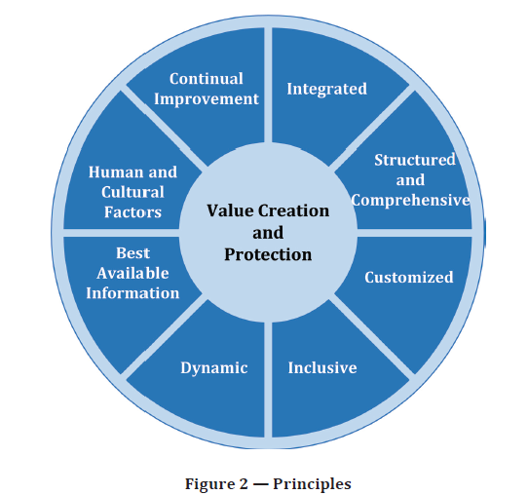
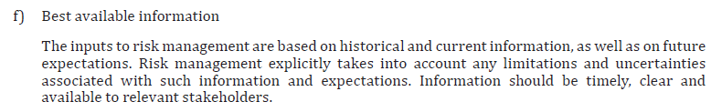
Best available information
Risk management and certification
are continuous information
refinement processes
ISO 31000 Principles

Slide 13

Mitigate
Start easy, take what you have.
Utilize AI to establish and improve the information
Add AI system quality characteristics
Add data and information quality characteristics
Add uncertainty characteristics and quantification
Add assumptions
Define thresholds, monitor, manage
Analyze & identify what improvement that matter the most, investigate sensitivity to quality characteristics
Real world
is biased
DNV & Per Myrseth
Notes:
Copyright, bildet er tatt av Per Myrseth, til fri bruk av DNV.

Slide 14
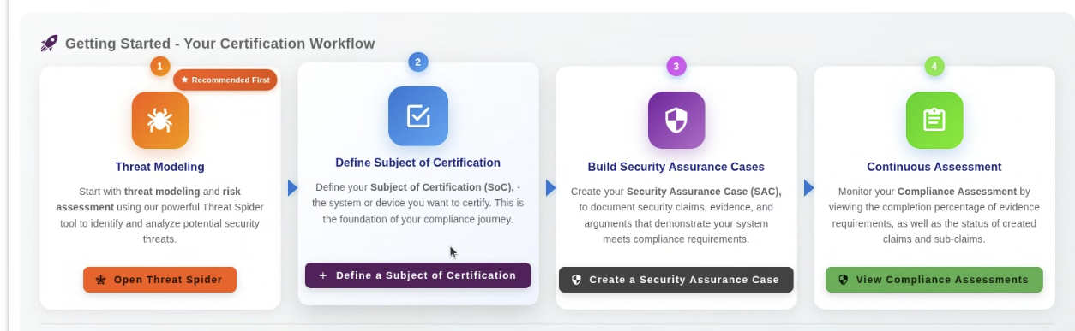
CertifAI: Example of tool deliverables

Slide 15
Key learnings
      Automation: Evidence and trust changed
      AI audits AI
      New risk to be managed
      New quality characteristics to be managed
      Rapid technology changes
      AI DevOps AI
      Data & AI governance, risk and compliance is the new survival capability
      Human risk and governance competence is a competitive advantage

Slide 16

Thank You
Human brainpower
is still relevant when AI audits AI

Slide 17
AI and data trustworthiness in context of conformity assessments
Expetations and limits
Per.Myrseth@dnv.com DNV Research. Norway

Slide 18
Human brainpower is still relevant when AI audits AI
Per.Myrseth@dnv.com

Slide 19

Governance, risk and compliance information
What do we know
What do we don’t know
How to map and measure what we know
How to measure what we lack and don’t know
DNV & Per Myrseth
Notes:
Copyright, bildet er tatt av Per Myrseth, til fri bruk av DNV.

