Slide 1

CertifAI Final Conference-Prague JUN 2026
Project Overview
Jose Arias – Tecnalia
HORIZON-CL3-2022-CS-01-04: INCREASED CYBERSECURITY 2022
Ref. Ares(2022)8966412 - 23/12/2022

Slide 2
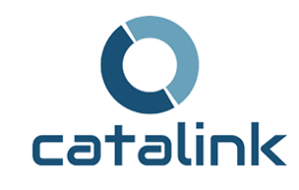



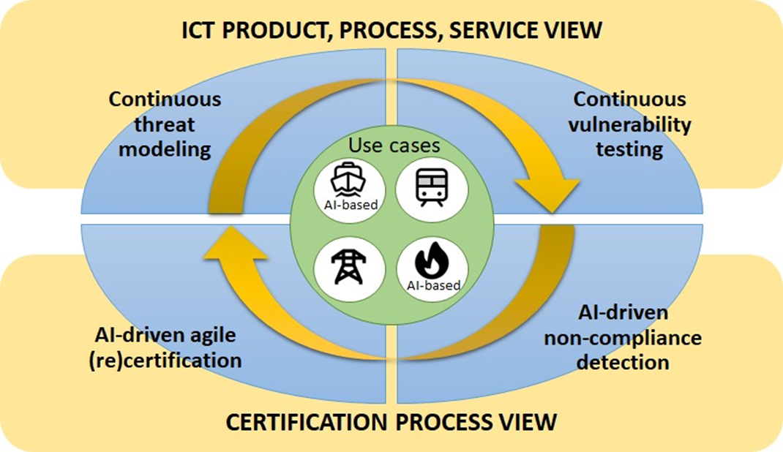







The Consortium

Slide 3

CertifAI DoA Objective
The CertifAI project will develop an open software framework for cost-effective AI-driven continuous assessment and (re-)certification of ICT products, processes and services, paving the way for a more secure and trustworthy EU’s digital world. Building on the EU Cybersecurity Act, CertifAI will leverage the established cybersecurity requirements, standards, and technical specifications (IEC 62443 and EU CRA) to deliver an efficient approach for ensuring that a product, once certified, will continue to be compliant with relevant standards throughout its life cycle.

Slide 4

Regulatory alignment
Built on the EU Cybersecurity Act and emerging regulatory pressure
Project Ambition
Standards-based
Develop a framework for cost-effective, AI-driven continuous assessment and (re-)certification of ICT products, processes and services — paving the way for a more secure and trustworthy EU digital world.
IEC 62443 and the EU CRA as reference standards and regulatory frameworks
Continuous compliance
Sustained throughout the full product lifecycle, not only at a single point in time
Less manual effort
Reduce the cost of certification and re-certification

Slide 5





Why continuous certification is so hard
Complex standards
Fragmented evidence
Compliance is not static
Cybersecurity standards are dense and difficult to operationalize into concrete checks.
Certification evidence is scattered across tools, documents, repositories and processes.
Products evolve after certification — compliance must be continuously re-established.
Many moving parts
Trust & oversight
Requirements, risks, controls, evidence and assurance arguments must stay aligned.
AI can help, but certification still demands human judgement.

Slide 6
What is an assessment?
An assessment is a structured process to determine how well a system, product, or organization conforms to a defined set of requirements—for example, IEC 62443 or the CRA. It involves gathering information and artifacts, comparing them against criteria, judging the degree of conformity, and documenting both strengths and gaps. In other words, an assessment is the disciplined act of asking: “Given this standard and this context, are we doing what we are supposed to do—and can we prove it?”
Other terms: evaluations, audit, appraisal, inspection, compliance review, …

Slide 7







CertifAI Approach
A connected workflow that turns standards and evidence into structured, traceable certification readiness.
Requirements
Interpret & Consolidate
Risk Analysis
Threat Modeling & Risk management
Assurance Case
Structured CAE Argumentation
Evidence
Link claims to artifacts
Validation
Check structure & gaps
Readiness
Audit-ready dossier
CertifAI supports, does not replace, certification readiness and continuous compliance — it structures requirements, evidence, risks and assurance arguments so that experts and certification bodies can work faster and with full traceability.

Slide 8
What is a CertifAI Compliance Assessment?
Starts from the product context: SoC (Subject of Certification) /ToE (Target of Evaluation) scope, architecture, assets, zones/conduits, intended use, SL-T, etc.
Builds a threat & security control picture: links assets to threats (MITRE ATT&CK/ATLAS/EMB3D) and mitigations to relevant IEC 62443/CRA requirements
Operationalizes requirements into granular, “testable” acceptance criteria tied to SAC claims
Populates and maintains a Security Assurance Case (SAC): Claim–Argument–Evidence chains with real artifacts (SBOMs, scans, tests, logs, procedures) that show why the SoC/ToE is (or is not) compliant with regulatory requirements.
Ensure that assessment are Repeatable and Reproducible
    Controlled evaluation criteria, defined conformance evidence types and clear procedural steps
    LLMs Interpretation variability

Slide 9
Assessment Scenarios
1️⃣ Embedded in the Product Lifecycle (Proactive)
  Assessment runs alongside the SDLC / DevSecOps principles
  Evidence is generated as the product is designed, built, tested and operated
  The Security Assurance Case is continuously updated → supports continuous compliance & CRA/IEC 62443 readiness
2️⃣ Stand-Alone Assessment (After the Fact)
  The assessment is used as an independent evaluation step
  Applied to a product already designed / deployed
  Existing artifacts/evidence (threat models, SBOMs, scans, logs, docs) are ingested to reconstruct the argumentation and determine current compliance status
3️⃣ Assessment type
  Gap analysis – initial snapshot of compliance and missing controls.
  Certification preparation – structured path to be “audit-ready”, with evidence mapped to clauses.
  Continuous compliance – repeated / automated checks as the product and its environment evolve.

Slide 10
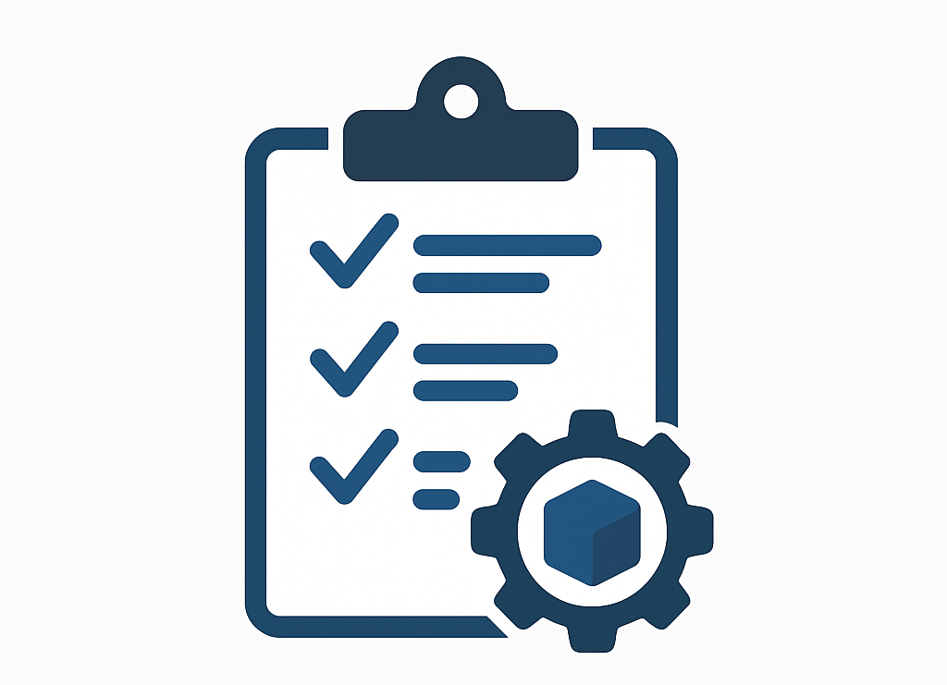


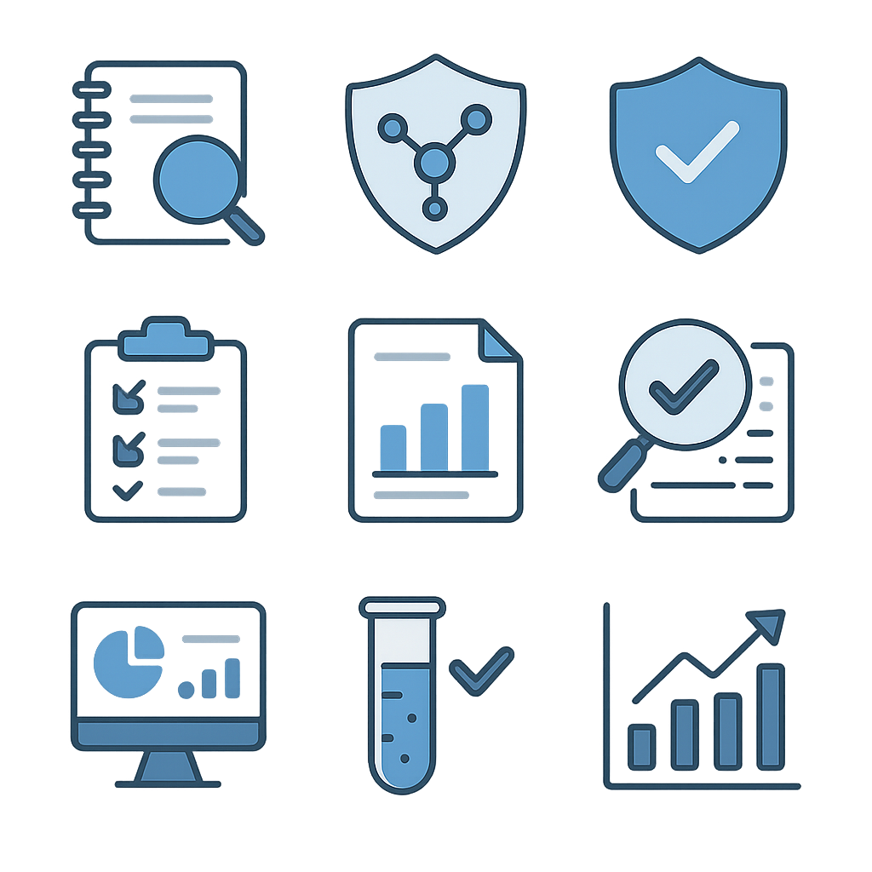
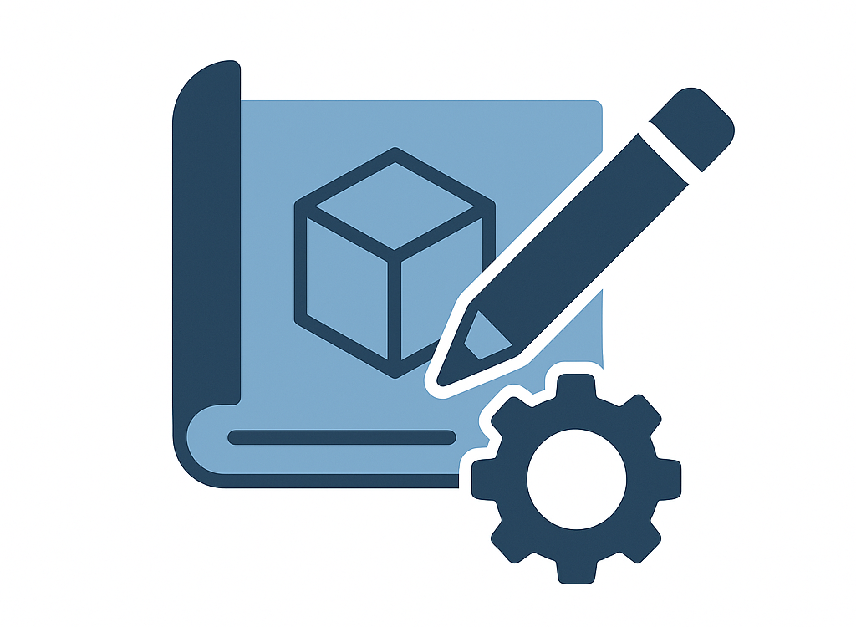
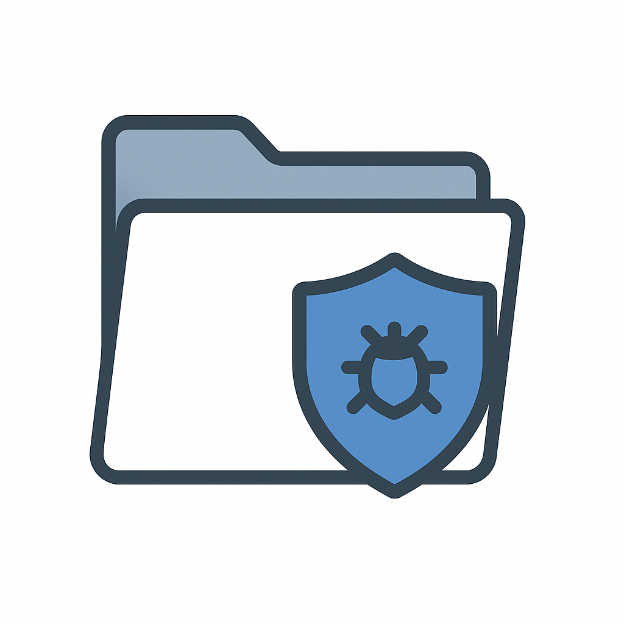


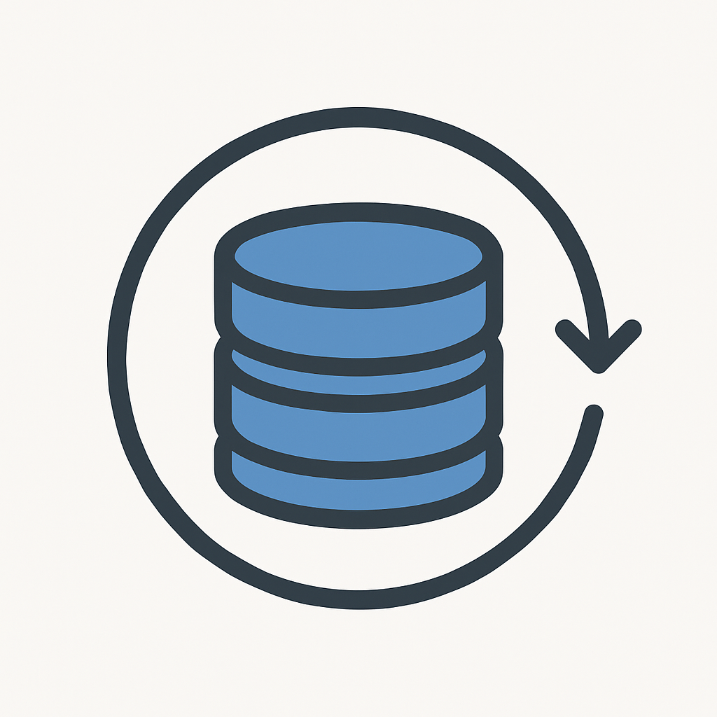
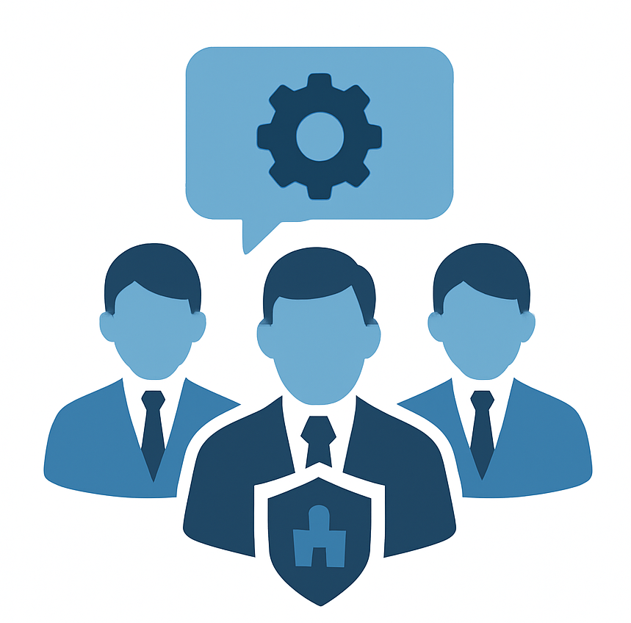
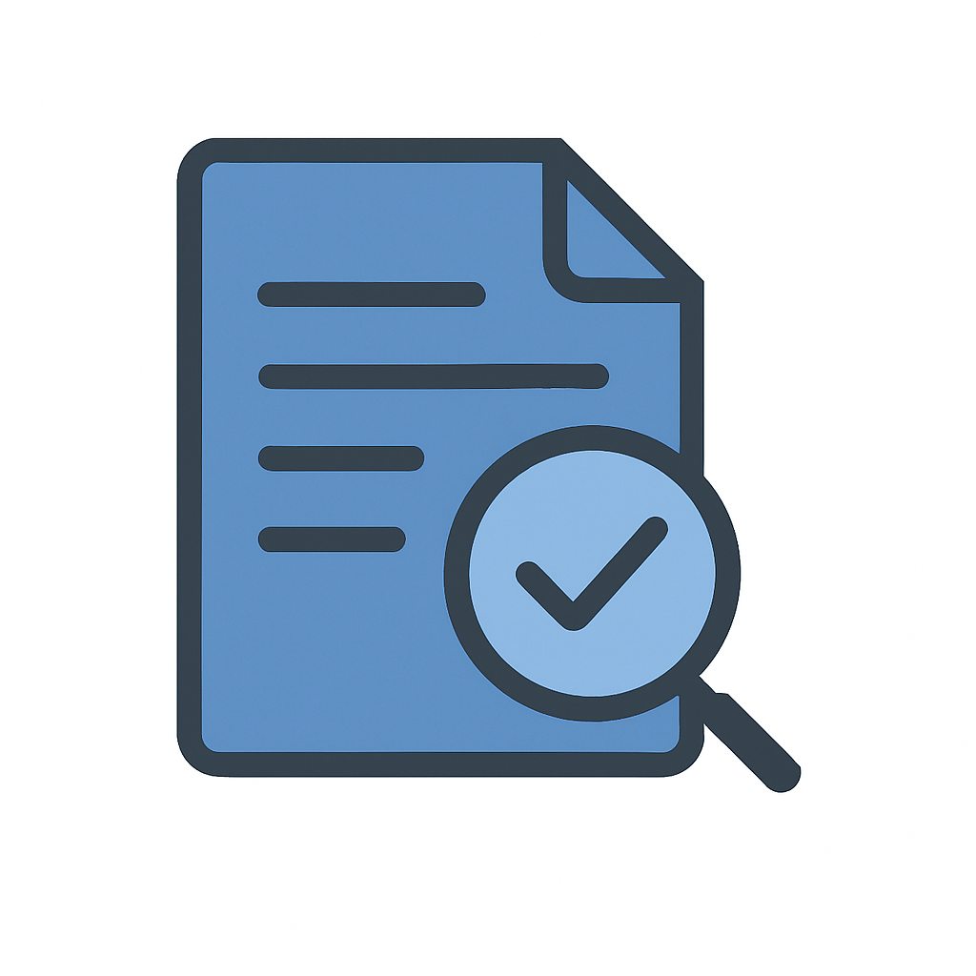

CertifAI Assessment Methodology
Inputs
CertifAI Compliance Assessment Methodology
PHASE 1
Plan & Prepare
PHASE 2
Evidence Collection
PHASE 3
Execute checks
PHASE 4
Reporting
PHASE 5
Ongoing Compliance
Product Specs
Assessment Objectives
RAG KB
Operationalize requirements
Automated check results
Assessment Report
Compliance Dashboard Monitoring
Product Design
Compliance Scope, SoC Dossier
SAC Draft
Human in the loop findings
Risk Assessment
Periodic Audits
Load Repository
Updated and validated SAC
Stakeholders briefing
Updated SAC with evidence
Assessment Plan
Evidence Gathering
Certification Drivers
Risk Assessment & Threat Modeling
Supported by Certification Framework Tool

Slide 11
Assessment Process vs Product Development Lifecycle
Spec Security Requirement
Risk Assessment
Threat Modeling
Security requirement
Secure Design
Secure design principles
Defense in depth
Secure Implementation
Secure coding standards
DAST/SAST
Security V&V Testing
Security req testing
Pen testing
Vulnerability testing
Deployment
SBOM Analysis
Vulnerability scan
Setup policies
Maintenance
Vulnerability Monitoring
Incident Management
Patch management
It is important to distinguish the roles of these two lifecycles:
The PDLC (Engineering World): This is the "How to Build" process. It follows established practices (like IEC 62443-4-1) to design, implement, and maintain the product. Its output is the product itself and the raw technical data (artifacts/evidence).
The Assessment Lifecycle (Regulatory World): This is the "How to Verify Compliance" process. It does not build the product; rather, it turns the development outputs into evidence of compliance. It evaluates the "raw material" provided by the PDLC against a structured Security Assurance Case (SAC).

Slide 12
How Assessment "Wraps" the PDLC
CertifAI Assessment Method
Spec Security Requirement
Risk Assessment
Threat Modeling
Security requirement
Secure Design
Secure design principles
Defense in depth
Secure Implementation
Secure coding standards
DAST/SAST
Security V&V Testing
Security req testing
Pen testing
Vulnerability testing
Deployment
SBOM Analysis
Vulnerability scan
Setup policies
Maintenance
Vulnerability Monitoring
Incident Management
Patch management
Developers write code, generate builds, and run unit tests
system operates in the field, generating logs and undergoing maintenance/patching
The assessment identifies "Non-Conformities" or "Gaps" where evidence is missing or insufficient
Gaps are fed back into the PDLC as prioritized work item
PHASE 1
Plan & Prepare
PHASE 2
Evidence Collection
PHASE 3
Execute checks
PHASE 4
Reporting
PHASE 5
Ongoing Compliance
The interaction between the two lifecycles creates a continuous feedback loop. The Assessment Lifecycle relies on the PDLC for evidence, and the PDLC relies on the Assessment Lifecycle for constraints and remediation requirements.

Slide 13

CertifAI Assessment Architecture Flow
Output Layer
Reporting
Assurance & Auditor View
CAE Graph Status & Progress
JSON Schema
Unified Compliance Dashboard
Claim & Sub-Claim Status
Rrequirements Satisfaction Scores
Evidence Coverage
Reporting Tools / GRC
Execution Layer
SAC Composition
Integration API
(REST Endpoints
SAC Composer
Claim-Argument-Evidence Graph Instantiated
Non-Compliance Validation
Compliance Scoring
Artifacts Repo
CI/CD Pipelines
Logic Layer
Threat Modeling
Requirement Operationalization
Threat Modelling
Threat Scenarios
RAG Knowledge Base
Sub-requirements & Acceptance Criteria
SAC Composer
Claim-Argument-Evidence Skeleton
IEC 62443 / CRA Clauses
Target Security Profile
Input Layer
Scoping &
Undestanding
Regulatory Requirements
RAG Knowledge Base
SoC Descriptions
Normalizad Requirements
SoC Model
(assets,zones/Conduct, components)
Cross-references

Slide 14



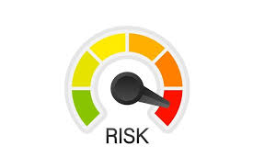
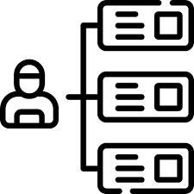
Core capabilities
WP5
WP5
WP2
WP3
WP4
WP3
WP3
Enhancing Continuous Threat Modeling & Risk Assessment
Developing AI-Powered Compliance Assistance
Automating the Generation of Security Assurance Cases
Continuous Vulnerability Monitoring & Remediation
Optimizing Security Testing through Formal Methods
Implementing dynamic threat modeling (ThreatSpider) and risk assessment techniques to identify evolving security threats and vulnerabilities.
Ensuring mitigation actions are aligned with IEC 62443 and other relevant frameworks, enhancing resilience.
Leveraging Large Language Models (LLMs) and Conversational Assistant to simplify the interpretation of requirements.
Providing guided recommendations for understanding requirements and to determine compliance.
Streamlining compliance validation by automating the creation of assurance cases, improving transparency and traceability to evidence.
Facilitating the identification and resolution of non-compliance issues with greater efficiency.
Developing automated methods to detect, assess, and address vulnerabilities that impact both cybersecurity and compliance.
Enabling real-time remediation strategies to maintain a cybersecurity and compliance posture.
Enhancing vulnerability testing through formal methods, improving the efficiency and reliability of security validation.
Reducing redundant testing efforts while maximizing coverage and effectiveness.
WP6
CertifAI Software Framework
Demonstrate results of the proposed approach and solutions through the implantation in the four use cases

Slide 15
Baseline vs CertifAI
Baseline
CertifAI
Starts from the standard's checklist of requirements
Each clause/requirement interpreted manually, one by one
Evidence collected ad-hoc to satisfy the checklist
Threats, controls & evidence linked only implicitly
Traceability kept in documents and spreadsheets
Integrated threat modelling — ThreatSpider
Select security controls & map to standard requirements
SAC Composer to build with CAE + evidence binding
Structured, traceable assurance cases from requirement to evidence
Same steps measured for direct comparison
VS
From checklist to risk. CertifAI starts from the identified threats, derives the security controls, maps them to the requirements of IEC 62443 / EU CRA, and records the full chain in a Security Assurance Case — so every requirement stays traceable to the evidence that satisfies it.

Slide 16
Ambition vs. current results
Original ambition | Where we stand
More efficient certification (effort-wise) | Project results prove the tools make the assessment process more efficient towards certification readiness
Comprehensive system & threat modelling for risk-driven certification | Achieved through ThreatSpider and the risk management methodology
Open AI-driven continuous certification framework | Core technical components developed and validated
Continuous compliance throughout lifecycle | Methodology and tool support established
Automated interpretation of requirements | RAG-based requirement consultation & consolidation achieved
Explainable traceability from requirements to certification artefacts, evidence-based certification readiness | SAC Composer and evidence-mapping mechanisms developed
Transparency on which artefacts are invalidated, and why | Automated SAC validation to flag non-compliant requirements and their evidence needs further integration and validation
Fully integrated end-to-end platform | Integration remains a challenge and a future-work area

Slide 17
Challenges faced
1
Complexity of Cybersecurity Across Multiple Domains
  Cybersecurity is a multifaceted discipline, spanning product security, operational aspects, governance, and compliance.
  Addressing all these layers simultaneously while ensuring alignment between technical and regulatory perspectives is being complicated.
2
Fragmentation of Knowledge and Interpretation Misalignment
  The field is highly fragmented, with different stakeholders interpreting key concepts differently.
3
Technical Challenges in AI-Based Solutions
  We rely on Large Language Models (LLMs) and AI-driven frameworks to enhance compliance automation and security assessments. However, the rapid evolution of AI technologies poses a challenge in keeping our solutions up to date, ensuring reliability, and managing risks associated
4
Complexity in Standards Comprehension & Compliance
  Cybersecurity standards (e.g., IEC 62443, CRA) have nuanced requirements that require deep expertise and precise interpretation.
  Gaps in understanding these standards and their practical implications have slowed tool development and integration efforts.
5
Interdependencies and Uncertainties in Execution
  The project involves multiple interdependent tasks, where technical and functional uncertainties have led to delays.
6
Data Availability & Validation Challenges
  Ensuring that AI models are trained with high-quality, domain-specific cybersecurity data is a challenge due to the sensitive nature of security information. Access to real-world datasets and validation mechanisms for AI-generated compliance recommendations remains a key constraint.
7
Evolving Regulatory & Market Landscape
  The regulatory environment is evolving (e.g., Cyber Resilience Act, AI Act and AI Act), requiring continuous adaptation of our methodologies. Ensuring long-term relevance of the developed tools amidst shifting compliance landscapes is a key challenge.

Slide 18
The Velocity of the Paradigm Shift
  2022: The “Traditional” ML Era
  Predictive Focus: Primarily utilized for classification, regression, and analytical predictions using structured datasets.
  Narrow Subfields: Neural networks and deep learning models were highly specialized, requiring massive bespoke training.
  Sequential Cycles: Innovation and implementation followed traditional, lengthy software development lifecycles (months to years).
  2023+: The Frontier LLM Era
  Generative Focus: Immediate capability to synthesize text, code, and insights from massive unstructured data pools.
  Generalized Power: Frontier models act as versatile foundational engines, instantly applicable to thousands of varied use cases.
  Hyper-Compression: A radical explosion of capabilities where major technological leaps occur in a matter of weeks.
Notes:
Over the last three years, frontier LLMs progressed exponentially from basic text-generation copilots (2023) into highly reliable, multimodal reasoning engines (2024-2025), and finally into autonomous, goal-oriented agents (2026). This unprecedented velocity fundamentally altered adoption curves. As hallucination rates plummeted and output verifiability improved, the traditional friction of prolonged enterprise R&D cycles was eliminated. Organizations shifted almost instantly from isolated pilot testing to embedding these intelligent systems directly into mission-critical, revenue-generating workflows.

Slide 19






Value & Impact
Less interpretation effort
End-to-end traceability
Early gap detection
Reduces the effort of reading and operationalizing requirements.
Links requirements, claims, evidence and assessment results.
Surfaces compliance gaps before they reach an audit.
Audit preparation
Continuous monitoring
Trustworthy EU digital space
Helps organizations prepare for audits and certification.
Provides a foundation for ongoing compliance monitoring.
Contributes to a more secure and trustworthy ecosystem.

Slide 20
Conclusions
A highly relevant, complex problem | CertifAI tackled continuous AI-driven certification, a genuinely hard and timely challenge
Real technical advances | Important progress in AI-assisted compliance assessment, assurance cases and threat modelling. AI agents show potential for assisting assessment tasks
Full automation is not realistic yet | Certification still needs expert oversight, judgement and trust
Strongest value is in readiness | Risk-driven approach, evidence structuring, assurance-case generation and expert-supported continuous assessment.
A deeper grasp of assessment complexity | The CertifAI methodology provides a structured, repeatable way to prepare an assessment ahead of the formal certification. Improved understanding of IEC 62443 and CRA compliance workflows
The next step is integration | Deeper integration and implementation of improvement cycles based on feedback from UCs.

