Slide 1
HORIZON-CL3-2022-CS-01-04: INCREASED CYBERSECURITY 2022
Ref. Ares(2022)8966412 - 23/12/2022

Slide 2
Summary of the Day's Discussions and Presentations
Key topics covered
Main takeaways and insights
Highlights from speakers and panels

Slide 3
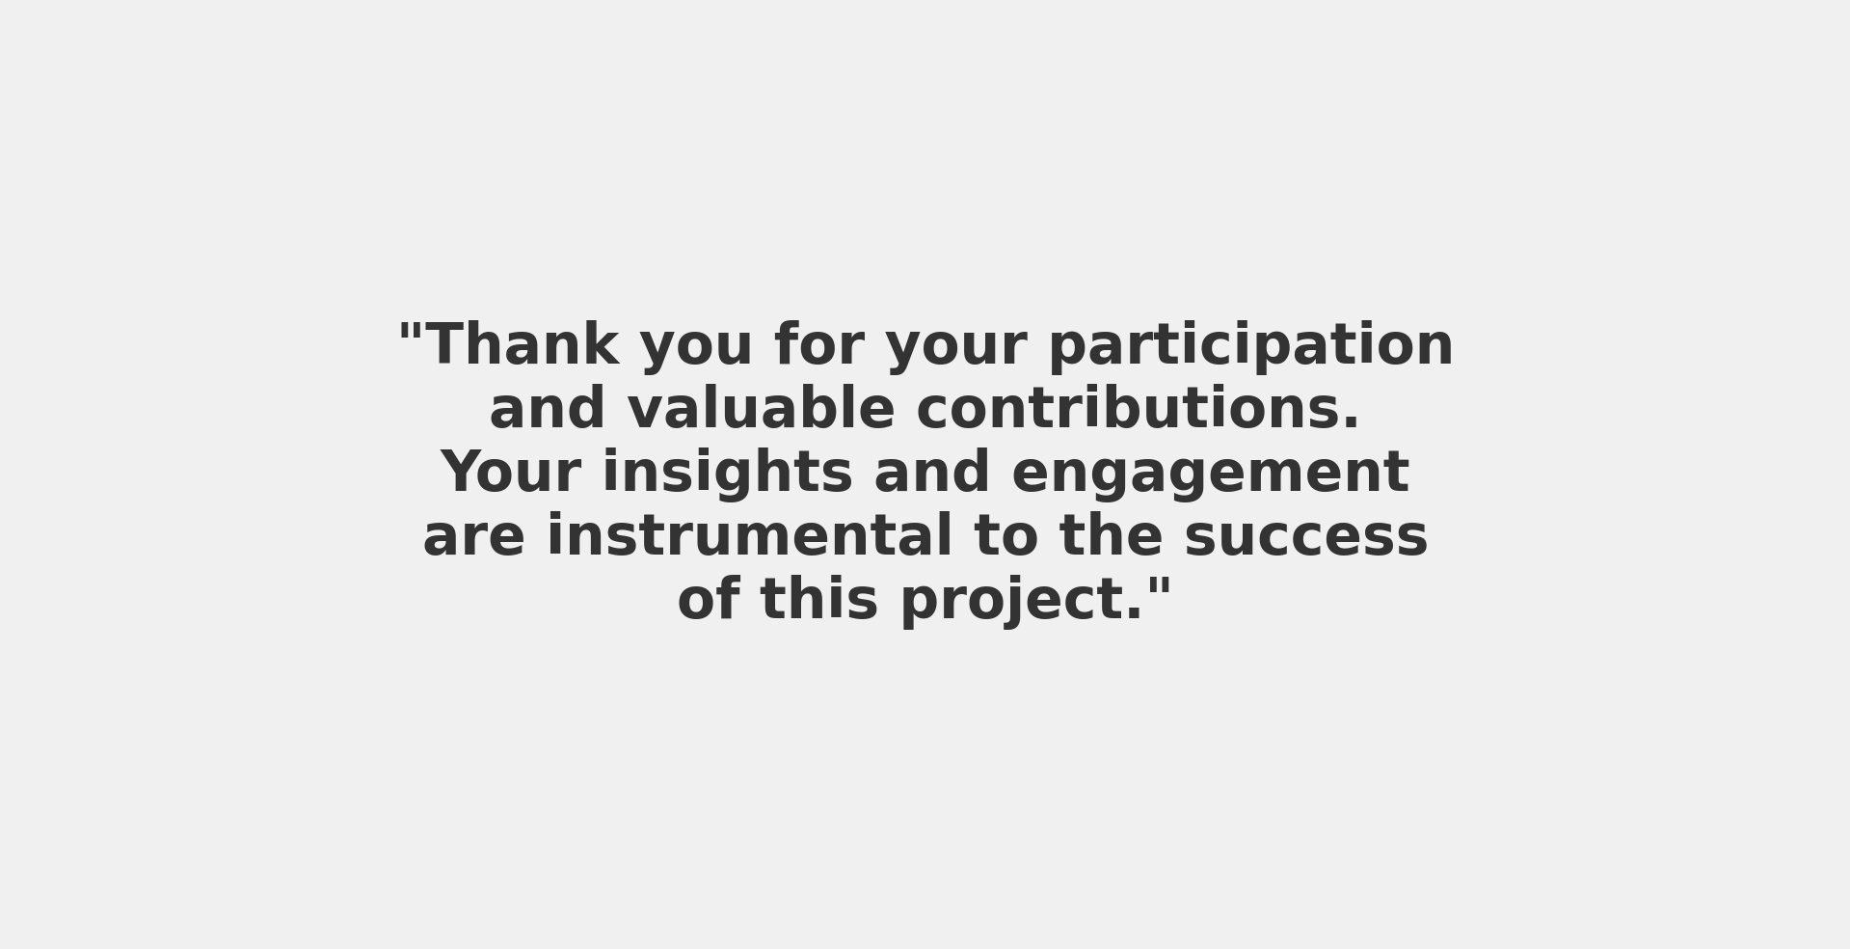
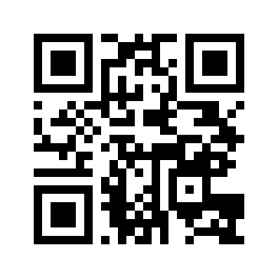

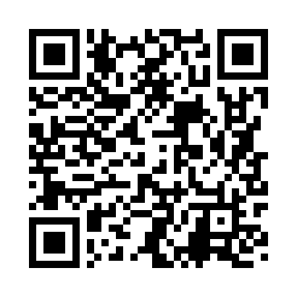
Closing and Next Steps
Contact information:
https://certifai.info/
Social Media
https://www.linkedin.com/showcase/certifaieu/

