Slide 1
Use Case 4 – PATROLIoT's Journey Towards CRA Readiness
Catalink
CertifAI Prague Final Conference
Maria Maslioukova
HORIZON-CL3-2022-CS-01-04: INCREASED CYBERSECURITY 2022
Ref. Ares(2022)8966412 - 23/12/2022

Slide 2





About Catalink
SME
Based in Cyprus
Expertise
Semantic Technologies
Software Development
AI & Computer Vision
Application Domains
Healthcare
Culture
Civil Security
Climate & Mobility
Starting Point
No previous certification experience
No previous compliance assessment experience
Notes:
Representative of many SMEs that will need to navigate CRA requirements without having dedicated certification or compliance experts in-house.
Transition:
To provide some context for the remainder of this presentation, let me briefly introduce PATROLIoT, the product involved in Use Case 4 of CertifAI

Slide 3



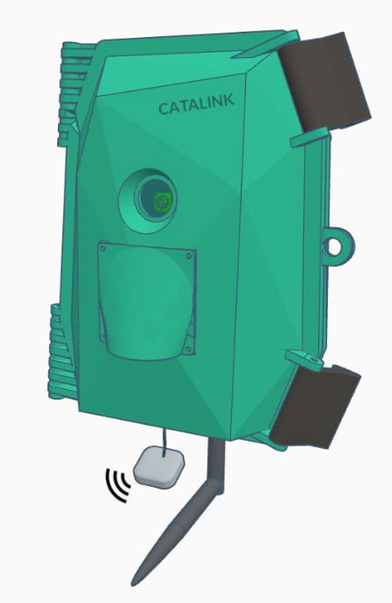


Catalink
Products
CASPAR
IRIS
Structured Data Semantic Exploitation Framework
Driver State Monitoring Android application
For more information:
https://catalink.eu/
SHELFMYSTORE
PATROLIoT
Pharmacy Planogram
Fire and Smoke Detection IoT
Notes:
CASPAR -> domain-agnostic tool for the automated retrieval and fusion of structured data from different sources, which enables the discovery of new knowledge and extraction of insights
IRIS -> app that provides real-time monitoring and assessment of the drowsiness and inattention level of a driver

Slide 4
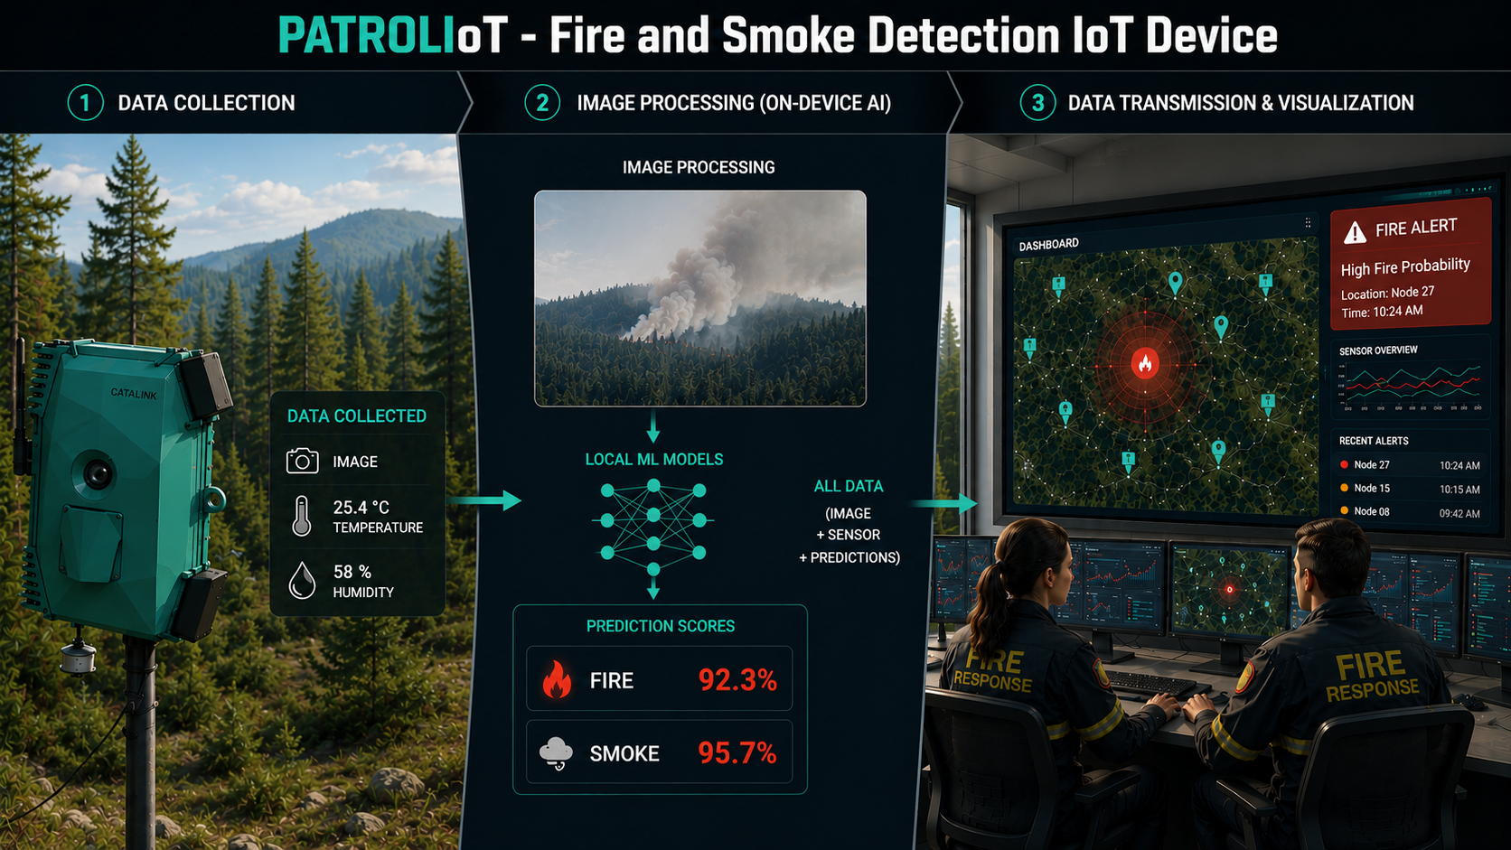
Notes:
IoT edge device
Self-powered
Collects environmental sensor data and images
Machine learning (image-based) fire and smoke detection
On-site data processing
Continuous reporting to dedicated dashboard
Transition:
As a connected product combining hardware, software, communications and AI capabilities, PATROLIoT falls within the scope of the CRA. This motivated us to better understand our current position and led to the initial CRA gap analysis.

Slide 5
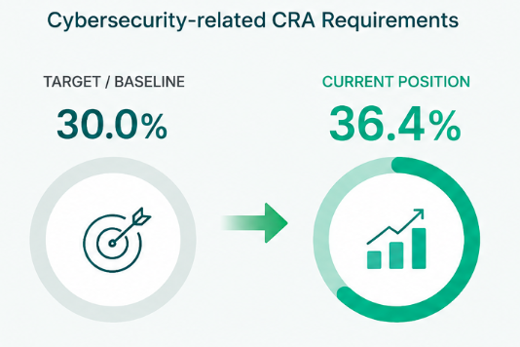
Initial CRA Gap Analysis
Key Outcomes
Established initial baseline
Identified evidence and process gaps
Defined improvement priorities
Supported by CertifAI tools and expert guidance
Notes:
Gap analysis performed with EZU
Objective: establish an initial baseline
Feedback across all CRA requirement areas
Our primary focus was the cybersecurity-related requirements (Annex I Part I & II)
Target: 30% -> Current: 36.4%
Analysis helped identify:
evidence & processes gaps
improvement priorities
Transition:
How did we improve our understanding and gather evidence? → CertifAI tools

Slide 6




CertifAI Journey So Far
Requirements Analyser
ThreatSpider
VIMPACT
SAC Composer
Understand CRA requirements
Analyse SBOMs and prioritise vulnerabilities
Build assurance cases & identify gaps
Perform threat analysis
CertifAI Framework
Notes:
General
Tools can be used individually or combined through the CertifAI Framework
In our case, they supported different stages of our CRA readiness journey
Requirements Analyser
Better understand CRA requirements and their intent
ThreatSpider
Perform threat analysis of PATROLIoT components
Identify threats and potential mitigations
VIMPACT
Analyse PATROLIoT software dependencies through SBOM analysis
Identify and prioritise mitigation of vulnerabilities (CVEs)
Key Observation
ThreatSpider and VIMPACT also generated evidence that could be reused within SAC Composer
SAC Composer
Build assurance cases for selected requirements
Use available evidence to assess status and identify potential gaps
CertifAI Framework
Provides a unified access point to the CertifAI tools
Transition:
While these tools already provided valuable insights and evidence, several CertifAI capabilities still remain to be evaluated before the final gap analysis.

Slide 7



Remaining Activities
ThreatSpider Risk Analysis
EXCLAIM
(AssureGraph)
Final CRA Readiness
Evaluation
Perform risk assessment
Evaluate SACs
CertifAI Framework
Notes:
General
Several CertifAI capabilities still remain to be evaluated
ThreatSpider
Explore risk assessment functionality
EXCLAIM/AssureGraph
Evaluate assurance cases and improve their quality
CertifAI Framework
Re-test the final integrated version
Final CRA Readiness Evaluation
Re-evaluate current position, progress and remaining gaps
Transition:
While several activities are still ongoing, the journey so far has already been a valuable learning and knowledge-sharing experience for the entire consortium.

Slide 8




Lessons Learned from an SME Perspective
Information Ecosystem
Where to Start?
Many information sources, difficult connections
Determining priorities and first steps is challenging
Evidence Expectations
Knowledge Growth
Identifying relevant evidence and the required level of detail
Many information sources, difficult to connect
Notes:
Information Ecosystem
Information exists in many places (regulations, standards, websites, vulnerability databases, etc)
Finding them is relatively easy, biggest challenge was understanding how everything fits together
Where to Start?
Many possible entry points
Difficult to determine sequence of activities
Expert support was valuable
Evidence Expectations
One of the most difficult parts for newcomers
Understanding:
what evidence is needed
how much detail is sufficient
when something can be considered "good enough"
Knowledge Growth
Understanding and confidence improves gradually
Tools and interaction with experts accelerate the process
Learning is a continuous process
The challenge was not finding information, but understanding how everything fits together.

Slide 9


Closing Remarks
Guidance & Training
Human-Centred AI
Successful CRA adoption requires guidance and training
AI should support understanding and keep people in control.
Build Human Capability — Not Only Documentation
Notes:
CRA
CRA is necessary and beneficial
Every company should be able to navigate the process
Training and guidance are equally important for successful adoption
Guidance
Regulations alone are not enough
Training and guidance are equally important
Closing the knowledge gap will determine successful adoption
AI
AI tools provide significant value
Especially for SMEs without dedicated certification personnel
AI should support understanding, not replace it
Humans should remain responsible and in control
Final Message
Without proper knowledge building, there is a risk that:
companies increasingly rely on AI to generate documentation;
reviewers rely on AI to analyse documentation;
Otherwise. we risk creating a situation where AI generates documentation and AI validates documentation, while people become detached from the reasoning behind it.
The real challenge is not only achieving CRA readiness, but ensuring that organisations build the knowledge and confidence required to sustain it.

Slide 10
Thank You
Questions?

