Slide 1
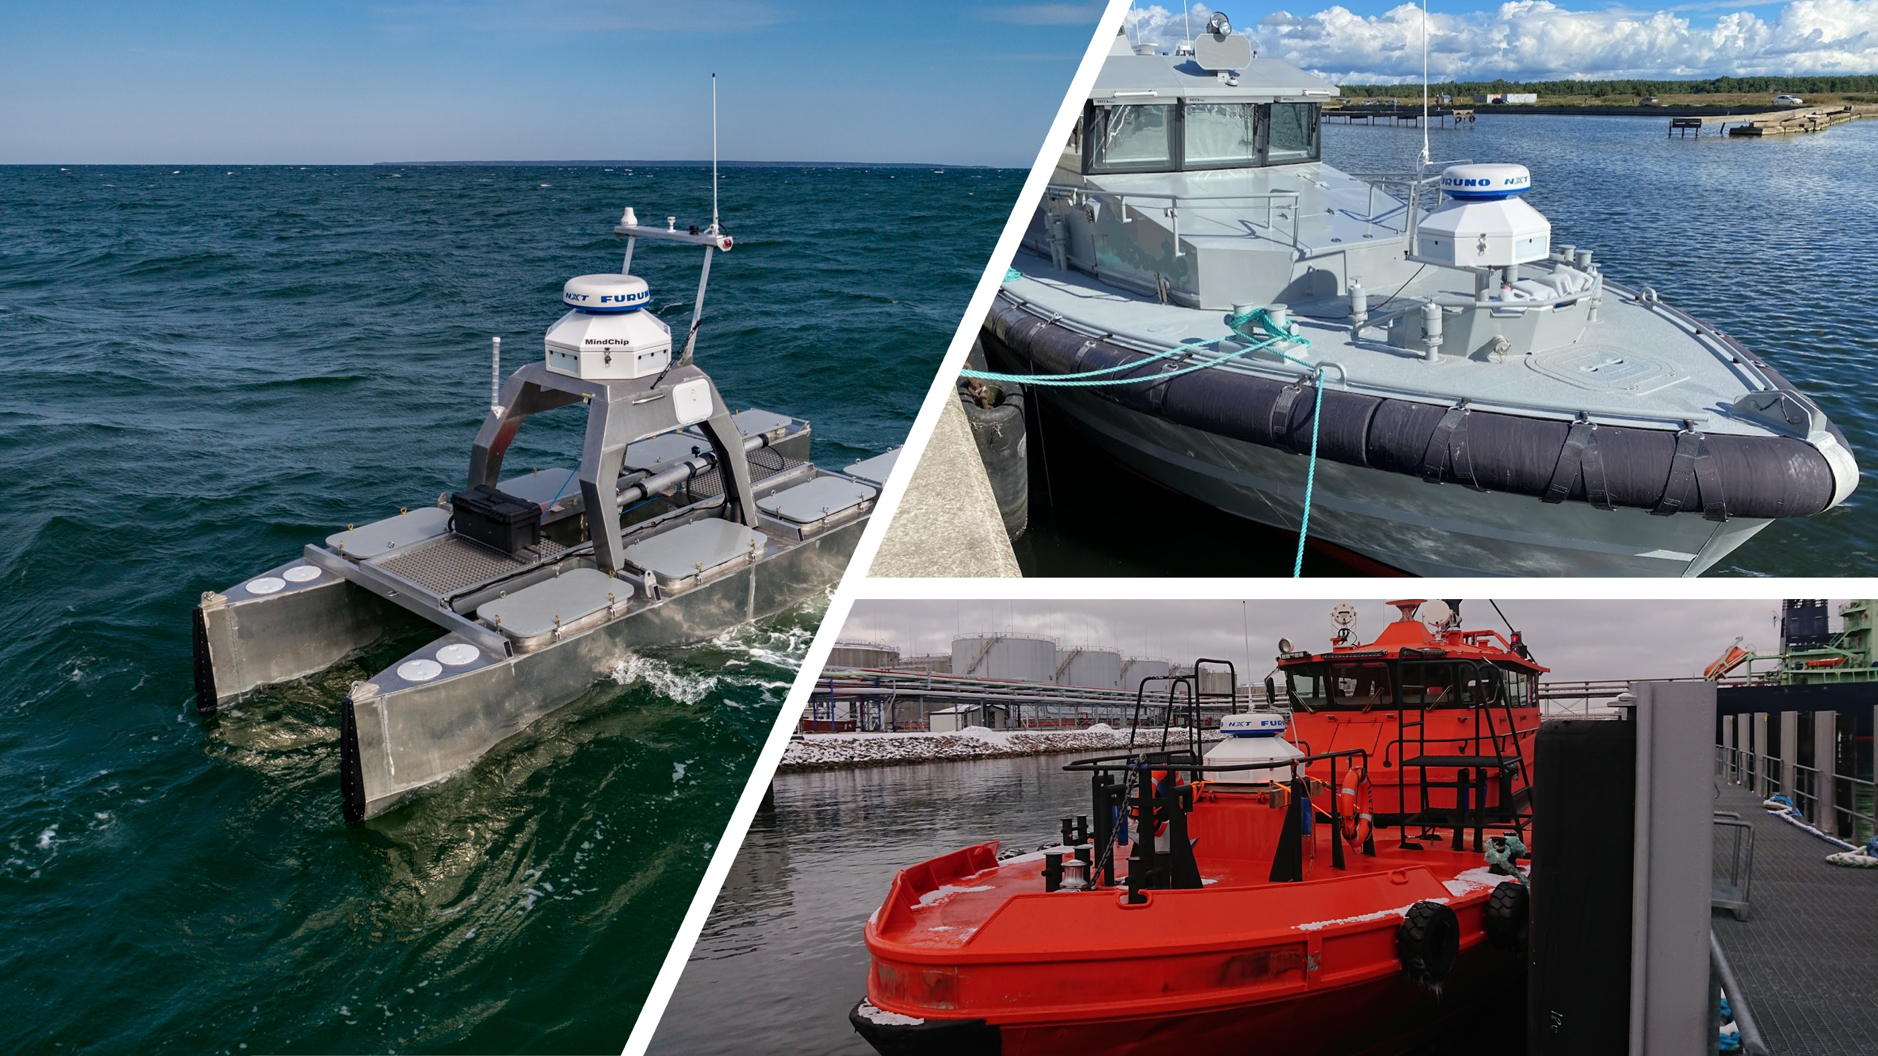

Use Case 3: MindChip Artificial Captain
for Maritime Autonomy
Tanel Kerstna, MindChip
HORIZON-CL3-2022-CS-01-04: INCREASED CYBERSECURITY 2022
Ref. Ares(2022)8966412 - 23/12/2022

Slide 2
About MindChip
Estonian-based deep-tech company
TalTech University spin-off
Maritime Situational Awareness & Autonomous Navigation Solutions developer
Main products: Artificial Captain product series: Remote Pilot and Full Autonomy
Never send a human to do a machine’s work

Slide 3
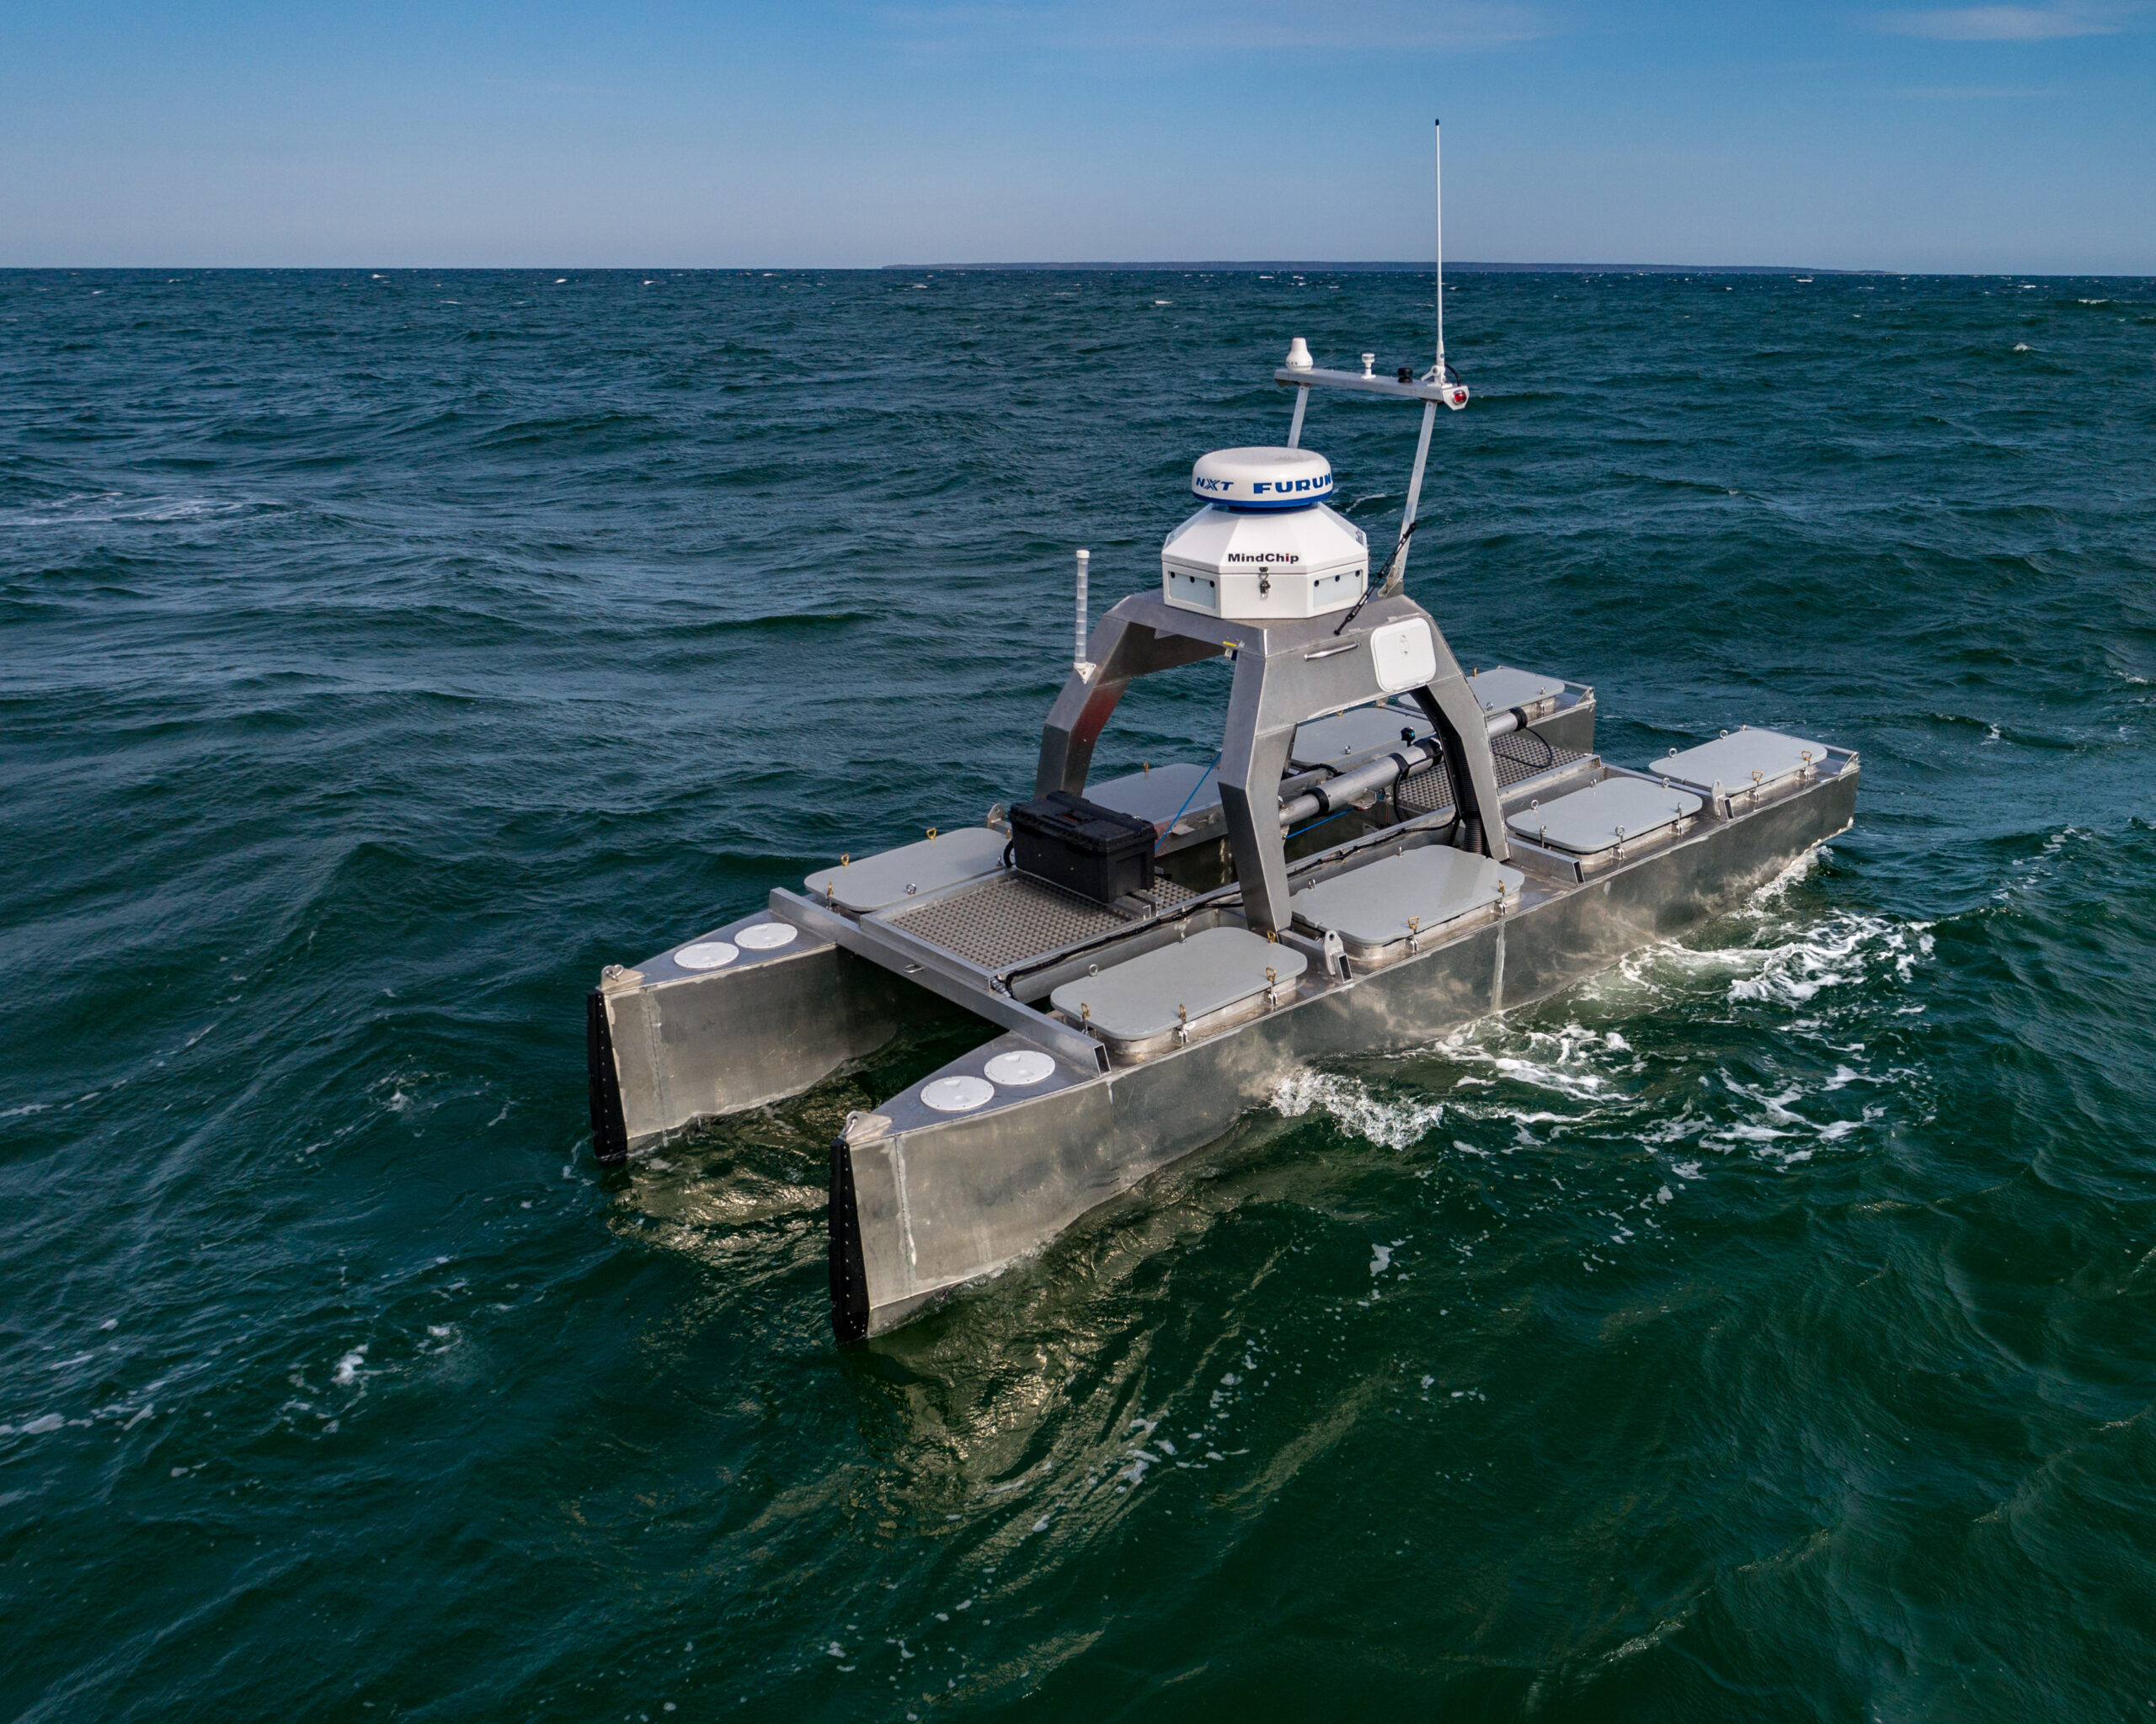
The Need for Autonomous Vessels
Autonomous vessels offer substantial reduction in operational costs
Facilitate tasks that may pose risks to human labor.
Applications include seabed monitoring, oil spill detection, border surveillance, environmental surveys, etc.

Slide 4
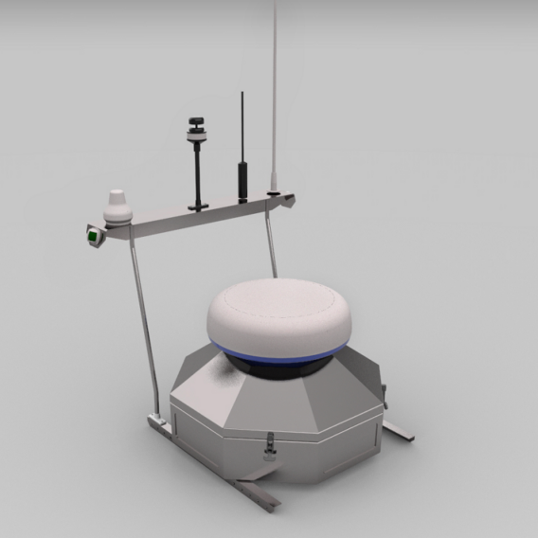
Mindchip Artificial Captain: A Comprehensive Solution
Two interconnected parts: Control Tower and Server Platform
Control Tower
Control Tower enables autonomous or remote-controlled operation with functionalities such as situational awareness, autonomous navigation & vessel control, object detection, 360º vision, and COLREGs-based navigation. It has customized interface controller to communicate with ship control systems
Server Platform
Server Platform provides real-time monitoring, telemetry, mission planning, and user management

Slide 5
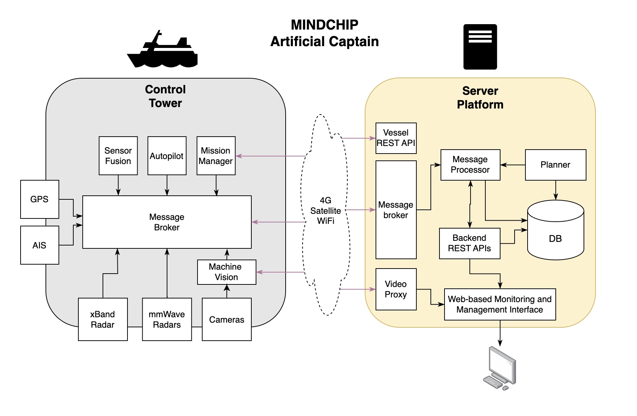
High-Level Service Diagram

Slide 6
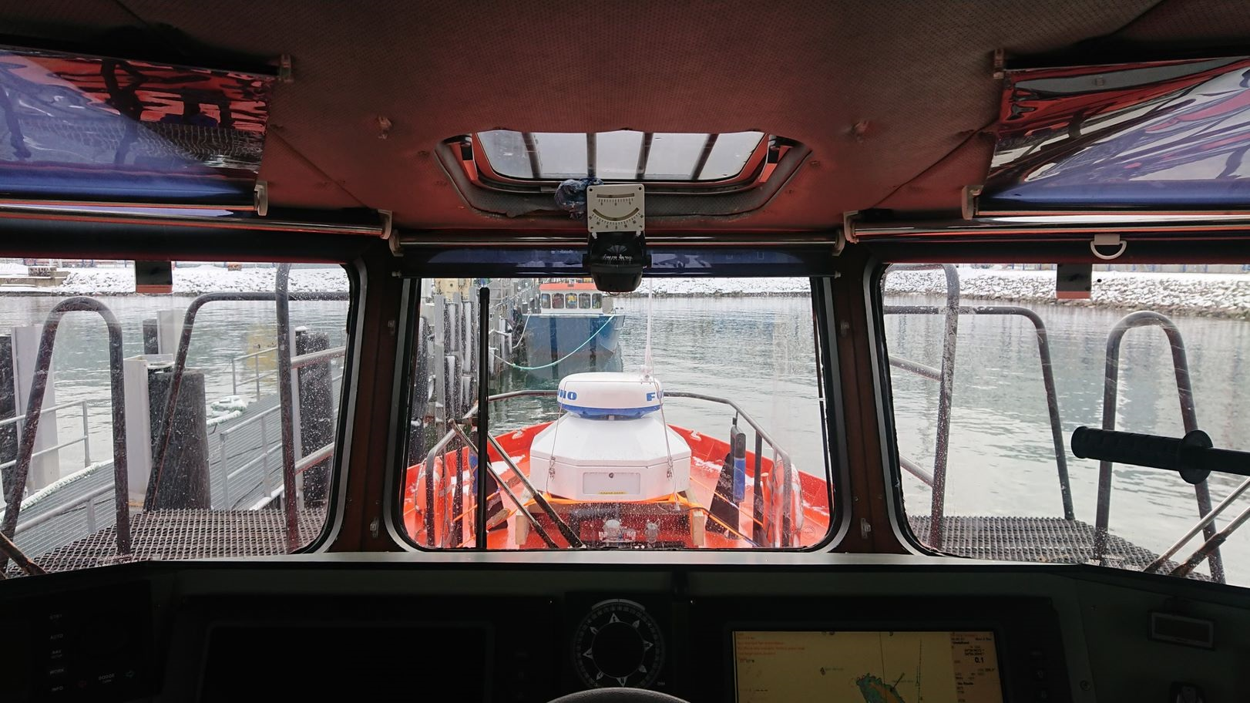
Need for Certification
Autonomous surface vessels may serve as an integral component of critical infrastructure, engaging in surveillance activities and navigating through areas with high marine traffic,
Imperative to implement stringent security measures
Various Standards
IEC 62443-2-4: a comprehensive set of requirements for security capabilities for IACS service providers
Unified Requirement (IACS)
  UR26: cyber resilience of ships
  UR27: cyber resilience of on-board systems and equipment

Slide 7
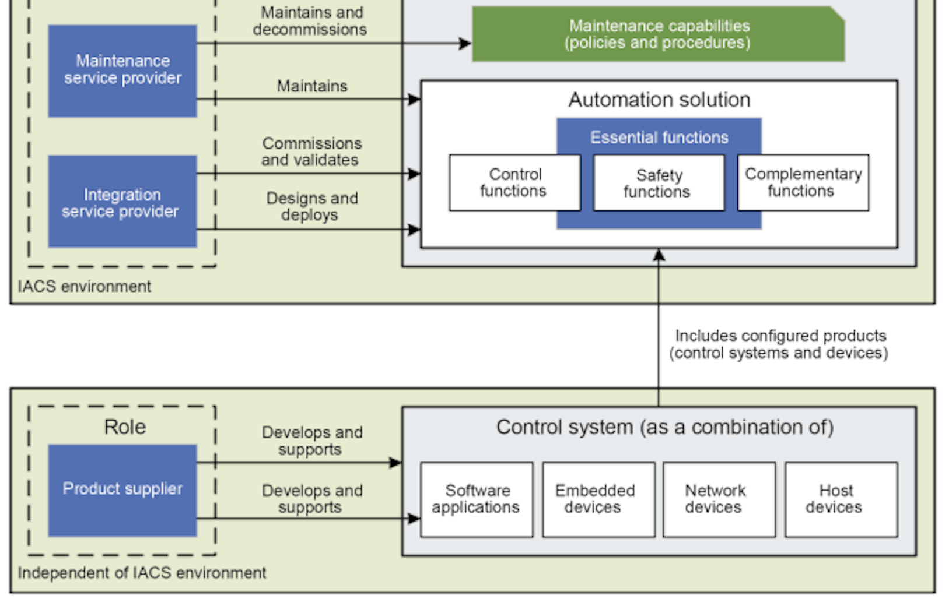
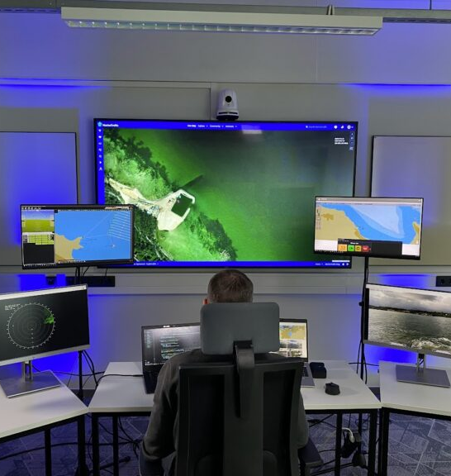
Scope within CERTIFAI
Subject for Certification: MindChip Server Platform
Service role according to IEC 62443-2-4:
  integration service provider
  maintenance service provider
Scope of Service Provider Processes – from IEC 62443-2-4 standard

Slide 8
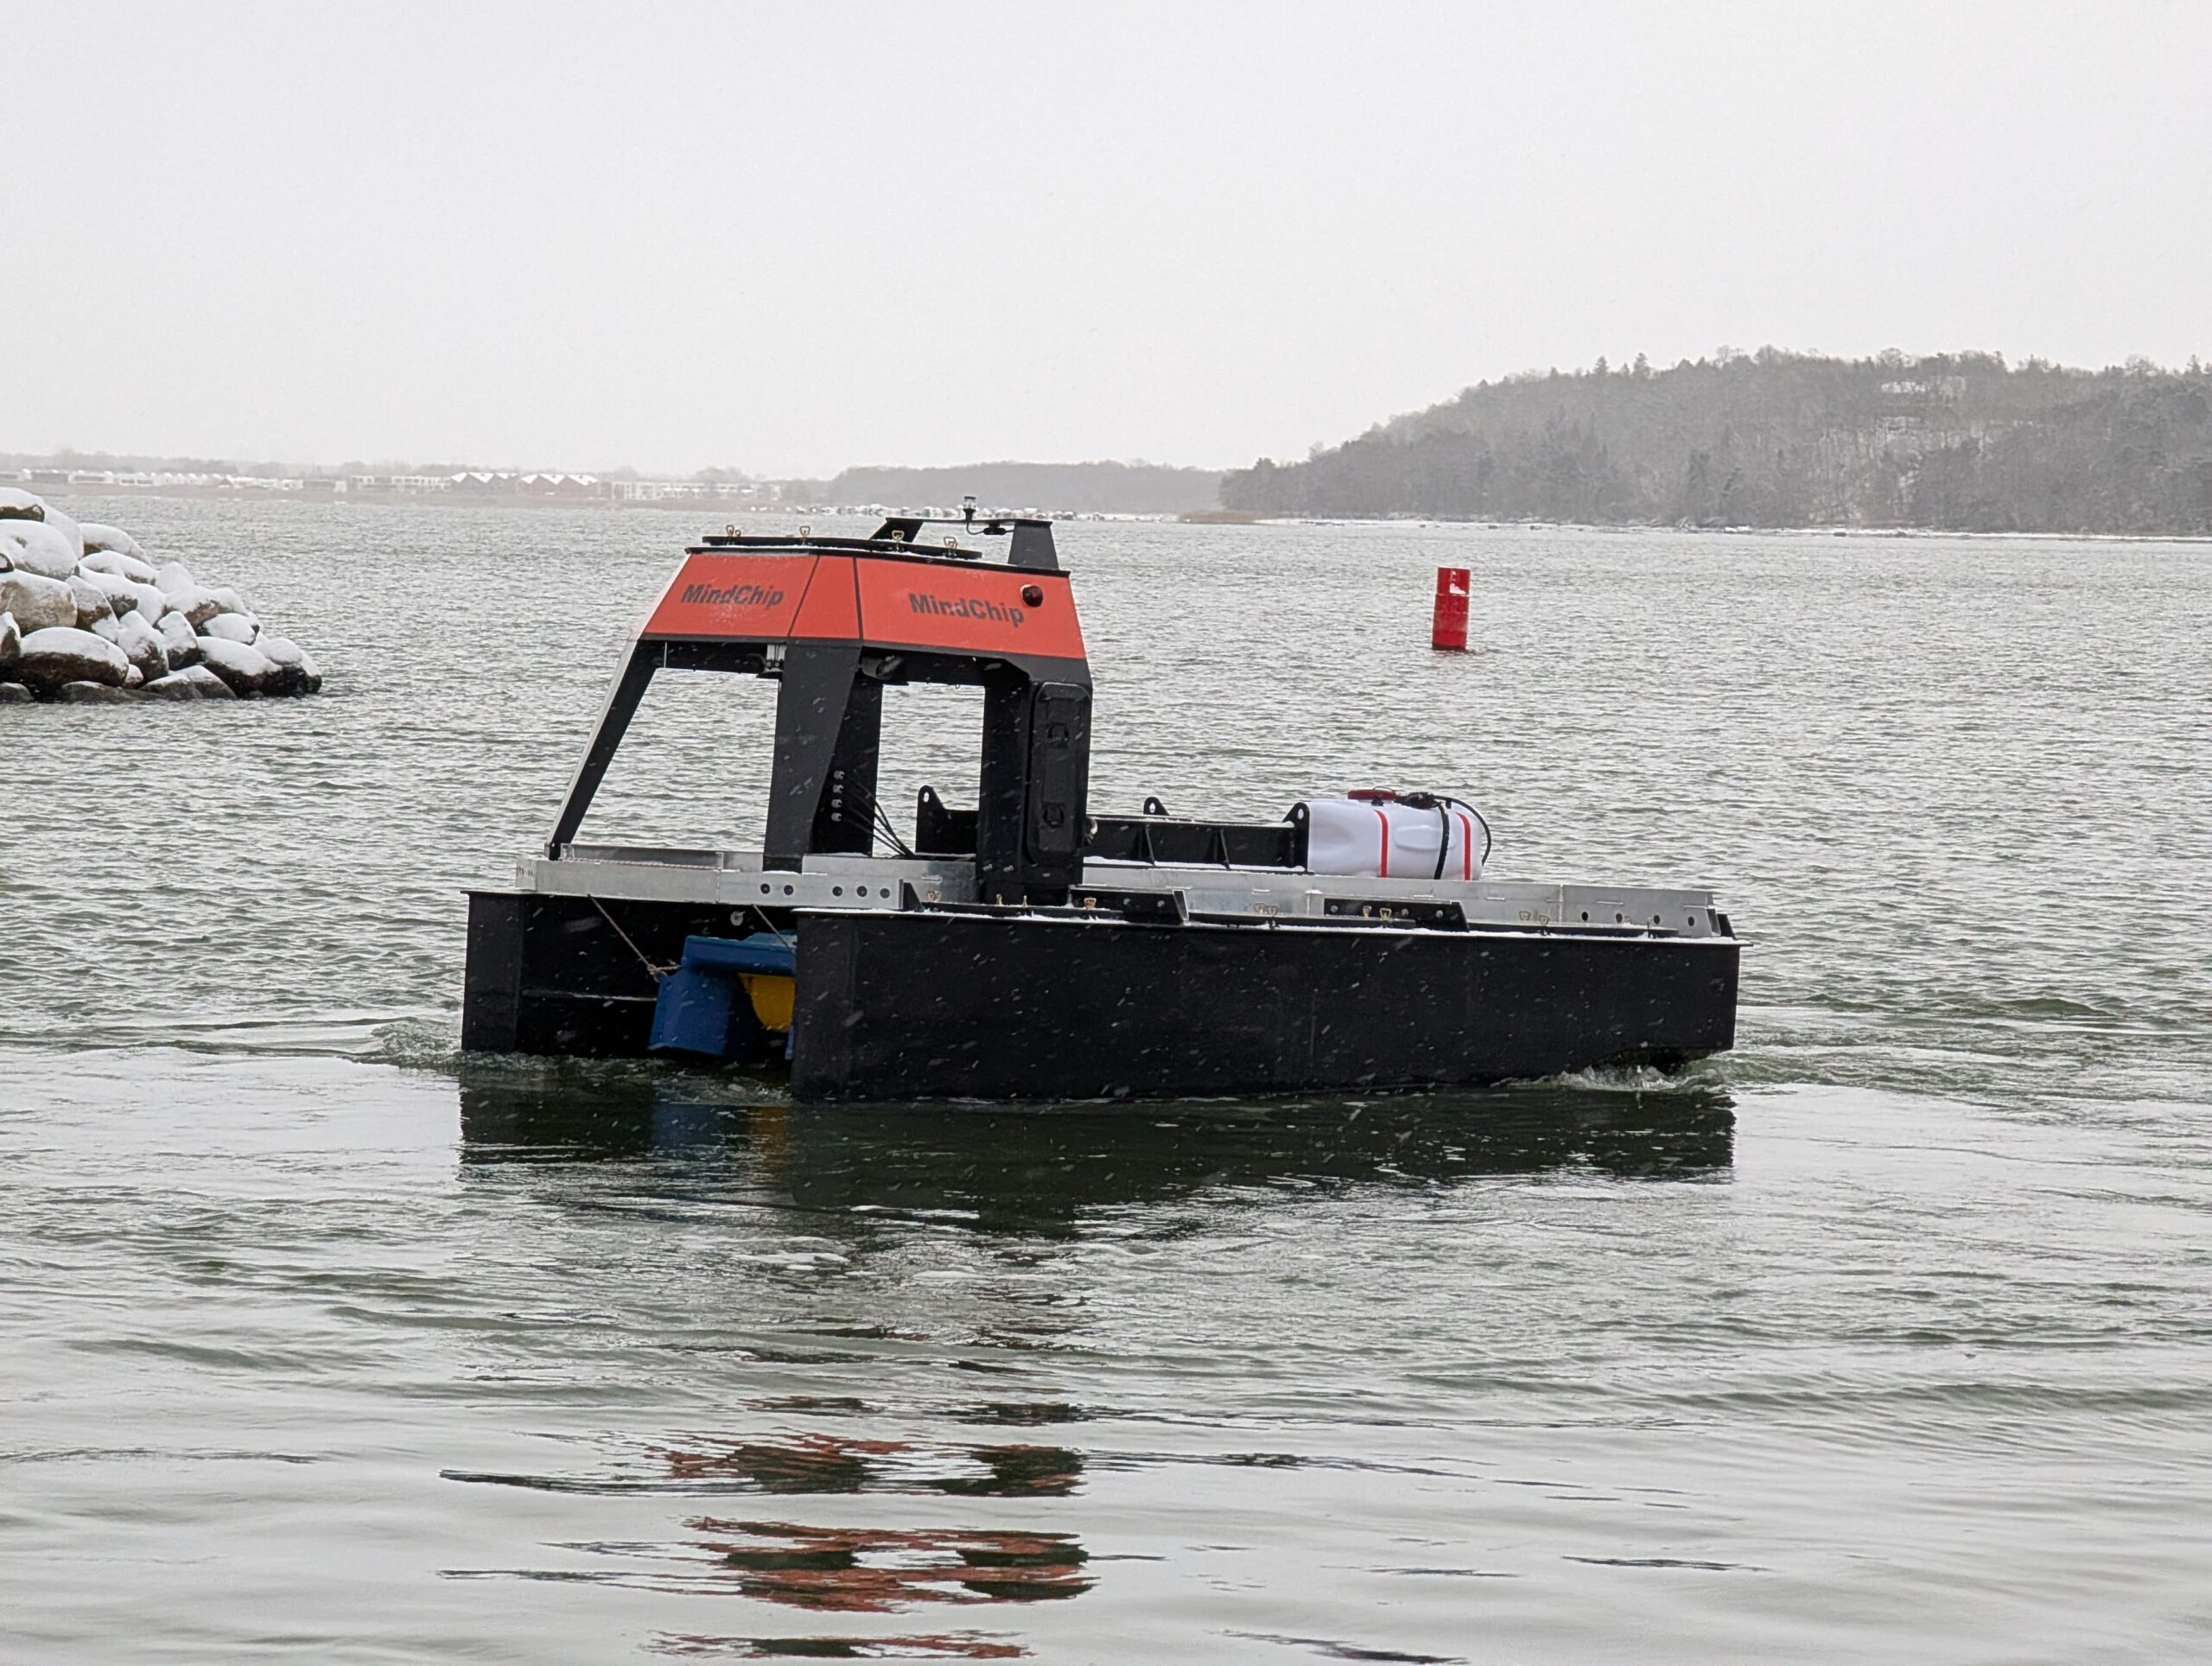
Making certification achievable for SMEs
CERTIFAI reduces the expert effort needed for cybersecurity certification.
Interprets IEC 62443 requirements into structured assurance evidence
Connects architecture, threats, vulnerabilities and mitigations
Automates parts of SBOM and vulnerability analysis
Supports continuous evidence updates for re-certification
IEC 62443-2-4 → Requirements → Threats & Risks → Evidence → Certification readiness

Slide 9
Easier route to IEC 62443-2-4 readiness
CERTIFAI helps SMEs move from scattered security work to audit-ready evidence.
RAG / SAC Composer: requirement understanding and evidence structure
Threat Dragon / Threat Spider: threat modelling and mitigation tracking
VIMPACT / SBOM analysis: dependency and vulnerability evidence
Continuous monitoring: keeping certification evidence up to date
CERTIFAI does not replace auditors — it helps SMEs prepare faster, with better traceability.

Slide 10
Thank You
For Your Attention

