Slide 1

Use case 2 – Smart Grid
Evgeny Prokofyev
HORIZON-CL3-2022-CS-01-04: INCREASED CYBERSECURITY 2022
Ref. Ares(2022)8966412 - 23/12/2022

Slide 2

About Us
European company in energy management and industrial automation, with strong expertise in electrification and smart energy systems.
Our R&D team, based in Seville, Spain, designs and develop products with a global scope.

Slide 3

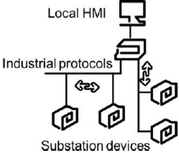
CertifAI Final Conference, Prague June 2026
UC 2 Energy. Electric Grid Controller certification
In the electric network, the Substation Automation Systems (SASs) are mission critical systems that control and monitor the electric infrastructure.
This UC is a non-AI product and is certified according to IEC 62443-4-1 and IEC 62443-4-2.
Why is Electric Network a Critical Infrastructure for the EC?
  Essential for the maintenance of vital societal functions
Its damage, destruction or disruption may have a significant negative impact for the security of the EU and the well-being of its citizens
Grid Controllers in electric substation
Improve the security of the devices architecture of the Substation Automation Systems (SASs) to protect the electrical network
Address the cybersecurity certification process of an Electric Grid Controller

Slide 4
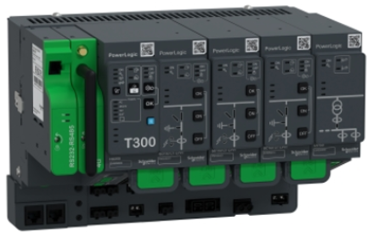
CertifAI Final Conference, Prague June 2026
REMOTE TERMINAL UNIT
Captures real-time information measured directly from substation assets or by using industrial communication protocols to exchange information with other elements of the substation
Captured information is shared with grid operators through the Supervisory Control and Data Acquisition (SCADA) system following industrial communication standards (IEC 101, IEC 104, Modbus, DNP3, IEC 61850, MQTT)
SCADA defines the operation strategy of the grid and routes it to such controller
UC 2 Energy
Electric Grid Controller Certification
POWERLOGIC T300
Key Element of the Electric Grid
Cyber-attacks exposed
Developed as per
IEC 62443-4-1
IEC 62443-4-2
Designed with cybersecurity mindset

Slide 5

CertifAI Framework
Threat Spider
VIMPACT
Threat Model
SBOM
Tools Integration
Subject of Certification
Useful approach through a defined workflow.
Security Assurance Cases
SAC Composer
Continuous assesment

Slide 6

Threat Spider
Threat Model
Risk Assesment
More comprehensive than conventional STRIDE based tools
Traceability with threat model
Detailed and specific mitigations mapped to threats
Extensive and detailed

Slide 7
SAC Composer
Intuitive match between requirements and evidences.
Evidence
Claim
Sub-claim
Requirement
Consistent traceability.
Evidence
Claim
Sub-claim

Slide 8
How CertifAI improves the process
Reduce the gap with IEC 62443-4-2
Improve process quality through test coverage increase
Reduce time for the (re-)certification by 20%

Slide 9
Thank You
For Your Attention

