Slide 1
HORIZON-CL3-2022-CS-01-04: INCREASED CYBERSECURITY 2022
Ref. Ares(2022)8966412 - 23/12/2022

Slide 2
Welcome & Introductions
Brief welcome message
Welcome everyone to the Final Conference and the final Advisory Board meeting of the CertifAI project.
We appreciate your time and expertise in helping shape the final phase of the project.

Slide 3
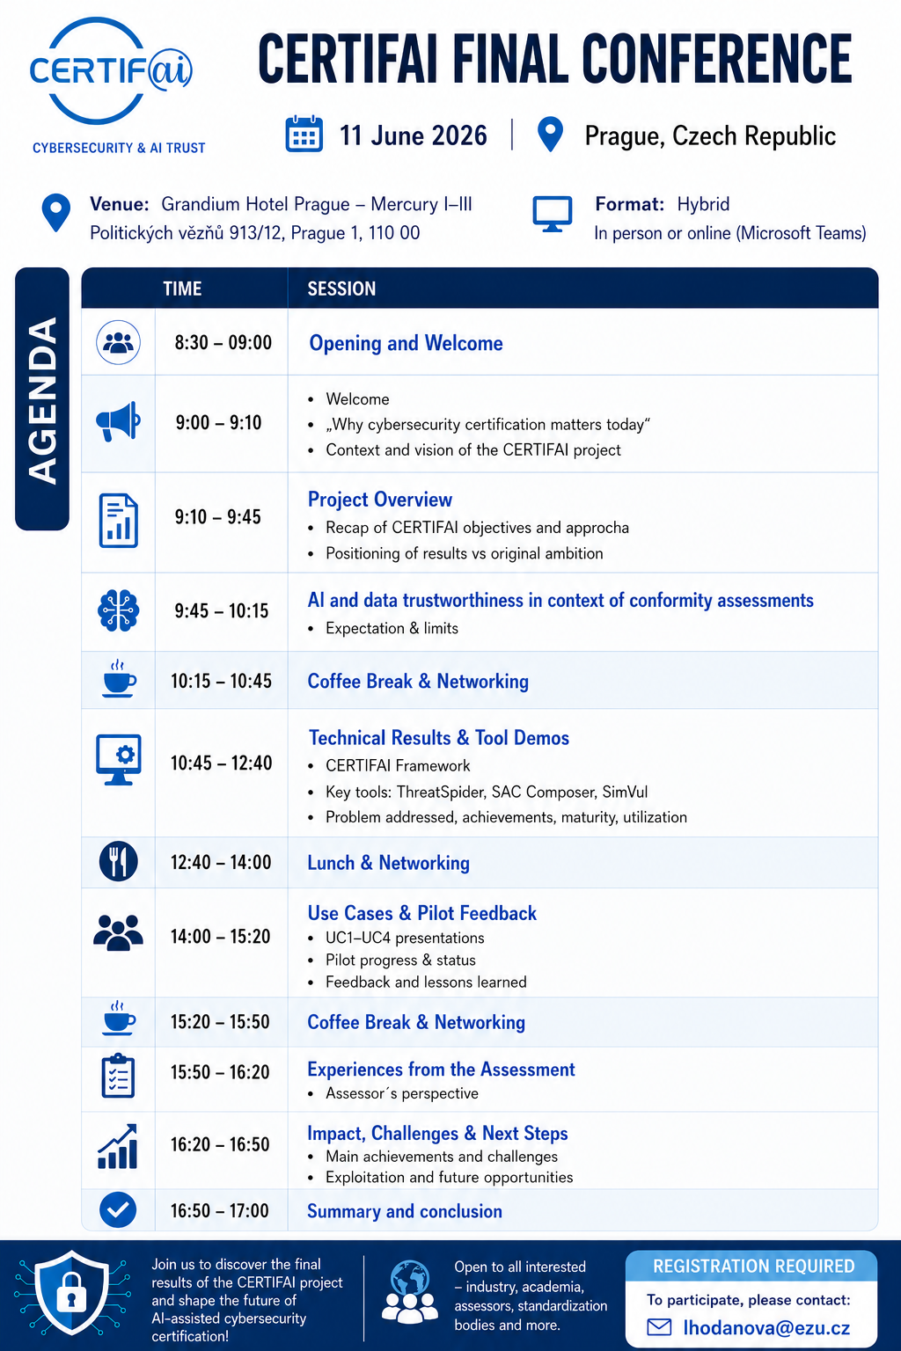
Explanation of the Agenda
Overview of the meeting structure
Key discussion points
Objectives of the session

Slide 4


Concept of the Advisory Board
Definition and purpose
Key responsibilities and expectations
Role of members in decision-making

Slide 5
Thank You
For Your Attention

