Slide 1
Workshop - CertifAI
Midterm Workshop - “Security Assurance Case COMPOSER”
NH Hotel, Prague
13/02/2025

Slide 2
Index
Context
Design & Modeling
Demonstration
Future work
Conclusions

Slide 3
Context & Motivation

Slide 4
Need to accelerate (re)certification
Need to curb costs
Limited/distributed knowledge

Slide 5
Need to accelerate (re)certification
Need to curb costs
Limited/distributed knowledge
Automation through Digital solutions
Natural Language Processing

Slide 6
Need to accelerate (re)certification
Need to curb costs
Limited/distributed knowledge
Automation through Digital solutions
Natural Language Processing
Security Assurance Case Composer
Security Assurance Case
meets
Large Language Models

Slide 7
Need to accelerate (re)certification
Need to curb costs
Limited/distributed knowledge
Automation through Digital solutions
Natural Language Processing
Security Assurance Case Composer
Security Assurance Case
meets
Large Language Models
(Agentic)

Slide 8
Security Assurance Case
SubClaim
Evidence
Argumentation with evidence
Structured natural language
Needs domain knowledge
Time consuming
Claim

Slide 9
Large Language Models
Language patterns
Domain knowledge
Limited context
Interaction

Slide 10
Security Assurance Case
Large Language Models
Argumentation with evidence
Structured natural language
Needs domain knowledge
Time consuming
Language patterns
Domain knowledge
Limited context
Knowledge base

Slide 11
Overview
User Interface
Threat Model
{Req IEC 62443}
Security
Assurance Case Composer
Security
Assurance
Case
Validation
Monitoring dashboard

Slide 12
SAC context
Benefits
Security Assurance Case (SAC)
“a powerful tool to analyze conformation of critical systems with established set of requirements” [1]
“effective at organizing the relevant assurance information necessary to achieve certification” [2]
“Provide an efficient path to certification compared to other approaches by providing focus and direction for the certification” [2]
ACs Historically originated for Safety in the 1950s
Great influence by “The uses of Argument” (1958) by Stephen Toulmin.
“A reasoned and compelling argument, supported by a body of evidence, that a system, service or organisation will operate as intended for a defined application in a defined environment.” [GSN standard]
Different notations:
Goal Structuring Notation (GSN)
Claim-Argument-Evidence (CAE)
…

Slide 13
SAC Composer
Benefit,
Why LLMs?
Large Language Model (LLM)
Deep-learning models with attention mechanism, based on Transformer arquitecture.
Probabilistic model
Pre-trainned with massive text corpus
From 7B to 600B parameters (~70B)
Semantic pattern understanding.
Open problem specification in NL
Show reasoning capabilities
Some human alignment
But can “hallucinate”

Slide 14
02
Design & modeling

Slide 15
Secutiry
Assurance Case Composer
After any user message…
Use current state
Trigger action(s) depending on state (& phase)
Update of state

Slide 16
Tool’s stages
1
2
3
Input selection
Claim-Argument Evidence creation
Refinement & context
Semantic similarity input
Prompt chaining
User instruction & conversation, RAG

Slide 17
Orchestration framework for agentic systems
Design diverse control flows –
single, multi-agent, hierarchical, sequential
With its stateful design,
Maintain context over time
Ensure smooth handoffs
Implementation
on

Slide 18
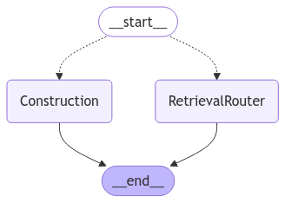
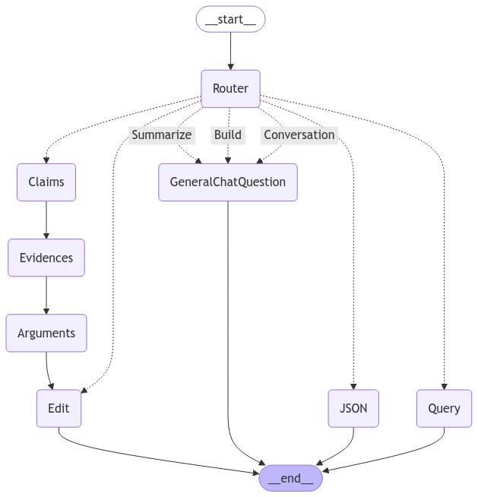
1
2
1
Input selection
Our flow.
2
CAE creation
3
Refinement
3
3
3

Slide 19
SAC Composer - Implementation
Claim from input
Evidences from claims
Subclaims and Arguments
Edit according to user request
Provide useful info to user
User intention vs. user instructions
What needs to be done to construct an Assurance Case?
What do we need as the state, i.e. all context info?

Slide 20
03
Demonstration

Slide 21
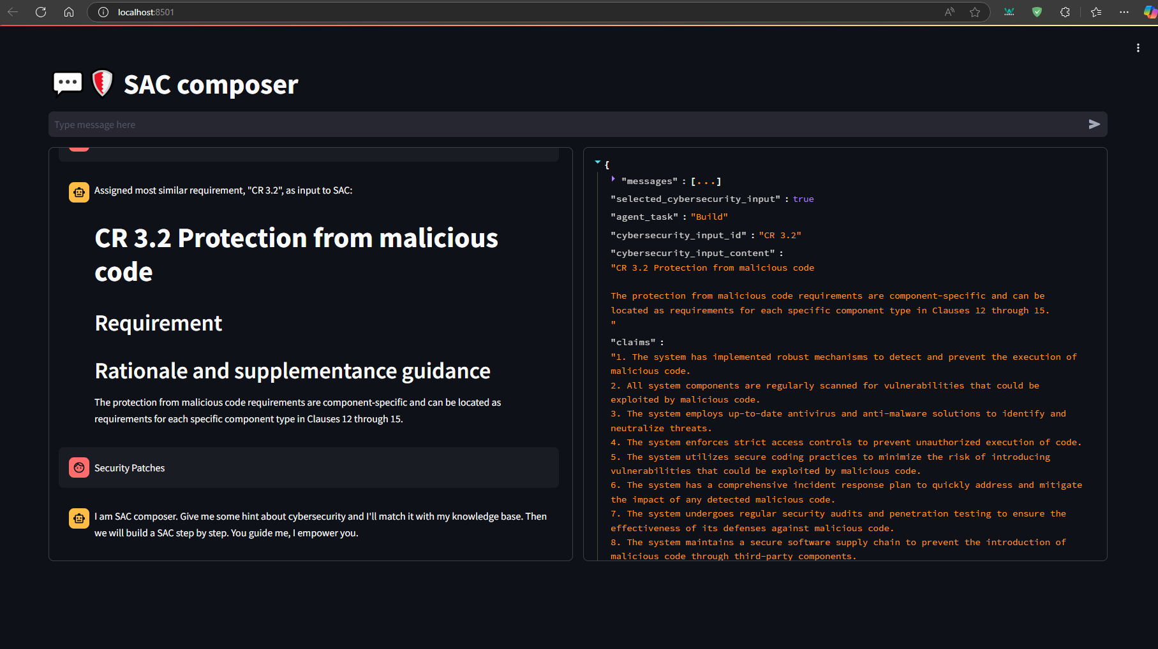

Slide 22
Streamlit app IP
Input message

Slide 23
Chat history

Slide 24
Streamlit app IP
State

Slide 25
Security Assurance Case
Composer

Slide 26
04
Future work

Slide 27
Keep on working…
Improve workflow functionalities
Intention prediction
Smooth interaction (User <-> chatbot)
Streaming, feedback
Integration
Data-Base & User-Interface, Monitoring

Slide 28
05
Conclusions

Slide 29
Experimented on AI on Security Assurance Case creation
Laid down a flexible framework
Good track, keep going.

Slide 30
References
[1] V. Sklyar and V. Kharchenko, ‘ASSURANCE CASE FOR SAFETY AND SECURITY IMPLEMENTATION: A SURVEY OF APPLICATIONS’, IJC, pp. 610–619, Dec. 2020, doi: 10.47839/ijc.19.4.1995.
[2] D. J. Rinehart, J. C. Knight, and J. Rowanhill, ‘Understanding What It Means for Assurance Cases to “Work”’, Dependable Computing.

