Slide 1
The auditor view of
AI driven certification preparation and execution
Certifai, Midterm workshop
Learnings and reflections based on Certifai participation
Per Myrseth, DNV

Slide 2




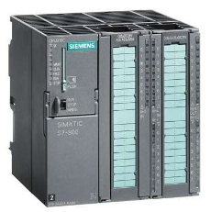

3-party - independent verifier
Supplier
Owner
System
integrator
Independent verifier
TIC = Testing, inspection, certification.
Increased focus and need for TIC services, increased demand.
Digitalisation and efficiency of TIC services needed, harmonize if possible.
All roles must contribute to the digitalisation journey.
TIC should be involved in the full lifecycle and post market monitoring

Slide 3

Certification. Preparation and execution
Preparation by vendor
Execution by 3-party
Subject for
certification
Certification process
Life cycle processes
All relevant information
All relevant information
Requirements &
thresholds
Record keeping
Info
Requirements
Cyber standard
e.g. IEC 62443 … security for operational technology in automation and control systems.

Slide 4
IEC62443-3-3 Security Level 1 summary – example

Slide 5
Audit output
Audit score for multiple products
For each requirement :
Arguments for compliance / claims
Evidence and its strength
Conclusion
Comment
UR E26 and ships in operation – anonymous example

Slide 6
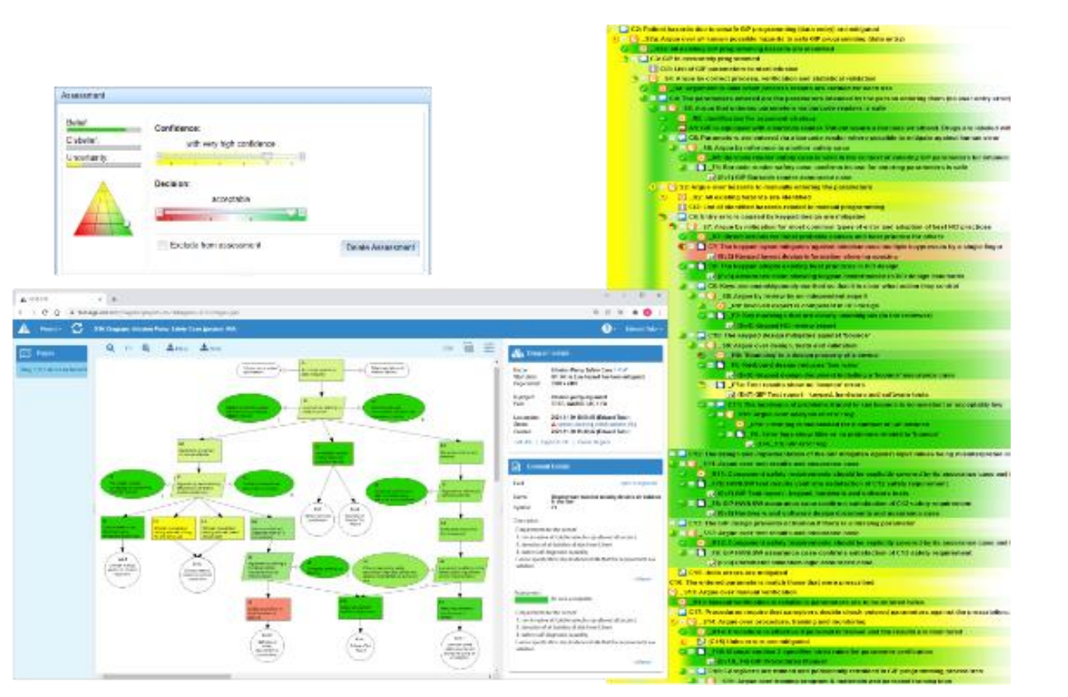
https://www.argevide.com/documents/PREMIS-Assurance-Case-Tool.pdf

Slide 7
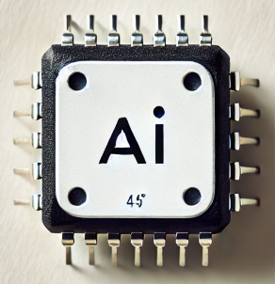
Vendor process
Devops traditionally
Devops with AI
Req. , docs & evidence
Req, docs & evidence
Validate
Tools
HMI
Validate
Validate
Info
Info
Validate requirements related to people, process, data & information, tools, methods, product quality characteristics, test results etc
Added focus: Trust in AI and the output. People’s ability to utilize AI with care, new processes and dependencies.
Auditor focus

Slide 8
AI in the vendor process and efforts
AI in system’s lifecycle
Design
Development
Testing
Operation
Change management
Example of changes
AI becomes a key asset to be Quality Assured
AI generates design, SW & AI code
AI generates documentation & evidence of compliance
AI to test systems and evaluate compliance
AI integrated with 3-party audit services
AI chatbots and quality agents gives efficiency gains
Vendor need AI competence and AI life cycle processes
Notes:
Much more dependent on data quality
AI needs to be retrained on new threats, vulnerabilities, standards etc.
Ease to do what if, evaluate mitigating / design alternatives
Dealing with new types of false positives and false negative vulnerabilities and threats

Slide 9
Life cycle focused certification
Vendor
Life cycle processes,
design, development, testing, operation, change mngt
What to certify,
Validate design,
Test and assure
Self assessment
Input to certification
Feedback,
request additional
information
Continuous
certification
Feedback
3-party
Certification process

Slide 10
How may AI impact 3-parties
Positive effects/can be managed:
Information collection and investigation:
Large volume of multimodal info sources. (text, video, figures, diagrams etc.)
Evaluation: Manage large number of requirements and evidences
Continuous / close to continuous
Auditors chatbots support in all steps
Ease integration with vendor dev-sec-ops & logs
Better reproducibility of audit, improve explainability and audit traceability

Slide 11
How may AI impact 3-parties, challenges
AI becomes a key asset to be quality assured
Need explainable AI & transparency
Trust and security of AI & data => new type of evidence needed, these are not in current standards
Standards are written for human-led audits and assessments. They often contain qualitative language (“appropriate”, “sufficient”, “robust”).
Vendor-AI may fool Auditor-AI or AI find better way of collaboration
Auditor need new competence, e.g. in quality of digital assets like AI, data, etc.
Notes:
Dealing with new types of false positives and false negative vulnerabilities and threats
Increased complexity, more info, heterogeneity, more requirements
Auditor need human oversight & human-in-the-loop
Tacit knowledge & common sense hard for Auditor AI
Certification of e.g. evidence creating tools, or tools for certification?
Liability of wrong audit conclusion, AI decisions in court.
AI may be more consistent than human.

Slide 12
From skilled workers to automation in decision making
Continuum
Knowledge
Skilled workers with education, experience, tacit knowledge, general intelligence
Agents with grades of autonomy
Information
Curriculum,
best practice
All relevant
training data
All relevant
training data
Data
Situational awareness
Situational awareness
Situational awareness
Manual work
Automation & autonomy

Slide 13
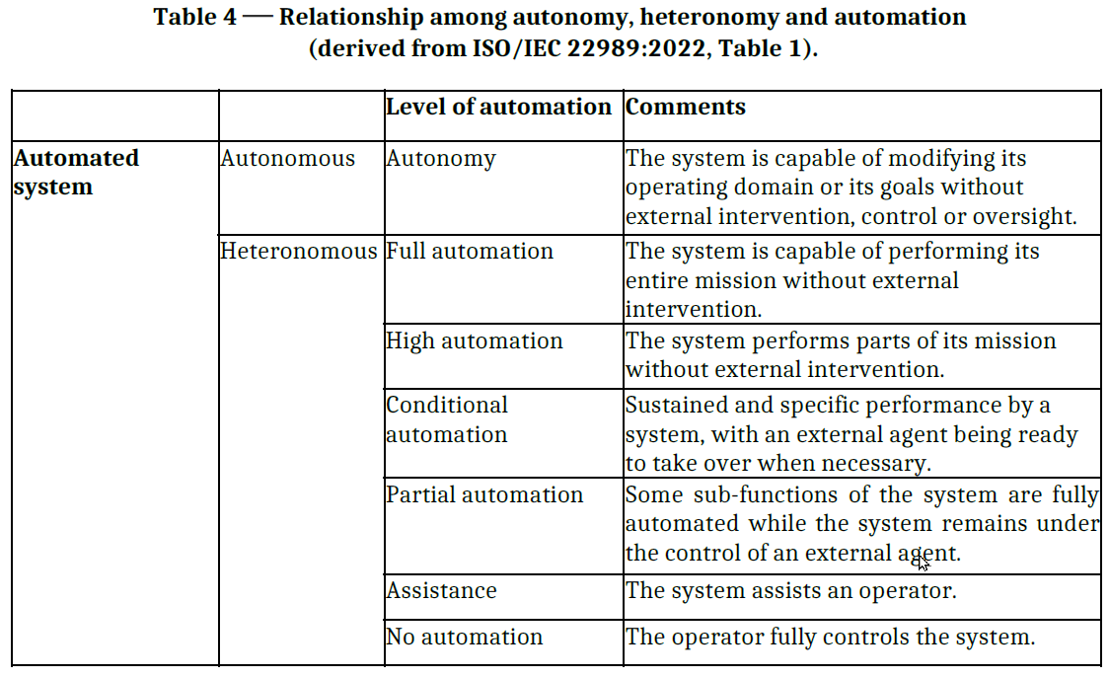

Slide 14
AI support in DNV Certificaiton services
Operational data => recertification planning, picking the topics that matters.
Complai, audit preparation, execution in the making, used by both vendor and auditor
2021.ai, audit preparation, used by both vendor and auditor
IQM, a digital auditor, real time monitoring/certification

Slide 15
Thanks for your attention

