Slide 1
Use Case 4 – Fire detection IoT
Catalink
Prague Mid-term Workshop
Maria Maslioukova
HORIZON-CL3-2022-CS-01-04: INCREASED CYBERSECURITY 2022
Ref. Ares(2022)8966412 - 23/12/2022

Slide 2
About Us
SME
Location: Cyprus
Collaboration with high-level Universities, research institutes & ICT industries.
Expertise: Semantic Technologies, Software Development, Computer Vision & Artificial Intelligence
Experience: Healthcare, Culture, Civil Security and Climate & Mobility
Certification experience: None

Slide 3
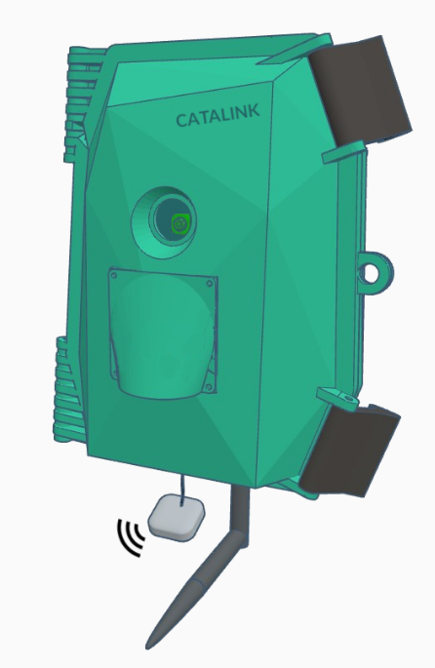
Catalink Products
CASPAR
IRIS
Structured Data Semantic Exploitation Framework
Driver State Monitoring Android application
For more information:
https://catalink.eu/
SHELFMYSTORE
PATROLIoT
Pharmacy Planogram
Fire and Smoke Detection IoT
Notes:
CASPAR -> domain-agnostic tool for the automated retrieval and fusion of structured data from different sources, which enables the discovery of new knowledge and extraction of insights
IRIS -> app that provides real-time monitoring and assessment of the drowsiness and inattention level of a driver

Slide 4
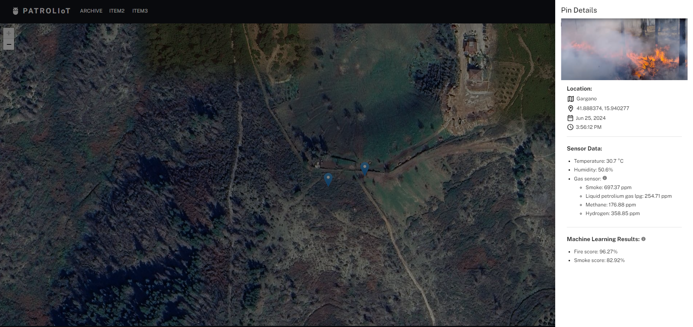
PATROLIoT
IoT edge device
Self-powered
Collects environmental sensor data and images
Machine learning (image-based) fire and smoke detection
On-site data processing
Continuous reporting to dedicated dashboard

Slide 5
IoTs
IoTs
Healthcare
Industry/
Manufacturing
Smart cities/
homes
Agriculture
Transportation
Notes:
IoTs, whether we notice it or not have become an inseparable part of our lives, with their applications raging from healthcare to agriculture.

Slide 6
IoTs & AI
Io
AI
IoTs
Data analysis/
trends
Facial recognition
Healthcare
Industry/
Manufacturing
Smart cities/
homes
Chatbots
Personalisation
Agriculture
Transportation
Notes:
Now, if we add AI to the equation, these cover the majority of our daily interactions with technology.

Slide 7
IoT cyber security attacks
IoTs often
Use default passwords
Unsafe communication
Unencrypted data storing
Automations
Notes:
Even though IoTs provide to businesses and the general public multiple benefits, they do not lack weaknesses, with one of them being cyber security.
This makes them very attractive for malicious actors, as they can exploit known IoT vulnerabilities such as:
The use of default credentials to connect to the device, without at least advising users/buyers to change them
Use of unsafe communications when transmitting collected data, or at least applying some kind of encryption to the data or using secure connections
Same applies for data storing
Also, IoTs often use automations in their procedures, with or without the help of AI technologies, that again can be exploited and used against them

Slide 8
IoT cyber security attacks
IoTs often
Exploited for
Use default passwords
Unsafe communication
Unencrypted data storing
Automations
Personal Information/Data leaks
Ransomware
Spoofing
Phishing
Denial-of-Service
Notes:
Having these "weapons" in hand, the attackers, can extract and leak personal information/data that can also be used for ransomware.
Additionally, by gaining access to the IoT the attackers can use it for spoofing or phishing or even worse denial-of-service attacks.
For example, imaging installing smart locks on your house and you are denied entry because someone deleted you from the list of residents, and on top of that asking you for ransom to gain your access back.

Slide 9
AI risks and trustworthiness
AI often is
Result in
A "black box"
Biased
Not secure by design
Personal Information/Data leaks
Discriminations
Ethical dilemmas
Misinformation
Notes:
AI risks and trustworthiness are also pressing concerns. Despite its power and plethora of applications, AI is not flawless.
Often it is perceived as a "black box", its decisions are opaque, and biased training data may lead to unfair outcomes, such as a job rejection based solely on the algorithms decision.
Security is another issue – AI systems are not usually designed with security as a priority, making them vulnerable to manipulations and data breaches, which also rise ethical dilemmas when person information can be extracted without consent.
Lastly, AI-driven tools can spread misinformation, which can reinforce biases and partial truths.
While AI has a multitude of applications, it remains just a tool – one with significant limitations that need to be addressed.

Slide 10
Cyber Resilience Act (CRA) and AI Act
CRA main outcomes
AI Act main outcomes
Improve cybersecurity and transparency of products with digital elements
Tackle known vulnerabilities &
Security updates
Data minimization
Facilitating compliance
Safer use of digital products
AI system risk assessment
Accountability
Transparency
Safety and fundamental rights
Notes:
Having all of this in mind, and with the rapid growth and interest in these technologies the EU has put into action two legislations, the Cyber Resilience Act and the AI Act.
Aiming to ensure that security is a main component of a product and considered throughout its life cycle.
That no product or AI system will be placed in the market that can pose a threat to its users in any way, thus facilitating transparency and trustworthiness.

Slide 11
Cyber Resilience Act (CRA) and AI Act
CRA main outcomes
AI Act main outcomes
Improve cybersecurity and transparency of products with digital elements
Tackle known exploitable vulnerabilities &
Perform security updates
Address data minimization
Facilitating compliance
Safer use of digital products
AI system risk assessment
Accountability
Transparency
Safety and fundamental rights
Notes:
Having all of this in mind, and with the rapid growth and interest in these technologies the EU has put into action two legislations, the Cyber Resilience Act and the AI Act.
Aiming to ensure that security is a main component of a product and considered throughout its life cycle.
That no product or AI system will be placed in the market that can pose a threat to its users in any way, thus facilitating transparency and trustworthiness.

Slide 12
CertifAI's Contribution
Gain insights of certification procedures
Familiarise with CRA and AI Act needs and requirements
Try innovative and user-friendly tools for risk assessments
Detect PATROLIoT's possible weaknesses, threats and vulnerabilities
Identify mitigations
Notes:
PATROLIoT will be no stranger to such threats or attacks.
Such an example would be an arsonist attempting to deceive the device, by preventing it from triggering the fire alert and notifying first responders during a wildfire.
This delay in detection could allow the fire to spread unchecked, worsening its impact.
To avoid this Catalink aims within CERTIFAI to:
Gain a better understanding of the certification procedures, as we have no prior experience
Familiarise with the needs and requirements of the upcoming EU CRA and AI legislations, or any other relating legislation/framework
Especially, with the help of CertifAI's innovative tools, that will provided better explainability of each step, thus being more user friendly and also assist us in better preparing PATROLIoT for its release to the market.
That is, continuously conduct risk assessments of its various components to detect possible threats and vulnerabilities, and of course the respective mitigations to make sure our product is secure and trustworthy.

Slide 13
Thank You
For Your Attention

Slide 14
Sources
European Commission, "Regulatory framework proposal on AI," Digital Strategy. [Online]. Available: https://digital-strategy.ec.europa.eu/en/policies/regulatory-framework-ai. Accessed: Feb. 4, 2025.
European Commission, "Cyber resilience act," Digital Strategy. [Online]. Available: https://digital-strategy.ec.europa.eu/en/policies/cyber-resilience-act. Accessed: Feb. 4, 2025.
Cyber Management Alliance, "IoT security: 5 cyber attacks caused by IoT security vulnerabilities," [Online]. Available: https://www.cm-alliance.com/cybersecurity-blog/iot-security-5-cyber-attacks-caused-by-iot-security-vulnerabilities. Accessed: Feb. 3, 2025.
Trend Micro, "Top AI security risks," [Online]. Available: https://www.trendmicro.com/en_id/research/24/g/top-ai-security-risks.html. Accessed: Feb. 3, 2025.

