Slide 1
Use Case 3: MindChip Artificial Captain
for Maritime Autonomy
Tanel Kerstna, Mindchip
HORIZON-CL3-2022-CS-01-04: INCREASED CYBERSECURITY 2022
Ref. Ares(2022)8966412 - 23/12/2022

Slide 2
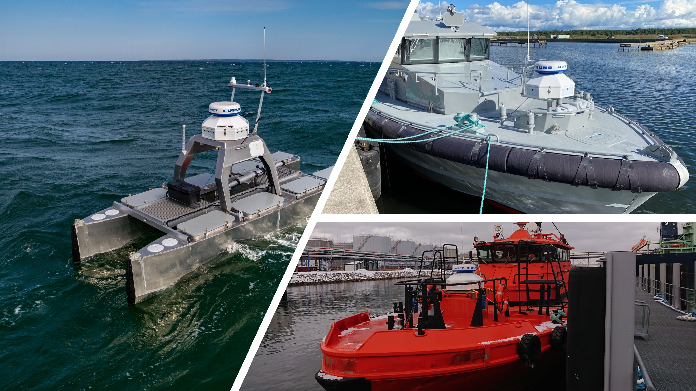
About Mindchip
Estonian-based deep-tech company
TalTech University spin-off
Maritime Situational Awareness & Autonomous Navigation Solutions developer
Main product: Artificial Captain
Never send a human to do a machine’s work

Slide 3
The Need for Autonomous Vessels
Autonomous vessels offer substantial reduction in operational costs
Facilitate tasks that may pose risks to human labor.
Applications include seabed monitoring, oil spill detection, border surveillance, environmental surveys, etc.

Slide 4
Mindchip Artificial Captain: A Comprehensive Solution
Two interconnected parts: Control Tower and Server Platform
Control Tower
Control Tower enables autonomous or remote-controlled operation with functionalities such as situational awareness, autonomous navigation & vessel control, object detection, 360º vision, and COLREGs-based navigation. It has customized interface controller to communicate with ship control systems
Server Platform
Server Platform provides real-time monitoring, telemetry, mission planning, and user management

Slide 5
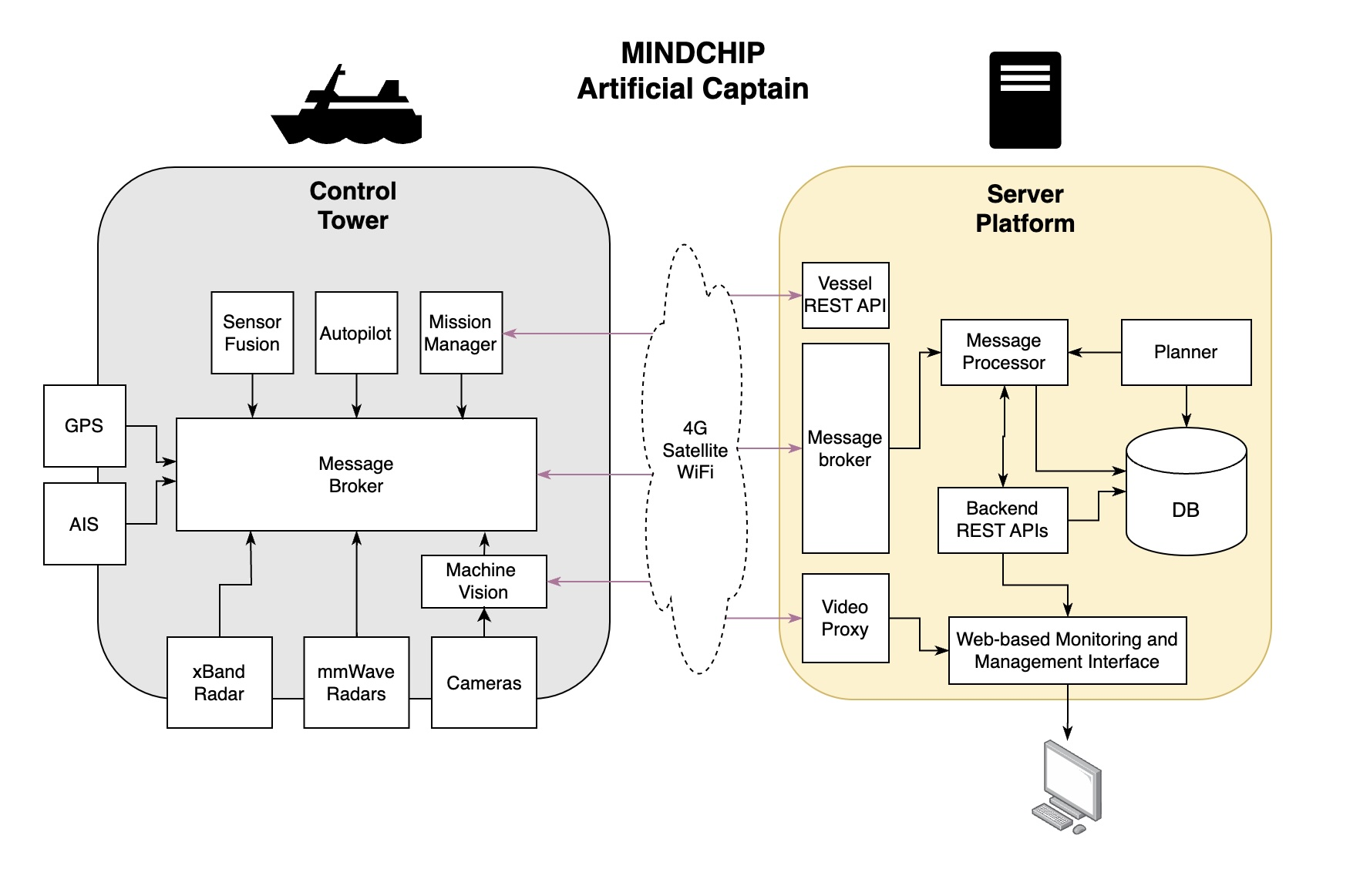
High-Level Service Diagram

Slide 6
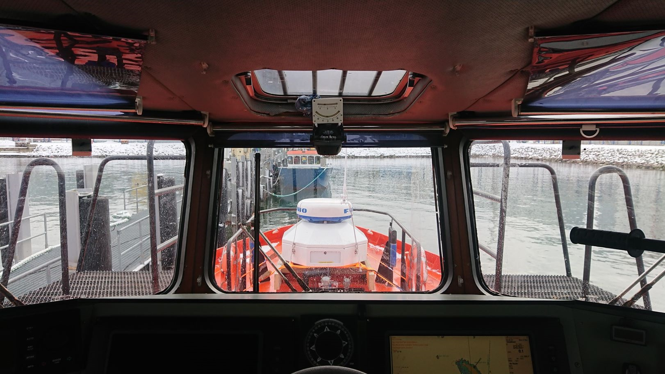
Need for Certification
Autonomous surface vessels may serve as an integral component of critical infrastructure, engaging in surveillance activities and navigating through areas with high marine traffic,
Imperative to implement stringent security measures
Various Standards
IEC 62443-2-4: a comprehensive set of requirements for security capabilities for IACS service providers
Unified Requirement (IACS)
UR26: cyber resilience of ships
UR27: cyber resilience of on-board systems and equipment

Slide 7
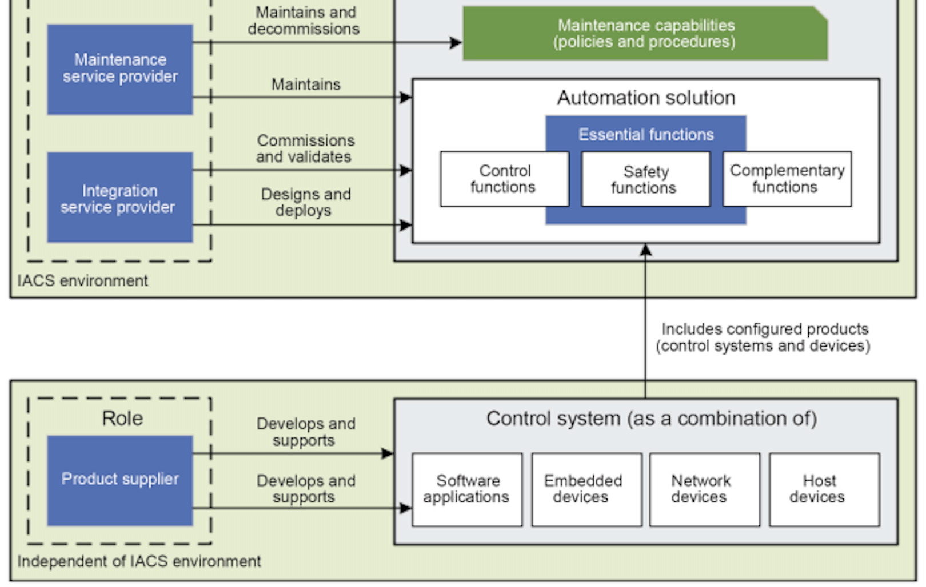
Scope within CERTIFAI
Subject for Certification: Mindchip Server Platform
Service role according to IEC 62443-2-4:
integration service provider
maintenance service provider
Scope of Service Provider Processes – from IEC 62443-2-4 standard

Slide 8
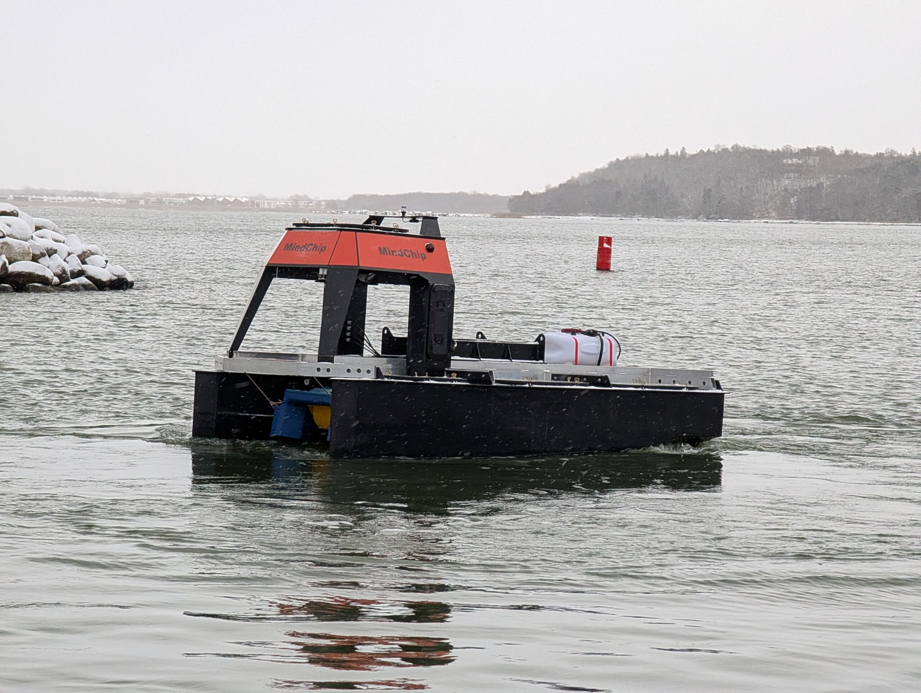
CERTIFAI Benefits for SME
Agile framework to help comply with cybersecurity standards and EU regulations.
Adaptability to specific cybersecurity requirements and evolving compliance needs
Provides best practices and guidelines to set up the environment aligned with certification standards
Reduction of certification effort, time and cost

Slide 9
KPIs
30% increase of detecting security vulnerabilities in the server platform
30% decrease of effort by automating testing activities in the server platform
Achieving compliance with applicable requirements from IEC 62443-2-4

Slide 10
Thank You
For Your Attention

