Slide 1
Use Case 1 – Railway
Hitachi Rail
Claudia Lutze
Peter Tummeltshammer
HORIZON-CL3-2022-CS-01-04: INCREASED CYBERSECURITY 2022
Ref. Ares(2022)8966412 - 23/12/2022

Slide 2
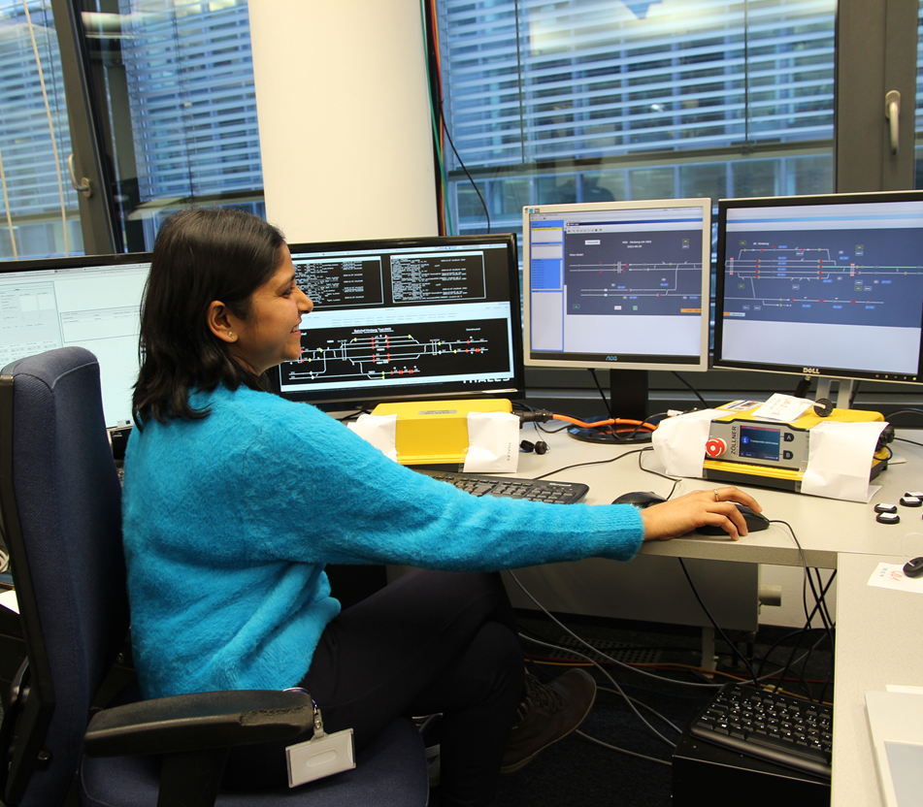
Hitachi Rail in Austria
Employees
480+
Office in
Vienna
With a 60+ years local footprint, Austria is one of Hitachi's key references in digitalisation of railways, providing modern signalling technologies and comprehensive traffic management systems to infrastructure operators.
Route Control Systems
Traffic Management Systems
Train Control Systems
SIL4 Platform
Complementary Solutions
Notes:
One of 4 development competence centres in Europe
Use cases: SIL (safety integrity level) 4 Platform and Warning System in complementary solutions

Slide 3
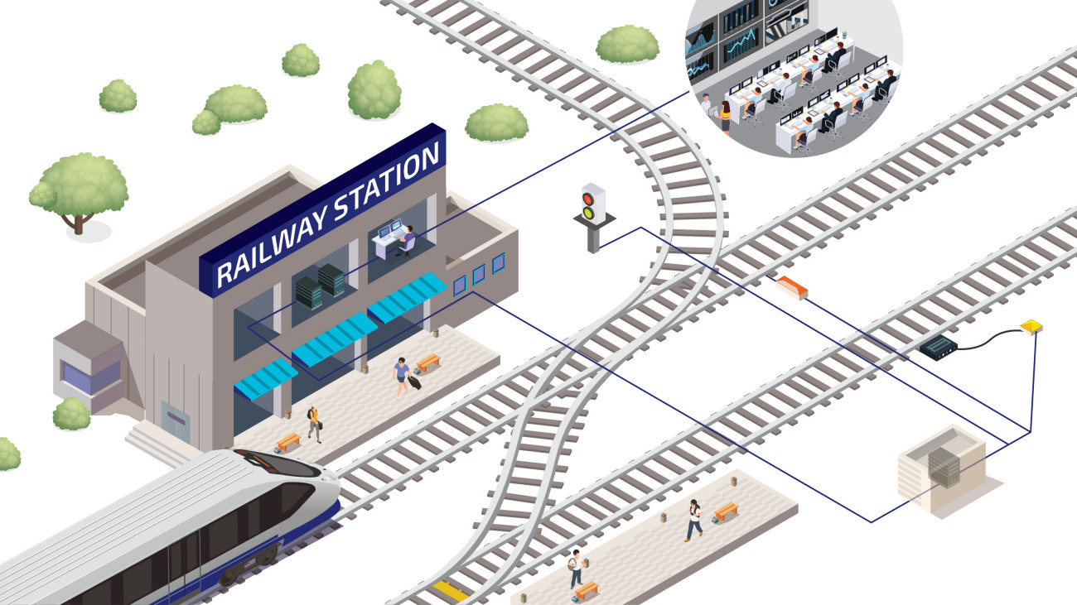
Source of Complexity in the Railway Domain

Slide 4
Why we Need Cybersecurity
Regulatory requirements
NIS2 directive for asset owners
Cyber Resilience Act for product suppliers
Hitachi Rail internal cybersecurity requirements
Certification requirements
Safety EN 50129,
Security IEC 62443-4-1, TS 50701, IEC PT 63452, ISO 27001 certification
Customer requirements
Security feature requests, fulfilment of regulations
Current Threat Landscape
Attacks on critical infrastructure are increasing

Slide 5
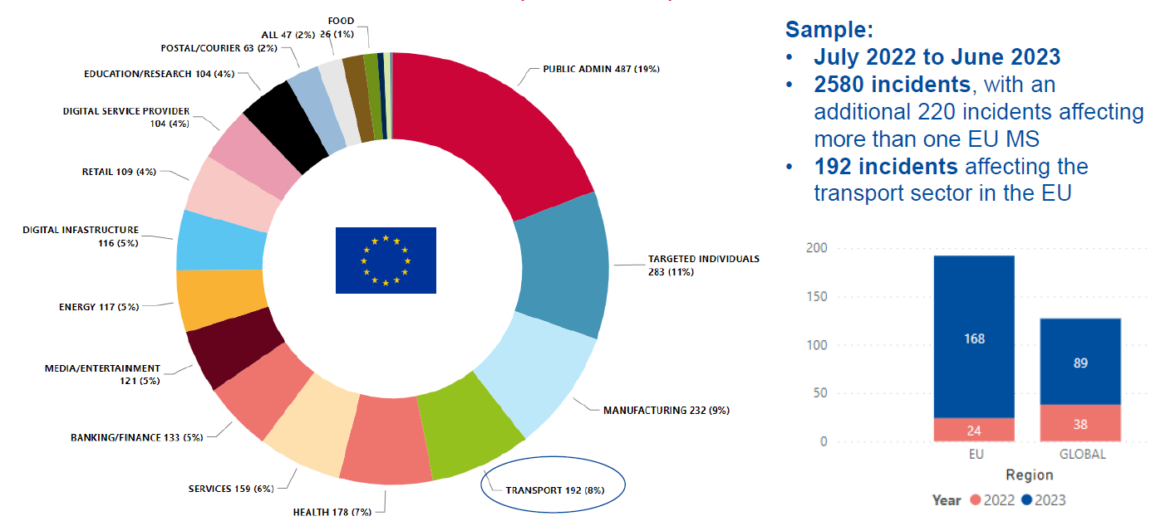
Sector Analysis – Transport
Source: ENISA Threat Landscape 2023: Transport Sector
Notes:
ENISA Threat Landscape 2024 – 11% of the reported incidents happened in the Transport sector
Transport sector – Maritime sector, Aviation sector, Railway sector, Road & Cross-Road sector
Prime threats Railway:
Ransomware and data-related threats are the two main threats targeting the railway sector (45% and 25%, respectively), followed by DDoS attacks with an increasing rate.
Ransomware and data-related threats are closely interlinked, as a ransomware attack is often followed by data leakage or exfiltration
Threat actors ETL 2023- Transport: State sponsored attacks (15%), Cybercriminals (47%), Hacktivist (23%), Individual actor (7%)

Slide 6
Generic certification approach
IEC 62443 product lifecycle standards for components
IEC 62443-4-1
IEC 62443-4-2
IEC TS 62443-6-2 Evaluation methodology for IEC 62443-4-2
CRA conformity
CLC/TC65X WG3 Cyber Security
Map CRA Annex I essential cybersecurity requirements to EN IEC 62443-4-2:2019, -4-1, -3-3
European level: EN IEC 62443-4-2 and EN IEC 62443-4-2/A11: Additions, deletions, modifications according to CRA requirements
Merge of EN IEC 62443-4-2 and EN IEC 62443-4-2/A11 on national level: NBN EN IEC 62443-4-2:2026

Slide 7
Threat – Vulnerability – Requirement (TVR) Traceability
IEC 62443 product lifecycle standards for components
IEC 62443-4-1:2018, Security for industrial automation and control systems - Part 4-1: Secure product development lifecycle requirements, Edition 1.0
IEC 62443-4-2:2019, Security for industrial automation and control systems - Part 4-2: Technical security requirements for IACS components, Edition 1.0
TVR traceability is requested by IEC 62443-4-1 and EU CRA
There is no pre-defined railway threat landscape

Slide 8
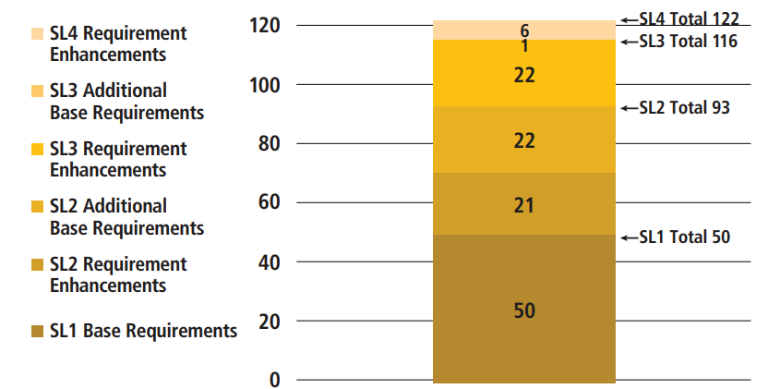
Experience with certification processes
3rd party conformity assessments on HITACHI Rail use case demonstrator were performed for several releases on
IEC 62443-4-1:2018, Security for industrial automation and control systems - Part 4-1: Secure product development lifecycle requirements, Edition 1.0
IEC 62443-4-2:2019, Security for industrial automation and control systems - Part 4-2: Technical security requirements for IACS components, Edition 1.0
Source: ISASecure The Case for ISA/IEC 62443

Slide 9
How CertifAI can improve it
Introduction of a (semi-)automated‚ ´standardized´, tool-based and sustainable risk assessment process / methodology for IEC 62443 components and systems and in future EU CRA products with digital elements
Aligned with safety tool classification criteria (EN 50128)
This process must use publicly available, maintained, and versioned resources to ease and sustain the adaption of
a dynamic threat landscape
a dynamic vulnerability landscape
IEC 62443-4-x, and in future EU CRA, requirement traceability
Introduction of a (semi-)automated version-controlled security assurance process
Aligned with IEC 62443-4-1 security verification and validation testing (SVV) processes
SVV-1 Security requirements testing, SVV-2 Threat mitigation testing, SVV-3 Vulnerability testing
and, in future EU CRA IEC EN 62443-4-2/A11 requirements testing, generating repeatable results.
Notes:
Risk assessment processes
must be learnt and understood,
must aligned throughout solutions and solution components, PS1 uses ATT&CK ICS knowledge base for TRA and PS2 uses ISO 27005 threat catalogue for TRA and PS3 uses STRIDE for TRA
must be aligned with dynamic resources – evolving threat landscape: ATT&CK provides 2 releases per year – ENISA threat landscape refers to MITRE ATT&CK knowledgebase
increasing known exploitable vulnerabilities –
Increasing actively exploited vulnerabilities – MITRE ATT&CK refers to CISA KEV known exploited vulnerabilities catalogue

Slide 10
Thank You
For Your Attention

