Slide 1
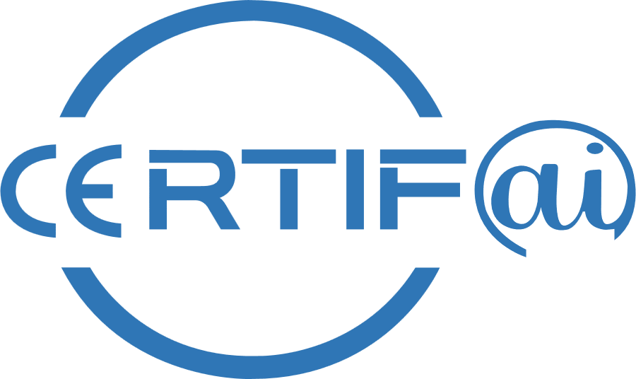
Agile conformance assessment for cybersecurity CERTIFication enhanced by Artificial Intelligence
Mid-Term WorkShop
HORIZON-CL3-2022-CS-01-04: INCREASED CYBERSECURITY 2022
Ref. Ares(2022)8966412 - 23/12/2022

Slide 2
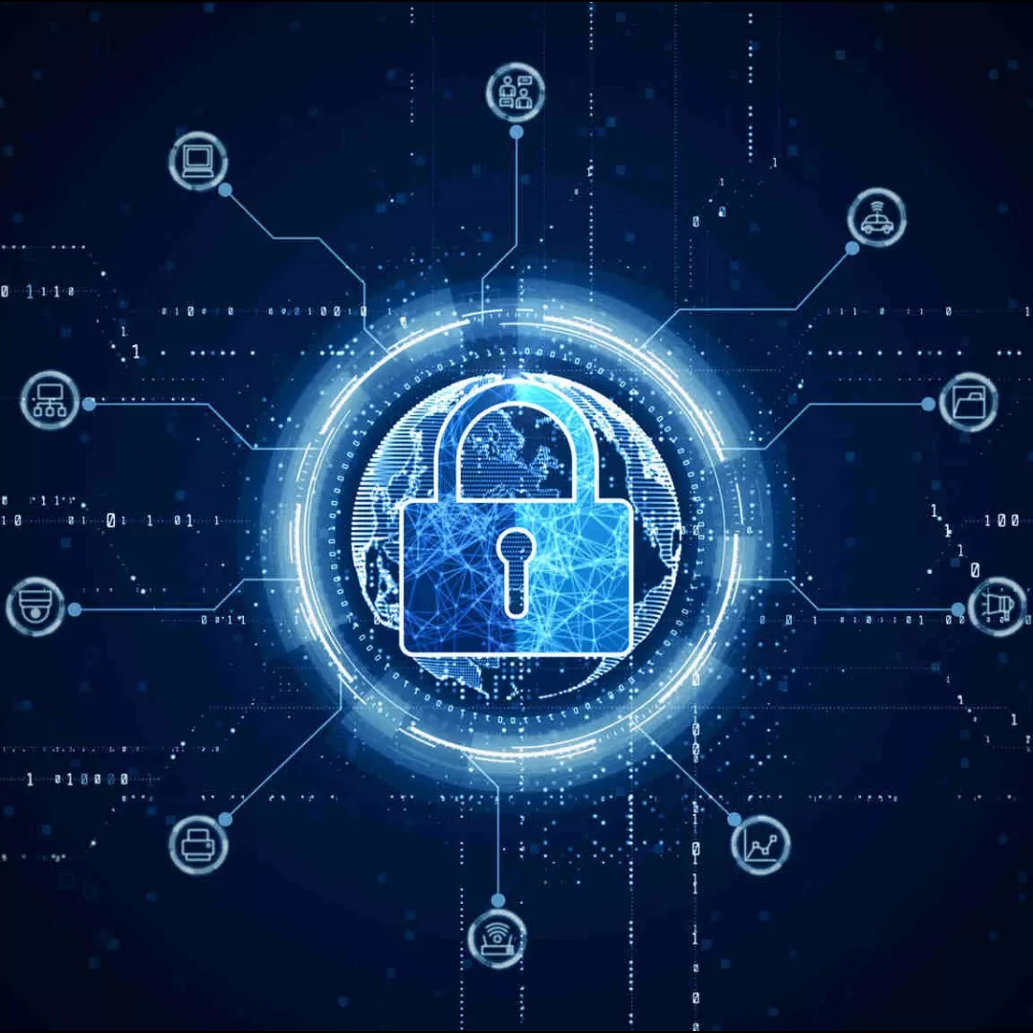
Cyber Attacks & Treats Overview
In 2022, businesses globally faced ransomware attacks approximately every 11 seconds, equating to nearly 7,850 attacks per day. techjury.net
Microsoft reports mitigating an average of 1,700 Distributed Denial of Service (DDoS) attacks daily. forbes.com
An estimated 560,000 new pieces of malware are detected daily. terranovasecurity.com
Approximately 30,000 websites are hacked daily worldwide. techjury.net
Forecasts suggest that by 2029, the global cost of cybercrime could reach $15.63 trillion USD, marking a 69.41% increase from 2024. statista.com
In 2022, the FBI received 800,944 cybercrime complaints, averaging about 2,194 reports per day. usafacts.org
Estimates the market size to reach $478.68 billion by 2030, with a CAGR of 9.5% from 2023 to 2030. strategicmarketresearch.com

Slide 3
Cybersecurity Market Trends
$101.5
Billion in projected spending on service providers by 2025
3.5
An estimated 3.5 million cybersecurity jobs are expected to be unfilled by the end of 2025
15%
Annual increase of cost related to cybercrime. The global cost of cybercrime is expected to surge from $3 trillion in 2015 to $10.5 trillion annually by 2025
+21%
Forecast of compound annual growth for direct cyber insurance premiums until 2025
$90B
Cybersecurity spending is projected to reach $90 billion by 2025, up from $57 billion in 2020, representing a CAGR of 10%
Source McKinsey & Company

Slide 4
EU Regulations and Directives
(CRA, AI Act, DORA, NIS 2, …)
Protection of Critical Infrastructure and National Security establish robust cybersecurity standards to protect critical infrastructures from cyberattacks that could disrupt essential services and destabilize national security
Protect Citizens and Businesses from the growing threats posed by insecure digital products and unchecked technologies
Responding to the Evolving Cyber Threat Landscape, regulators are compelled to continuously update and enforce cybersecurity standards to mitigate evolving threats, ensuring that defenses remain effective against new attack vectors and that organizations are prepared for future challenges
Enhancing Accountability and Incident Response emphasize accountability and timely reporting (e.g., mandatory breach notifications) to ensure that organizations are proactive in their risk management
Rebalance responsibility by placing the burden on manufacturers and providers to ensure robust cybersecurity and ethical AI practices
Harmonize standards across the EU to reduce fragmentation, foster a trustworthy digital ecosystem, and reinforce Europe’s global standing as a regulator of high-quality, secure, and ethically managed technology

Slide 5
Addressing Cybersecurity Challenges through Standards
Adopting standards and frameworks provides organizations with a structured approach to identify, protect, detect, respond to, and recover from cyber incidents
These frameworks include risk management processes, continuous monitoring, and proactive threat mitigation strategies to stay ahead of attackers
Standards and frameworks help organizations assess their security posture and implement continuous improvement mechanisms
Governments worldwide are implementing stricter cybersecurity regulations
Adoption of cybersecurity standards enables businesses to build resilience, adaptability, and proactive risk management strategies.
Compliance with cybersecurity frameworks helps businesses avoid economic and reputational damage due to breaches
The adoption of cybersecurity standards is a proven strategy to address current and future cybersecurity challenges. Businesses, governments, and final users all benefit from a standardized, proactive approach to cybersecurity, making the digital landscape safer and more resilient

Slide 6
Problems Faced by Organizations to Comply with Standards
Complexity of Standards: Organizations without a dedicated compliance or cybersecurity team often struggle to interpret the extensive and technical requirements found in standards such as IEC 62443. Mapping organizational processes to abstract control objectives can be particularly challenging without domain expertise.
Resource Constraints: Smaller or less mature organizations may lack the necessary personnel, budget, or training to implement and maintain the controls required by the standards. This leads to a reactive rather than proactive security posture, potentially delaying certification efforts.
Integration with Business Processes: Without in-depth knowledge of the standards, organizations may find it difficult to embed security controls into existing workflows and their own operations.

Slide 7
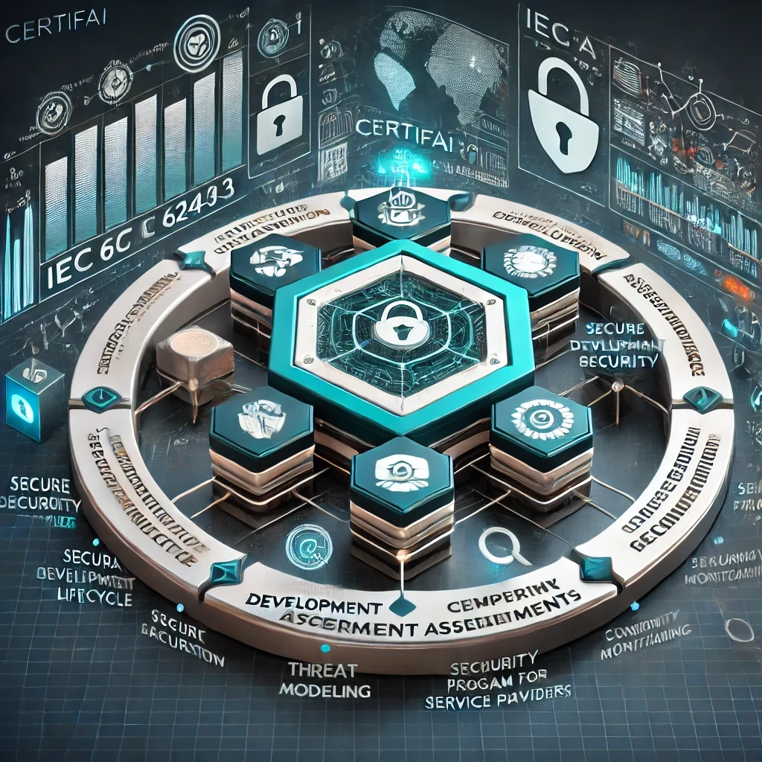
CertifAI Overall Objective
“CERTIFAI project will develop an open software framework for cost-effective AI-driven continuous assessment and (re-)certification of ICT products, processes and services, paving the way for a more secure and trustworthy EU’s digital world. Building on the EU Cybersecurity Act, CERTIFAI will leverage the established cybersecurity requirements, standards, and technical specifications to deliver an efficient approach for ensuring that a product, once certified, will continue to be compliant with relevant standards throughout its life cycle. In accordance with the ENISA Cybersecurity Threat Landscape Methodology, the CERTIFAI framework will deliver (1) tools for developing and continuously updating threat models and performing risk assessment, thus identifying potential threats, (2) tools for vulnerability testing based on the threat models, thus detecting vulnerabilities, and (3) tools for detecting and mitigating violations of conformity with standards, thus ensuring continuous assurance and compliance with regulatory requirements and industry standards. The CERTIFAI framework will be evaluated and demonstrated in four distinct use cases and made openly available for the EU’s research and industry communities.”

Slide 8
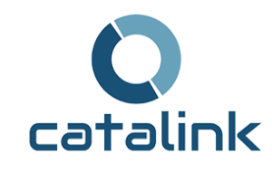

Slide 9
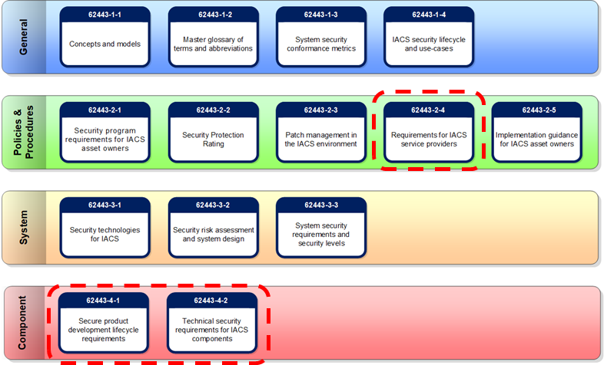
CertifAI Scope in terms of Standards-1
The goal of the IEC 62443 Series is to improve the safety, reliability, integrity, and security of Industrial Automation and Control Systems (IACS) using a risk based, methodical, and complete process throughout the entire lifecycle.
Part 4-1: Product security development
life cycle requirements describes the
requirements for a product/component developer’s
security development lifecycle. The principal audience include suppliers of Control System and Component products.
Part 4-2: Technical security requirement for IACS components describes the requirements for IACS Components based on security level. Components include Embedded Devices, Host Devices, Network Devices, and Software Applications. The principal audience include suppliers of components that are used in control systems
Part 2-4: Security program requirements
for IACS service providers specifies
requirements for IACS service providers such as system integrators or maintenance providers.

Slide 10
CertifAI Scope in terms of Standards-2
The problem addressed by CRA:
inadequate level of cybersecurity inherent in many products
inability of consumers and businesses to currently determine which products are cybersecure
The CRA proposal provides two sets of essential requirements:
Product cybersecurity requirements in Annex I, Section 1 of the CRA proposal
Vulnerability handling process requirements in Annex I, Section 2 of the CRA proposal
The Cyber Resilience Act seeks:
harmonized rules when bringing products to the market, software with a digital component;
a framework of cybersecurity requirements governing the planning, design, development and maintenance of such products, with obligations to be met at every stage of the value chain;
an obligation to provide duty of care for the entire lifecycle of such products.
These requirements should be the subject of a standardization process by the European Standardization Organizations (ESOs) to express them in the form of specifications in harmonized standards. Not yet

Slide 11
CertifAI’s Value Proposition
Implementation Guidance
Defines an approach to correctly implement security controls
Compliance Assurance
Ensures traceability of compliance evidence and validation of security measures.
Evidence Collection
Traceability & Validation
Certification Readiness Reports
AI-powered Support
Automates aspects of the certification process using AI and LLMs. Knowledge Augmentation uses LLMs to provide instant insights on cybersecurity requirements thought an AI Agent and RAG
Bridging the Gap
Helps practitioners interpret IEC 62443 and CRA requirements

Slide 12
CertifAI: Addressing Cybersecurity Compliance Challenges
Enhancing Continuous Threat Modeling & Risk Assessment
Implementing dynamic threat modeling and risk assessment techniques to identify evolving security threats.
Ensuring mitigation actions are aligned with IEC 62443 and other relevant frameworks, enhancing resilience.
Developing AI-Powered Compliance Assistance
Leveraging Large Language Models (LLMs) and Retrieval-Augmented Generation (RAG) to simplify the interpretation of cybersecurity requirements.
Providing guided recommendations for implementing robust security measures and hardening products.
Automating the Generation of Assurance Cases
Streamlining compliance validation by automating the creation of assurance cases, improving transparency and traceability.
Facilitating the identification and resolution of non-compliance issues with greater efficiency.
Continuous Vulnerability Monitoring & Remediation
Developing automated methods to detect, assess, and address vulnerabilities that impact both cybersecurity and compliance.
Enabling real-time remediation strategies to maintain a strong cybersecurity posture.
Optimizing Security Testing through Formal Methods
Enhancing vulnerability testing through formal methods, improving the efficiency and reliability of security validation.
Reducing redundant testing efforts while maximizing coverage and effectiveness.

Slide 13
CertifAI’s Functional View
Governance
Development Team
Operations Team
Requirements Analysis
Design
Coding
Testing
Deployment
Maintenance
Product Documentation
Configuration Settings and Screenshots
Password Policy Definitions
Testing and Validation Reports
Policy and Procedure Documents
Change Logs and Version Histories
Incident Reports
Training Records
….
Context Information
Context Information
Evidence Metadata Structure
Evidence Classification Modeler
Formal Verification
Risk Assessment &
Threat Modeler
Requirements Analyzer
Retrieval Augmented Generation (RAG)
Compliance Engine
LLM Agent
Evidence Mapper
Logs,
SBOM
Threat Modeler
Implementation Guidance
Assessment Criteria
Vulnerability Management
Threats/
Mitigations
SAC Composer
Compliance Verifier
Security Controls Repository
CVE DB
Risk Manager
Compliance Statements
(CAE JSON structure)
Risk Profile
Abstraction Layer
SAC Repository
Vulnerability and Incident exposure
Assessment Scope
Requirements Rating
Assessment Scope
SAC Repository
Compliance Manager
Assessment Tool
Standards & Regulations
Assessment Planner
Assessment Monitor Dashboard
Assessment Reporting

Slide 14
CertifAI Does Not Replace Certification Bodies
CertifAI is not a certification authority
Our role is to support organizations in their journey to certification by providing structured guidance and tools
CertifAI will not issue compliance certificates

Slide 15
CertifAI’s Timeline
✅Preliminary Version of RAG for Requirement Comprehension
Developed an initial version of RAG system to facilitate the understanding and interpretation of cybersecurity requirements. Focused on database refinement and enrichment to improve the accuracy and relevance of responses.
✅Gathering Requirements for Use Cases Collected d and analyzed requirements for diverse use cases, laying the foundation for upcoming demonstrations
Iterate on Current Development to Refine and enhance ongoing projects to improve functionality and performance
Develop Evidence Management Utility. Create a tool to manage evidence and link it to the SAC framework.
Establish Formal Verification Approach. Develop methods for formal verification to support rigorous testing activities.
Integrate Project Functionalities. Advance the tool to incorporate all ongoing project features into a cohesive system.
Validate Tools and Results Through Demonstrators. Test and verify tool effectiveness using demonstrators for each Use Case (UC)..
✅ Development of a Threat Modeling Tool. We have Designed and implemented a threat modeling tool to analyze security risks and identify mitigation actions aligned with standards such as IEC 62443.
✅Initiation of an Integrated Cybersecurity Compliance Tool. Launched the development of a comprehensive tool that integrates multiple functionalities, providing a single platform for cybersecurity compliance, risk assessment, and automated assurance case generation.
01 Sept 2023
28 Feb 2025
31 Ago 2026
Finalize Assessment Methodology. Complete the methodological framework detailing the assessment process.
✅Security Assurance Case (SAC) Composer – PoC Stage
Progressed to the PoC stage, identifying development frameworks, integrations, and output formats for automating the generation of assurance cases. Enhances transparency in compliance by structuring security arguments and justifications efficiently.
✅Software Bill of Materials (SBOM) for CVE Monitoring & Risk Management
Developed a SBOM-based approach to track Common Vulnerabilities and Exposures (CVE), enhancing vulnerability management. Provides automated risk assessment and recommends remediation actions to improve cybersecurity posture.

Slide 16
Challenges Encountered
Complexity of Cybersecurity Across Multiple Domains
Cybersecurity is a multifaceted discipline, spanning product security, operational aspects, governance, and compliance.
Addressing all these layers simultaneously while ensuring alignment between technical and regulatory perspectives is being complicated.
Fragmentation of Knowledge and Interpretation Misalignment
The field is highly fragmented, with different stakeholders interpreting key concepts differently.
Technical Challenges in AI-Based Solutions
We rely on Large Language Models (LLMs) and AI-driven frameworks to enhance compliance automation and security assessments. However, the rapid evolution of AI technologies poses a challenge in keeping our solutions up to date, ensuring reliability, and managing risks associated
Complexity in Standards Comprehension & Compliance
Cybersecurity standards (e.g., IEC 62443, CRA) have nuanced requirements that require deep expertise and precise interpretation.
Gaps in understanding these standards and their practical implications have slowed tool development and integration efforts.
Interdependencies and Uncertainties in Execution
The project involves multiple interdependent tasks, where technical and functional uncertainties have led to delays.
Data Availability & Validation Challenges
Ensuring that AI models are trained with high-quality, domain-specific cybersecurity data is a challenge due to the sensitive nature of security information. Access to real-world datasets and validation mechanisms for AI-generated compliance recommendations remains a key constraint.
Evolving Regulatory & Market Landscape
The regulatory environment is evolving (e.g., Cyber Resilience Act, AI Act and AI Act), requiring continuous adaptation of our methodologies. Ensuring long-term relevance of the developed tools amidst shifting compliance landscapes is a key challenge.

Slide 17
Thank You
For Your Attention

