Slide 1
HORIZON-CL3-2022-CS-01-04: INCREASED CYBERSECURITY 2022
Ref. Ares(2022)8966412 - 23/12/2022

Slide 2
Welcome & Introductions
Brief welcome message
Welcome everyone to our workshop and first Advisory Board meeting. We appreciate your time and expertise in shaping the future direction of our project.
Quick ‘Tour de Table’
01
Your Name & Position
Your Organization & Expectations
02
Michal Hager Head of Cyber Security Department
Elektrotechnický zkušební ústav, s.p. (EZU)
Expectations:
Active participation and engagement in discussions
Sharing valuable insights and expertise
Providing constructive feedback on presented topics

Slide 3
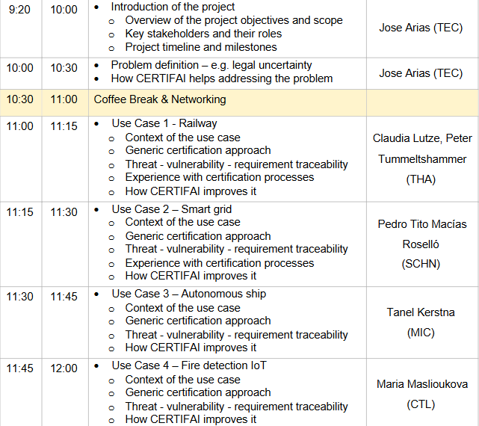
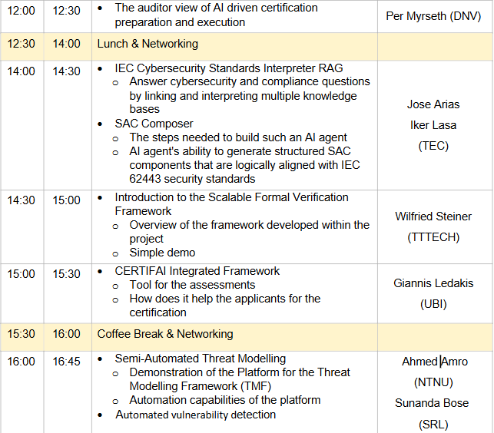
Explanation of the Agenda
Overview of the meeting structure
Key discussion points
Objectives of the session

Slide 4
Concept of the Advisory Board
Definition and purpose
Key responsibilities and expectations
Role of members in decision-making

Slide 5
Thank You
For Your Attention

