Slide 1

HORIZON-CL3-2022-CS-01-04: INCREASED CYBERSECURITY 2022
Ref. Ares(2022)8966412 - 23/12/2022

Slide 2
Summary of the Day's Discussions and Presentations
Key topics covered
Highlights from speakers
Main takeaways and insights
Notes:
Key Topics – AGENDA
Highlights from speakers:
Problem definition: A lot of EU Regulations – how to navigate
Standards and how they can help us and how to integrate them
CertifAI project – bridging the gap, implementation guidance, compliance assurance, AI-powered support
CertifAI does not replace Certification Bodies, but rather support organizations in their journey to certification by providing structured guidance and tools​​
Use cases – four different views and level of experience – hence expectations – hence the needs to address them during the project
Auditor view – AI driven certification – how far can we go and what the challenges are.
Demos and the CertifAI framework itself: SAC Composer, Threat Modelling Framework and Automated vulnerability detection
Takeaways and insights from audience:
Ask those who are online and here (outside of consortium)

Slide 3
Invitation to Advisory Board
Purpose and role of the Advisory Board
Benefits of joining
Modus operandi: meetings, information sharing, collaboration
How to express interest in joining:
  Contact: Lenka Mariánková
            lmariankova@ezu.cz

Slide 4
Pre-invitation to the
Final Conference
Purpose of the Final Conference
Key deliverables and expected outcomes
Tentative date and location

Slide 5
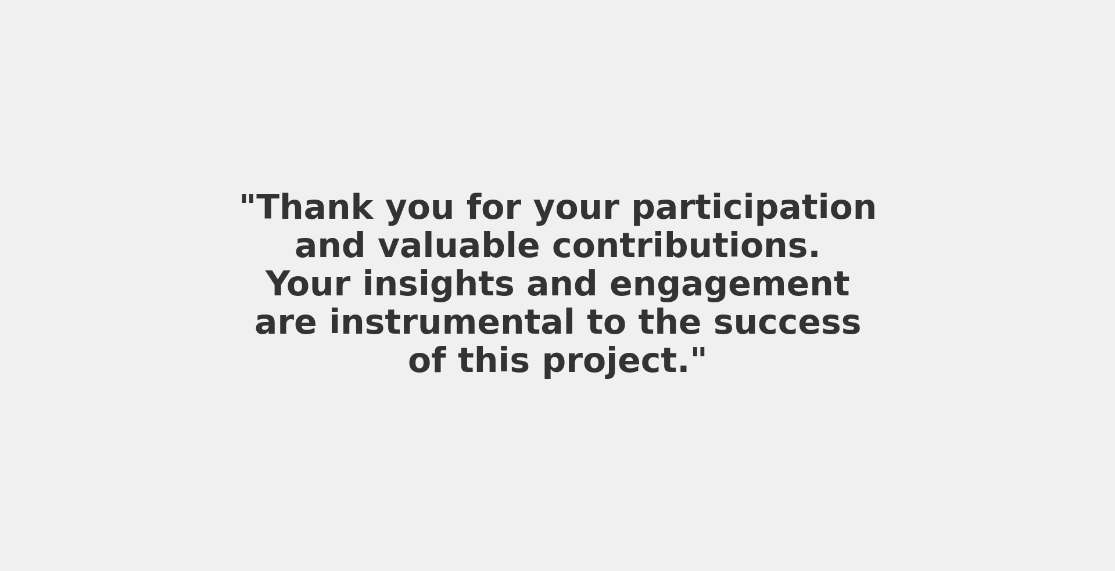
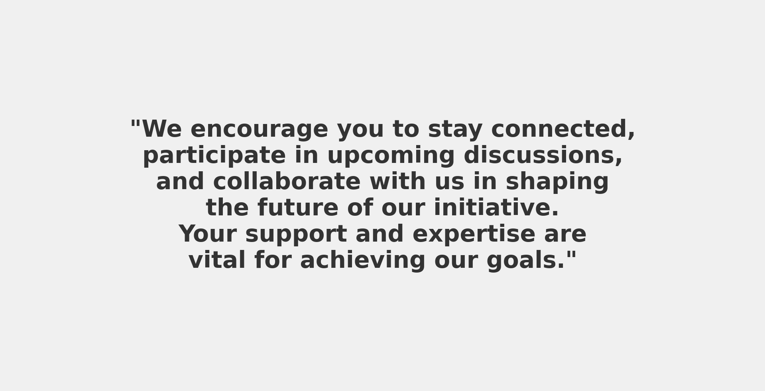
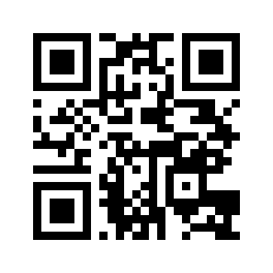

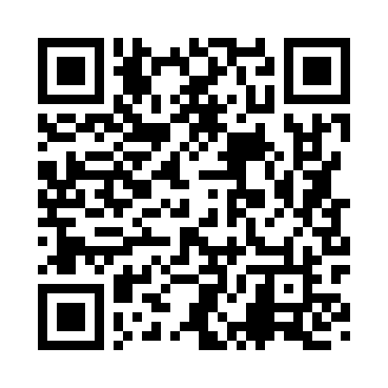
Closing and Next Steps
Next key milestones:
AI for conformity assessment results
Assurance evidence correlation results
Continuous threat monitoring & risk management results
CERTIFAI Framework - Final Version
Contact information:
https://certifai.info/
Social Media
https://www.linkedin.com/showcase/certifaieu/
Notes:
GIFTS – GLASS – dont leave immediatly ☺

