Slide 1
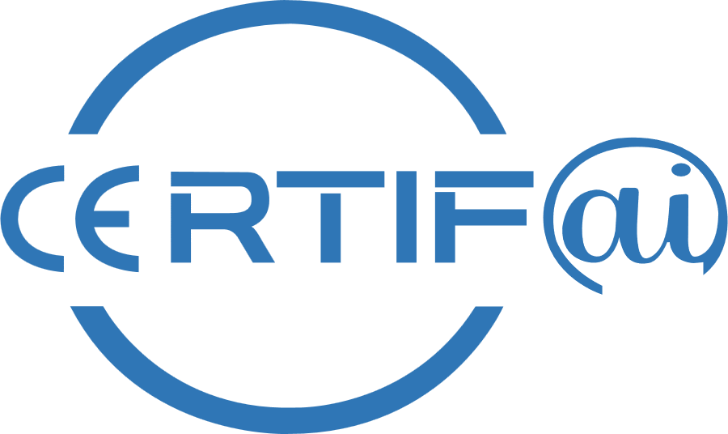
CertifAI Integrated Framework,
Giannis Ledakis (UBITECH)
HORIZON-CL3-2022-CS-01-04: INCREASED CYBERSECURITY 2022
Ref. Ares(2022)8966412 - 23/12/2022

Slide 2
Problem Statement & Challenges
Conformity assessment to security standards is needed reduce the impact of cyberattacks and increase the resilience of ICT products, services, and processes throughout their life cycle.
Traditional conformity assessment process is predominantly a static and expensive one-time assurance activity that does not cater to the needs of agile product delivery, which promotes continuous product updates and upgrades, and often changes in requirements.
Each update opens doors to product vulnerabilities, and consequently poses cyber risks for product users and companies’ reputation.
To avoid these issues, it is essential to enable a partial and continuous lean re-certification of ICT products, services, and processes, to empower manufacturers to prevent, detect, counter and quickly respond to cyber threats
CertifAI integrate framework will be the central point of reference for the CertifAI tools and enable the dynamic certification process

Slide 3
Our Approach
CERTIFAI Integrated Framework implementing the methodology for agile cybersecurity conformance assessment by integrating the research results of WP2-WP5.
Enables compliance assessment based on the artifacts defined and the evidence generated across various phases of the development process of ICT products and services.
Provides user interface for defining and managing the conformance process
Taking as inputs the requirements, the threat model and the evidences, analyzes the compliance of the overall product or a service.

Slide 4
Relevant Objectives
OB1: Reduce the time and effort of (re-) certification and (re-) assurance using AI
OB2: Improve assurance evidence correlation for cost-effective re-certification
OB3: Reduce the effort of testing by implementing AI-based test case selection and formal methods
OB4: Enable continuous and proactive cybersecurity evaluation and certification

Slide 5
Design Process
Features collection
Software Requirements & User stories definition
Sequence diagrams
Common Interfaces (APIs ) agreement
Overall Architecture

Slide 6
Name | Offered Functionalities
Unified Controls Catalogue | Provides practitioners with comprehensive information to accurately interpret and implement each requirement
Security Assurance Case (SAC) Builder | Constructs and maintains assurance cases
ML-based vulnerability detection | Collate and analyze logs from multiple applications and systems
Vulnerability Insights and Metrics Performance and Control Tool - VIMPACT | Provides insights into the vulnerability landscape of software dependencies
Formal Verification Framework | Toolkit and methodology to support formal verification
Risk Management Framework | Contextual framework for continuous risk management processes
CertifAI Conformance Assessment | Aggregating the results from all tools to provide a final scoring and report regarding the conformance assessment based on the needs and the assets of any organization
CertifAI Integrated Framework Dashboard | Dashboard provides a central point of interaction for the users of CertifAI
CertifAI Tools Overview

Slide 7
CertifAI Functional View
WP2 T2.1
Standards’ Repository
WP5
T5.1, T5.2, T5.4
Development Team
Requirements Analysis
Threat Modeler
Requirements Analyzer
Security Controls / Guidelines…
Product Documentation
Configuration Settings and Screenshots
Password Policy Definitions
Testing and Validation Reports
Policy and Procedure Documents
Change Logs and Version Histories
Incident Reports
Training Records
….
Threats
Requirements
Design
WP2 T2.2
WP3 T3.1, T3.2
Risk Profile
SAC Validator
SAC Composer
Evidence references
Evidence Mapper
Coding
Risk Manager
Compliance Statements (SAC)
Data Lake
Schema
Mitigations / Countermeasures
Evidence references
Compliance Engine
WP4
Testing
Test Gen
Consolidates rating results in a dashboard
WP2 T2.3
WP6 T6.2
Deployment
Compliance
Monitor
Compliance Manager
Operations Team
WP3 T3.3, T3.4
WP5 T5.3
Maintenance
Vulnerability and Incident exposure
VM

Slide 8
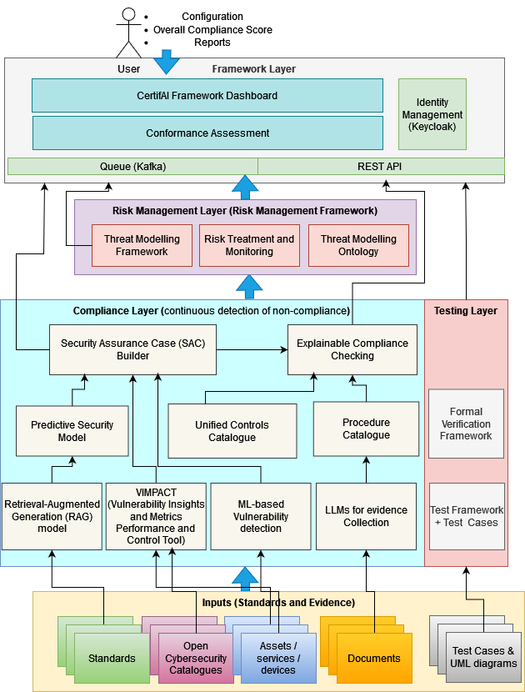
Technical Architecture
Presents the tools and their interconnections
Identifying implementation responsibilities with the building blocks of the framework
A continuous refinement process based on the project development needs
Next iteration of the architecture under internal assesment

Slide 9
Certification Process
Goal: To evaluate whether a product meets the specified standard's requirements.
A certification process involves reviewing and analyzing a set of evidence to determine compliance with the specified requirements
Context analysis
Understand the characteristics and scope of the product and organization subject to the certification
Gather Evidence
Compilation and organization of the body of evidence that supports proof of compliance and map them to the requirements
Review Evidence
Analyze how each piece of evidence, along with its supporting arguments, substantiates the associated requirement
Determine Compliance
Assess the adequacy and sufficiency of the provided evidence and determine how well the requirement is being met to determine satisfaction or if there are findings that prevent compliance

Slide 10
CertifAI Conformance Assessment Methodology
Plan and Prepare
Determine standards scope
Define target objectives (SL, ML, …)
Determine organizational scope
Develop the assessment plan
Collect and organize evidence
Map evidence as a proof of compliance with requirements of the standards
Build and control body of evidence supported in a SAC
Data Gathering
Create a detailed report with findings
Include quantitative scores and qualitative insights
Suggest a roadmap for achieving full compliance
Share the assessment report with relevant stakeholders
Analyze Evidence
Report Results
Evaluate evidence in accordance with acceptance criteria
When product in operation monitor for non-compliance issues
Rate the level of compliance
Document findings

Slide 11
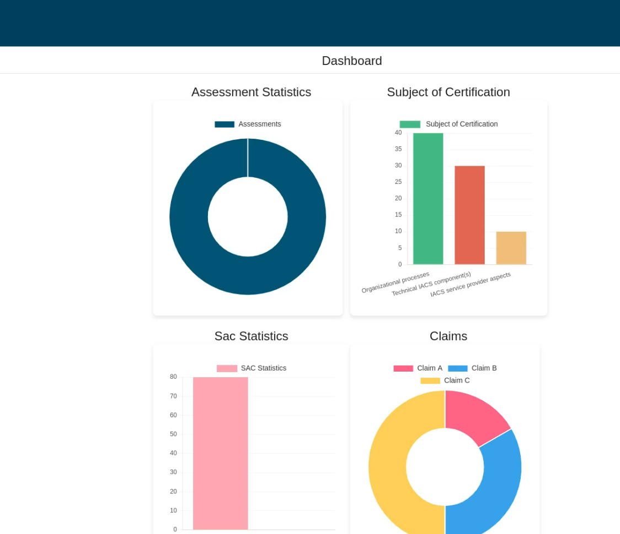
CertifAI Integrated Framework
Development of the Integrated Framework using a “top-down” prioritization
Starting from the conformance assessment to allow user define assessment in a proper way
Basic flow implemented with definition of Subject of Certification and Security Assurance Case
Then continue with integrating with other tools

Slide 12
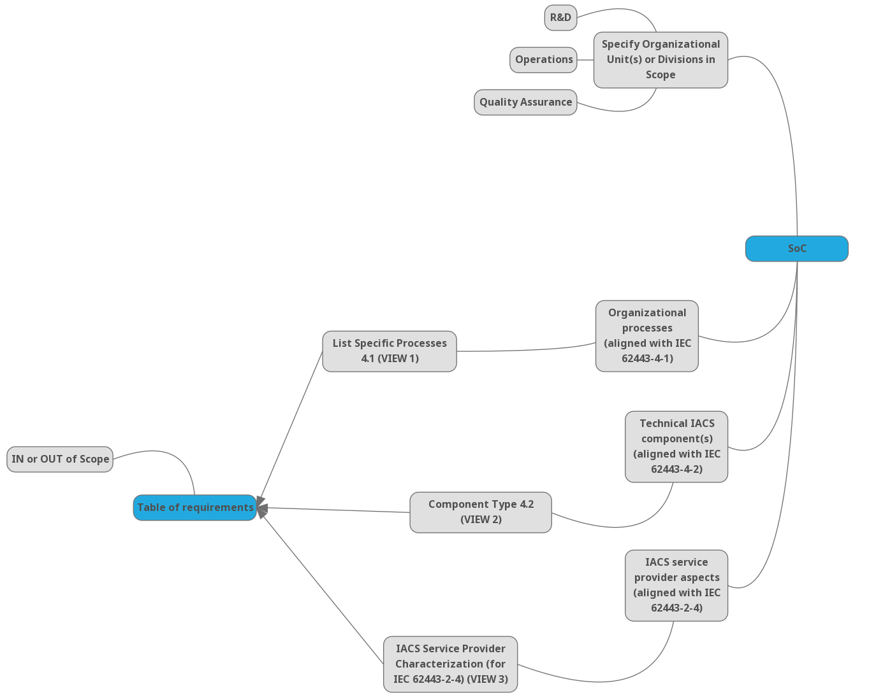
Step 1: Define Subject of Certification

Slide 13
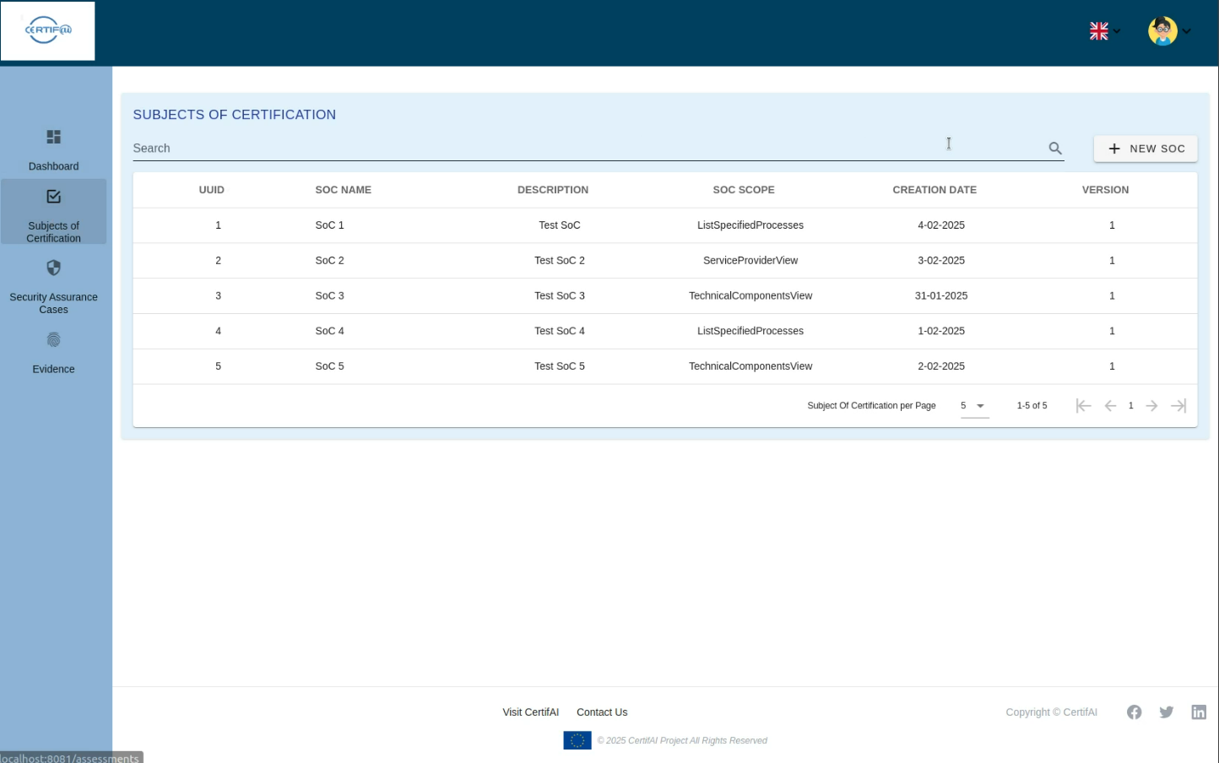
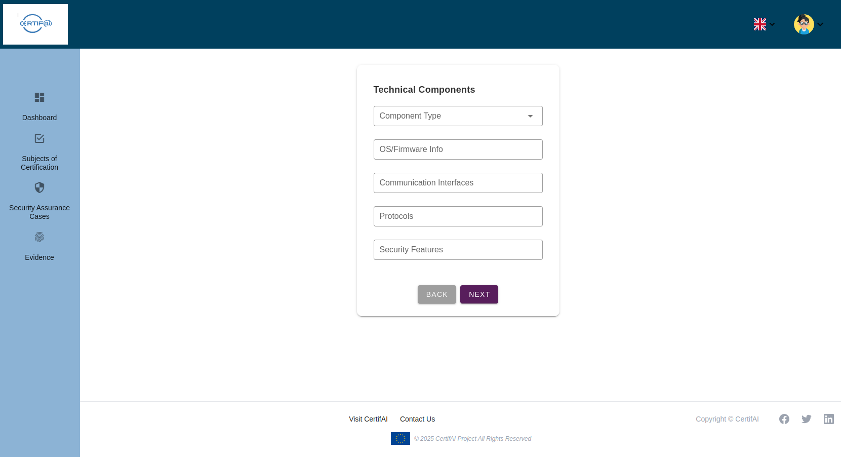
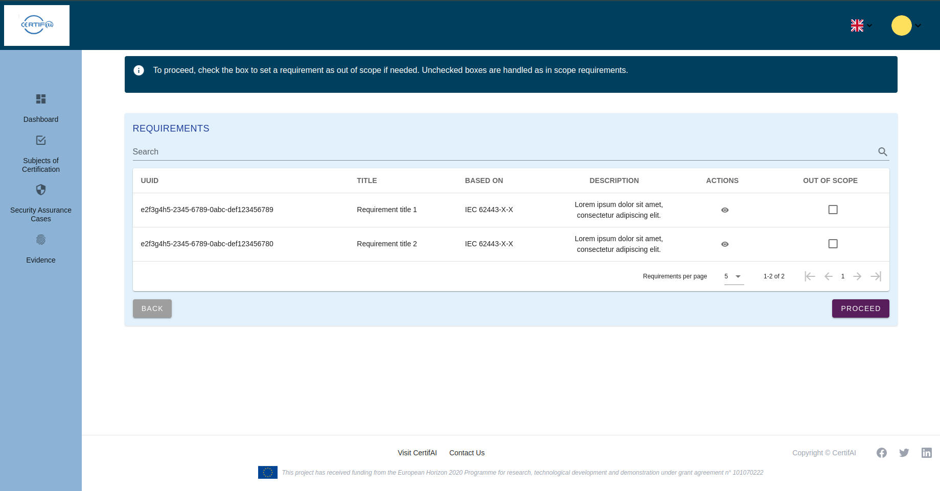
Certification Process : Subject of Verification

Slide 14
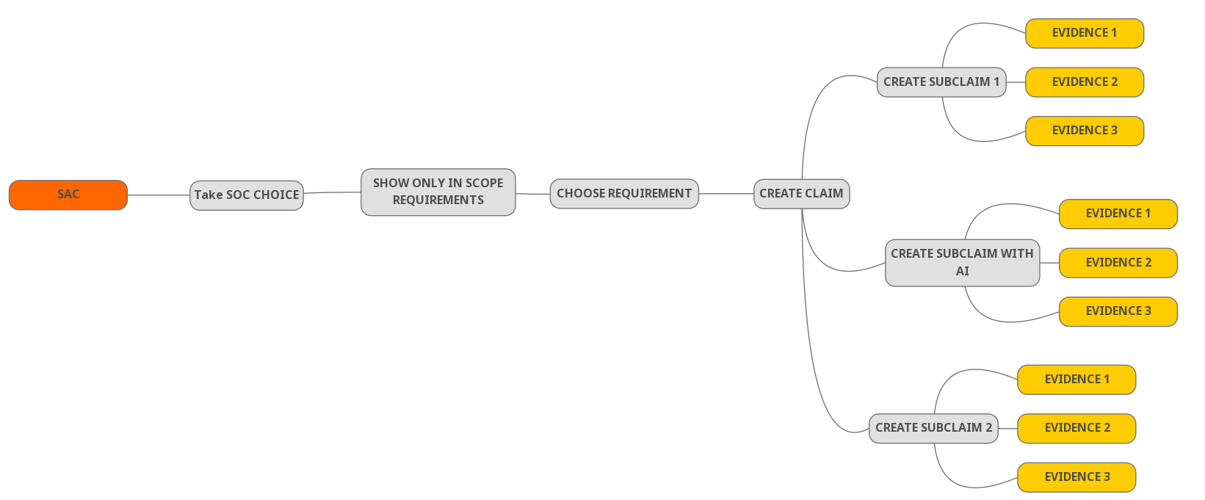
Step 2: Define Security Assurance Case

Slide 15
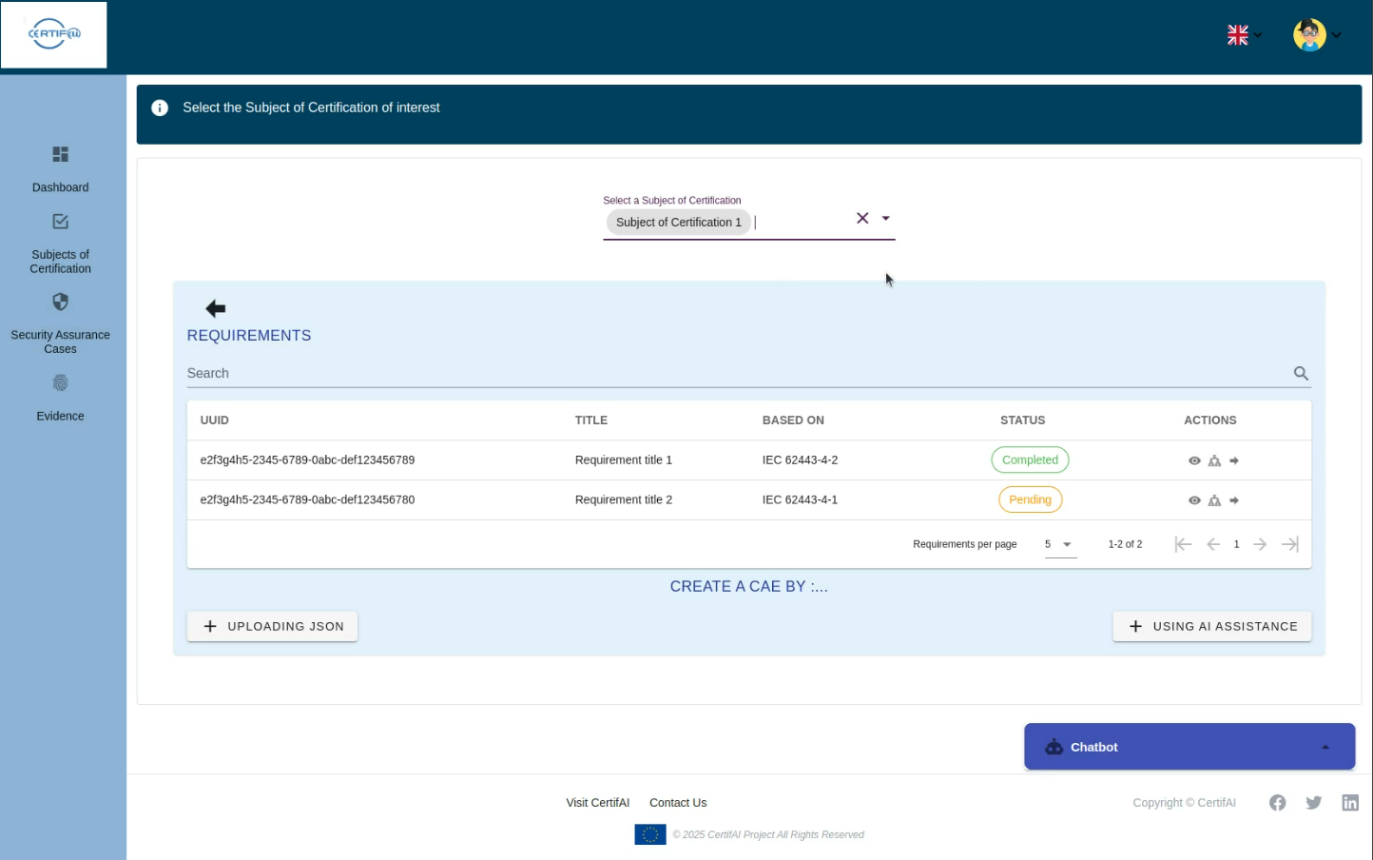
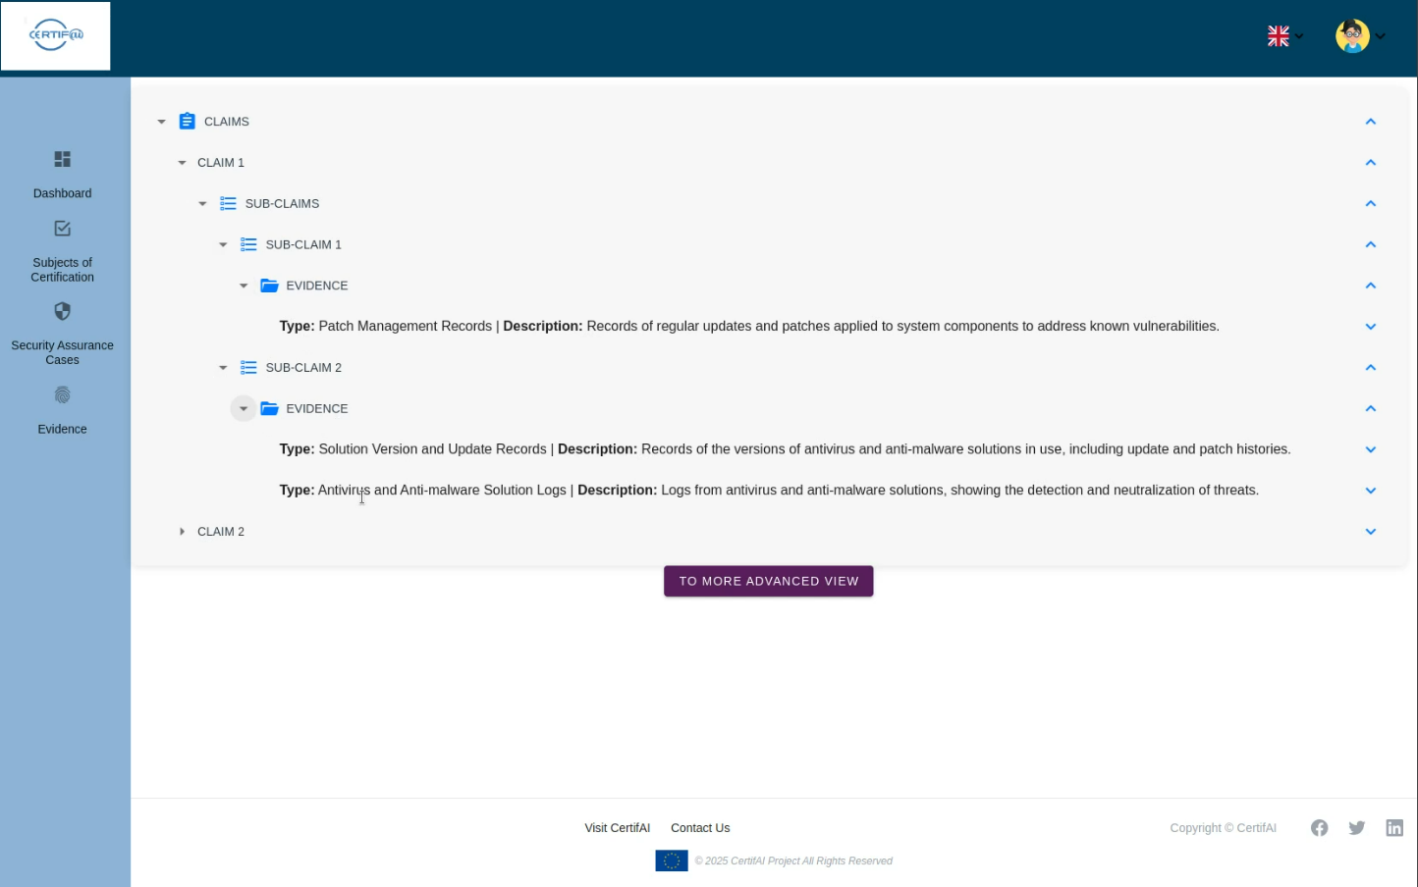
Certification Process : Security Assurance Case

Slide 16
Demo Time

Slide 18
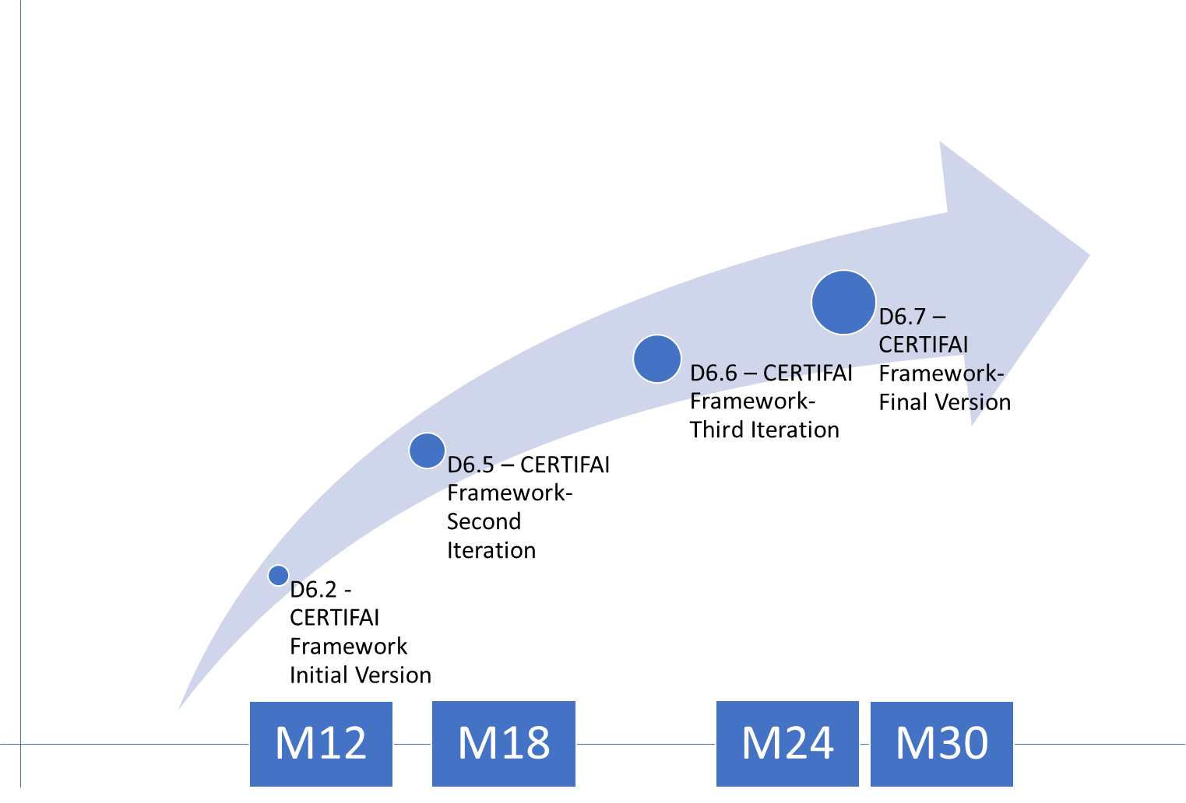
Current State
Next Steps
M12 initial concepts
M18 First PoC being developed
Integrate with threat modeling
Integrate the other tools of the framework
Improvements
Next Steps & Release Planning

Slide 19
Thank You
For Your Attention

